Slide 1
Lviv urban space accessibility

Slide 2
The main purpose of the project
1
creating accessible public transport stops
2
creating a barrier-free city environment

Slide 3
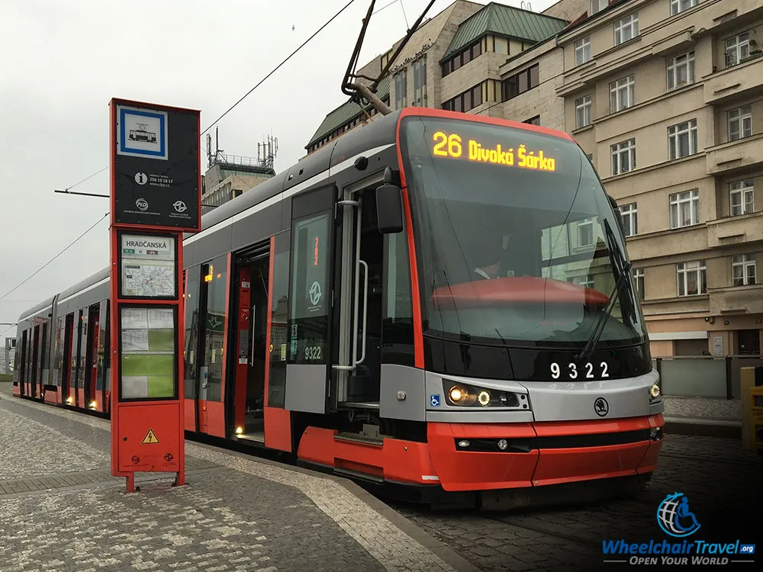
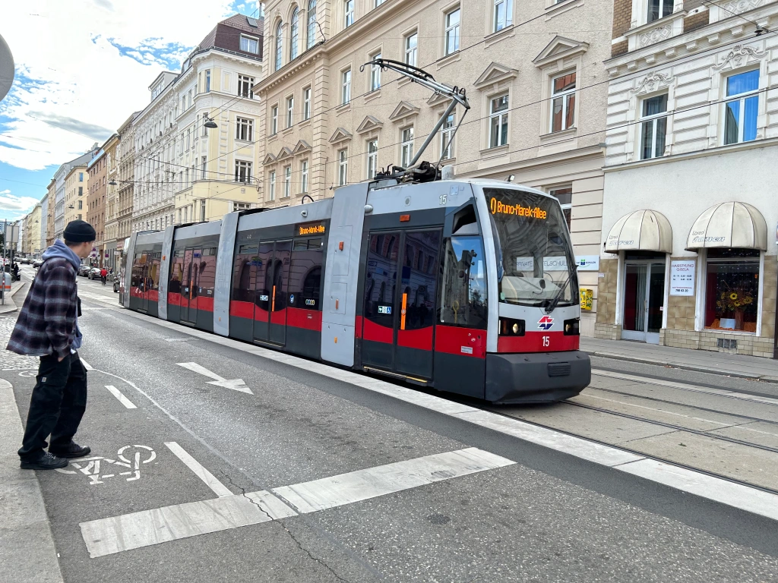
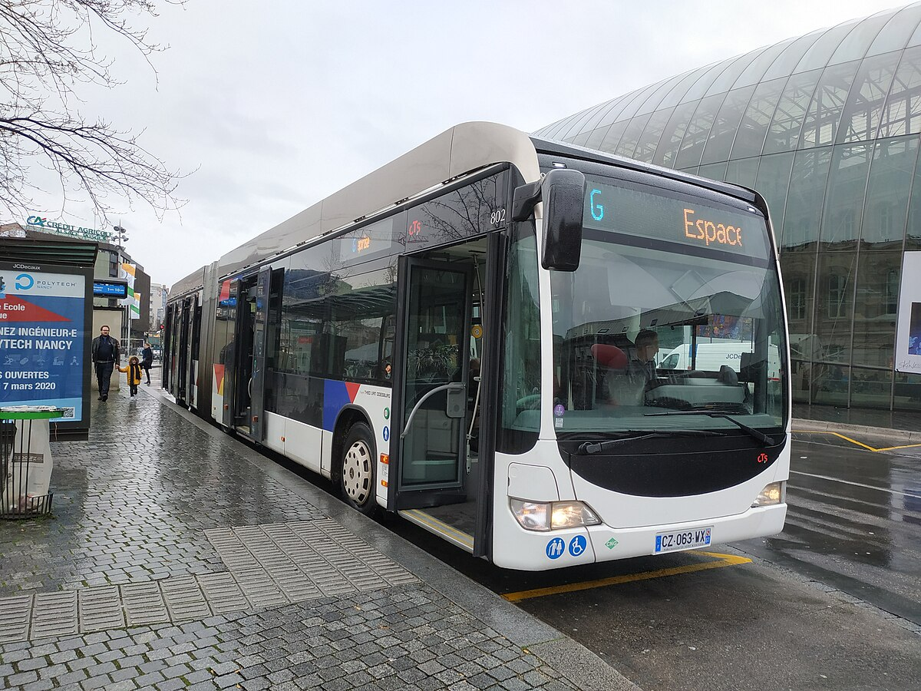
Our inspiration
Prague
Vienna
Strasbourg

Slide 4
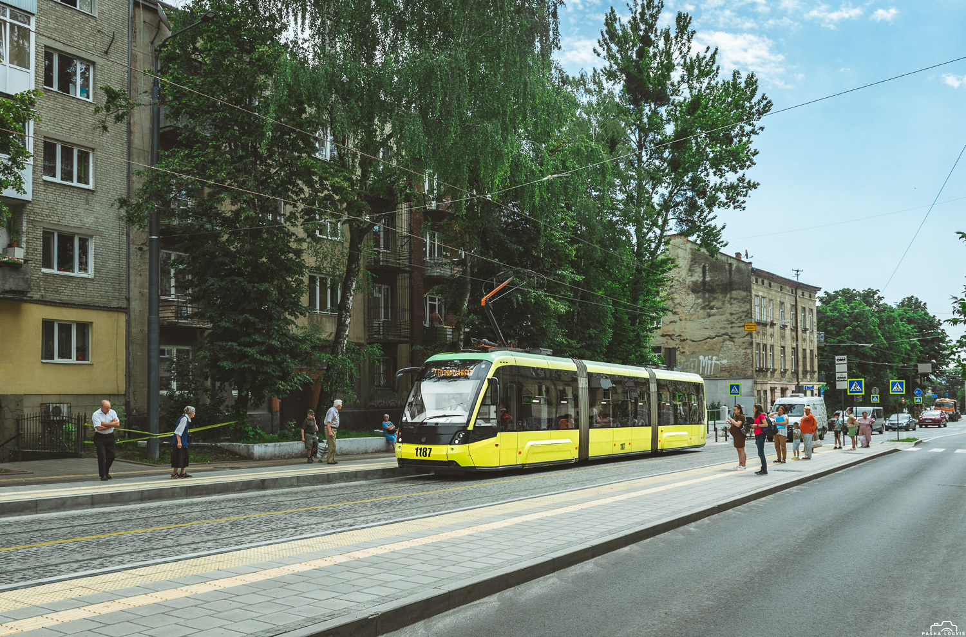
37% of tram stops fully accessible
But only 17% in total

Slide 5
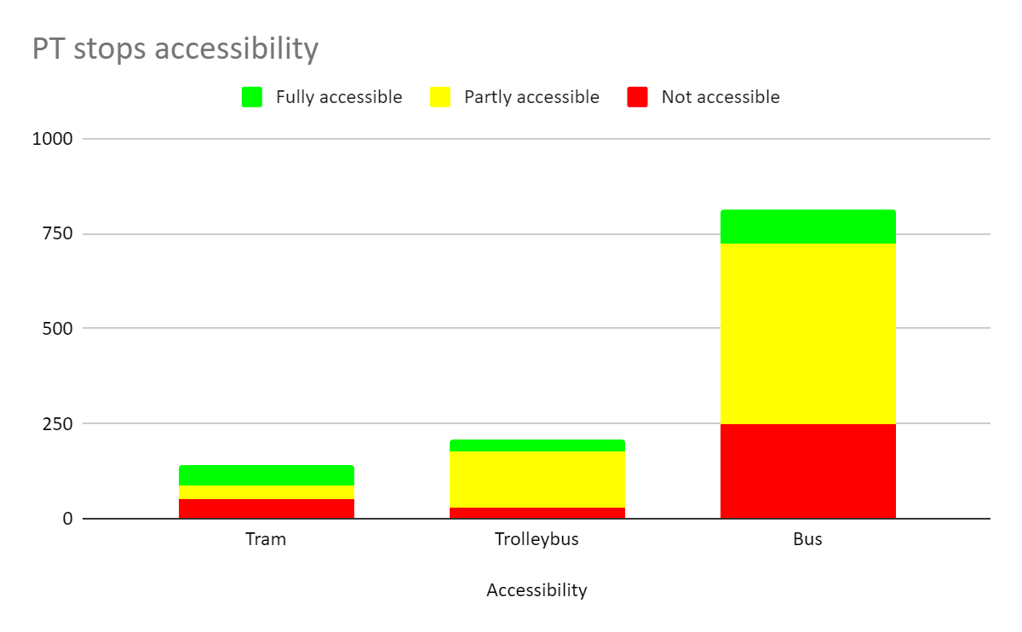

Slide 6
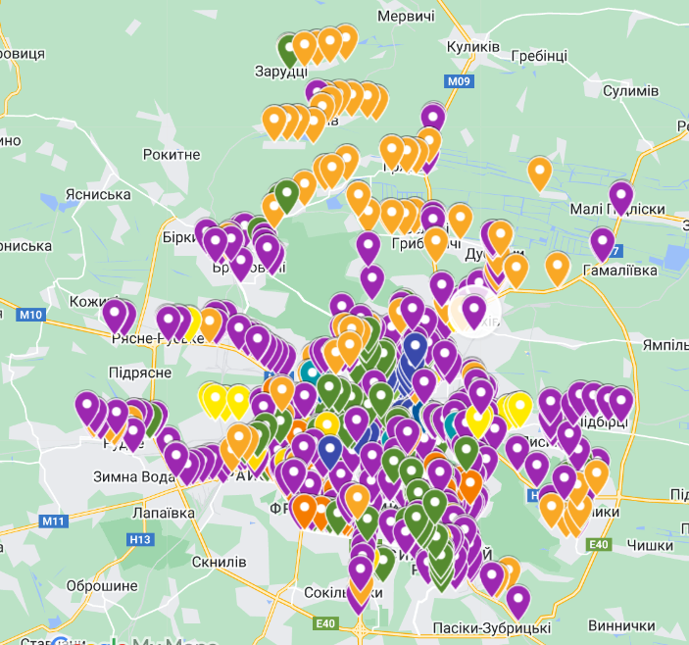
930 public transport stops in municipality

Slide 7
 | As of 12.2023 | 1000 UAH / unit | Proposed to implement | Reachable till 12.2024
Accessible | 158 |  |  | 511
Partly accessible: | 536 |  | 125 | 411
Increase curb height for 5-10cm | 431 | 220 | 20 | 411
Extend tram boarding platform | 56 | 165 | 56 | 0
Remove bus bay | 49 | 230 | 49 | 0
Not accessible: | 236 |  | 228 | 8
No boarding platform at all | 135 | 160 | 135 | 0
Island stop needed | 7 | 315 | 6 | 1
Vienna stop needed | 5 | 250 | 4 | 1
Increase curb height for 15-20cm | 83 | 230 | 83 | 0
Reconstruction needed | 6 | - | 0 | 6
Not maintained by municipality: | 116 |  | 116 | 0
Partly accessible | 39 | 220 | 39 | 0
Not accessible | 77 | 160 | 77 | 0

Slide 8
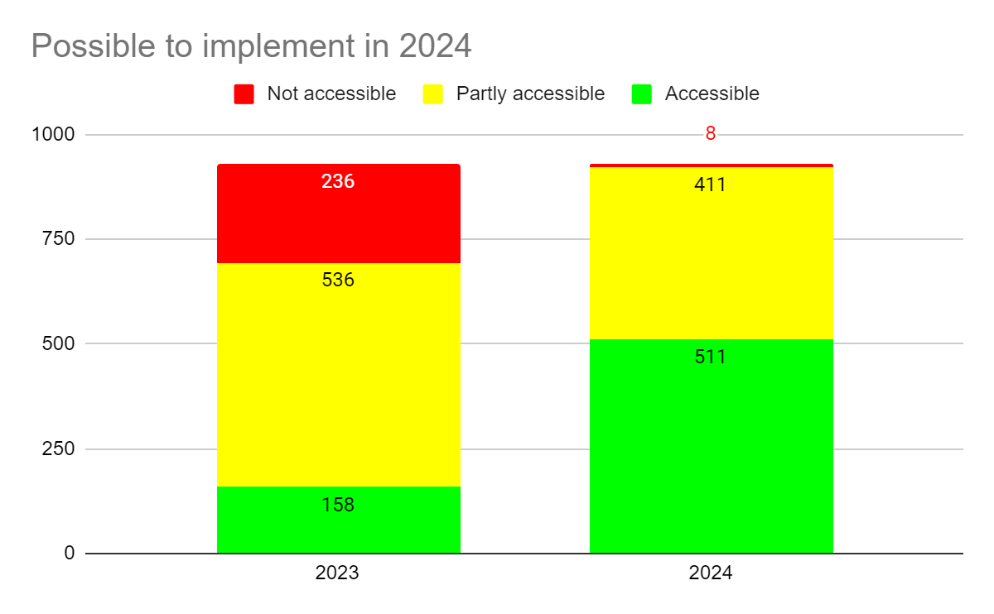
Estimated costs - 1,8 mEUR

Slide 9
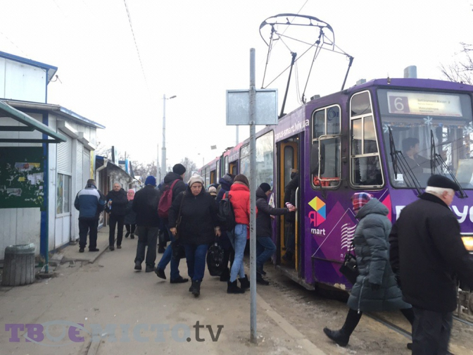
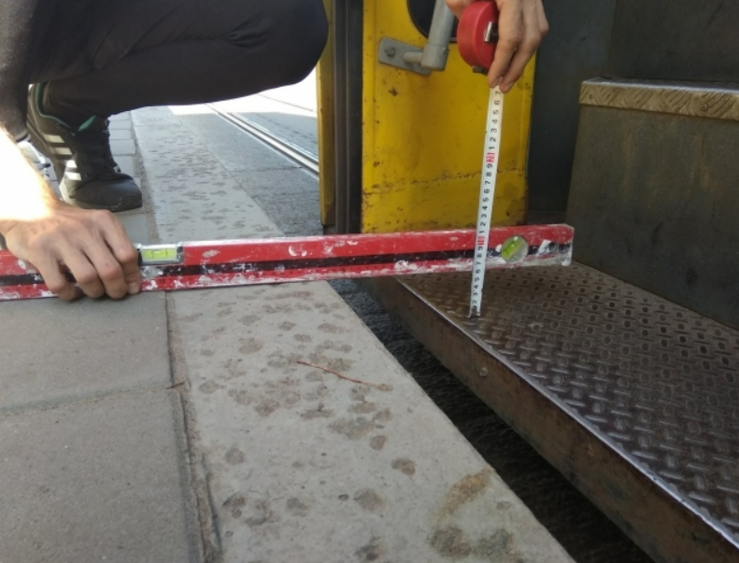
50% (72 tram stops) Require to move curb or raise curb more than 5 cm

Slide 10
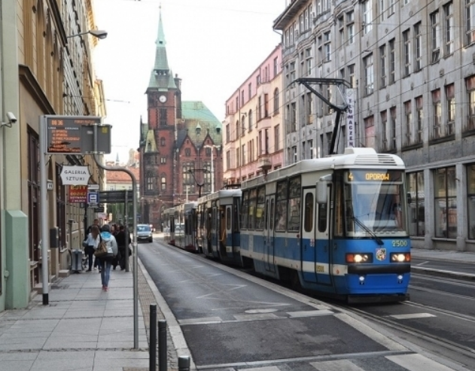
5 tram stops - “Vienna style” stops
ID | Name | Routes
4 | Academy of Arts | T04, T08
19 | Park of Culture | T03, T04, T09
20 | Park of Culture | T03, T04, T09
247 | Mechnykova | T01, T07
581 | Pidzamche station | T06
Example of “Viena type” stop

Slide 11
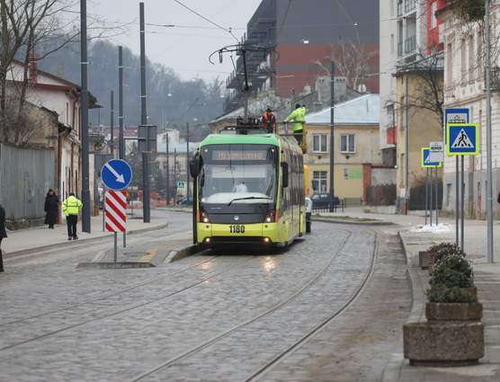
7 Island stops
ID | Name | Routes
18 | Kropyvnytskoho sq. | А06 А07 А20 А25 А29 А31 А34 А51 А52 Т06
23 | Pid Dubom | Т06 Т09
40 | Teatralna | А01 А03 А05 А06 А15 А29 А37 А39 А46 А47 А53 А61 Т06
41 | Opera Theatre | А06 А07 А20 А25 А29 А31 А34 А41 А51 А52 Т06
42 | Mytna sq. | А05 А15 А18 А29 А39 А47 А61 Т02
242 | Military Hospital | А05 А15 А18 А29 А39 А47 А61 Т02
245 | Medical University | А05 А15 А18 А29 А39 А47 А61 Т02
island stop on Zamarstynivska str. in Lviv

Slide 12
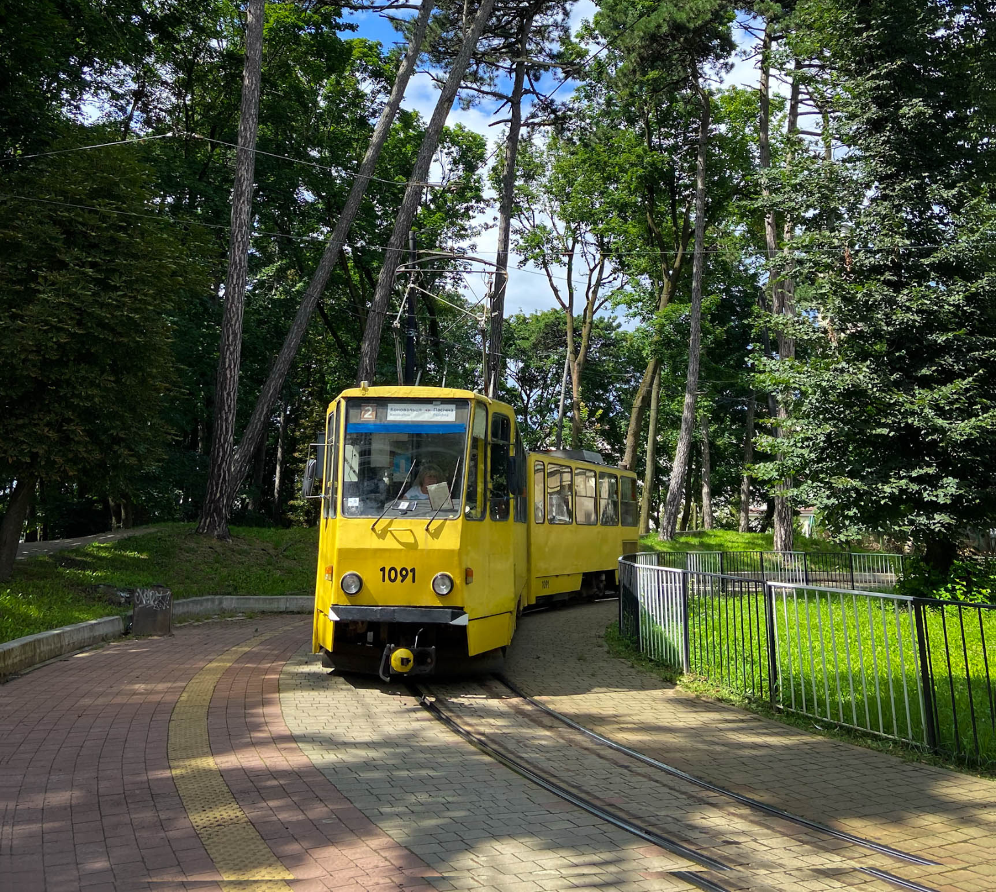
5 stops require significant construction works
ID | Name | Routes
32 | Stryiskyi market | T04, T08, A53
184 | Krupzavod | Т07, A06, А11, А61, А131
286 | Pasichna | Т02
311 | Franka sq. | T08
703 | Tatarbunarska | T01, T07
Stop requiring significant construction works to provide full accessibility

Slide 13
Mobility and Street Infrastructure Department
+380 (32) 297-58-45
dep.mobility@lvivcity.gov.ua

