Slide 1
7th partner meeting
STATE OF THE PLAY
Vilnius, 14th of May 2024

Slide 2
Today we will talk about…
1. Monitoring of semester 3
3
2. Budget and reporting for semester 2
6
3. Questions and answers
10

Slide 3
#1. monitoring OF SEMESTER 3

Slide 4
SEMESTER 3
Exchange of experiences |  | State of play
Lithuania: Study Visit + Interregional Peer Review (IPeR) + Key Findings Report | P3 | Foreseen in mid May.
Presentation of the working document of the Joint Study on the transition pathways towards smarter business enabling service provision. | AP7 | Foreseen in Lithuania Study Visit
Norway: Study Visit + Interregional Peer Review (IPeR) + Key Findings Report | P6 | Foreseen in June 18th and 19th
3rd Stakeholder Group meeting | All partners | In course of action.
Online Follow-up Meeting | All partners | At the end of semester 3.

Slide 5
SEMESTER 3
Communication strategy |  | State of play
Activity report (to be done by CM) | LP+All partners | In course of action.
3rd newsletter (Testimonials) | LP (suport from P2+ P3) | In progress. To be closed by the end of semester 2.
Press-notes + social media engagement | LP + All partners | In course.
Ongoing internal communication | LP | In course of action.
Project management |  | State of play
Database of regional stakeholders | all partners | In progress during phase 1.
List of good practices | all partners | In course of action. Database in the Interreg Europe Webiste.
Reporting semester 3 | all partners | Deadline: 01/12/2024

Slide 6
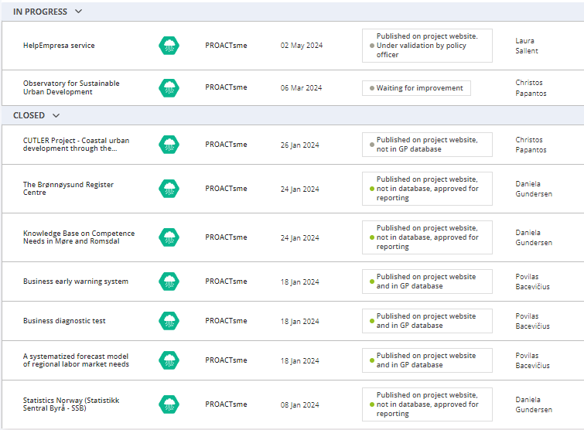
List of Good Practices: what do we currently have?
SEMESTER 3
Partner | Nº of Good Practices | Status
LP | 3 | rejected
P2 | 3 | Approved for reporting
P3 | 3 | Approved – GP database
P4 | 0 | -
P5 | 0 | -
P6 | 1 | Improving
P8 | 1 | Under validation
We must report the GP to create the data base of 14 good practices we have agreed upon in the application form.

Slide 7
#2. Budget and reporting for semester 2

Slide 8
SEMESTER 2
Justified budget for semester 2
Partner | Total foreseen | Semester 2 report | Difference | % of the budged used
LP | 47.200,00 € | 48.395,33 € | -1.195,33 € | 103%
P2 | 33.930,00 € | 29.953,96 € | 3.976,04 € | 88%
P3 | 25.900,00 € | Not included yet | ? | ?
P4 | 24.825,00 € | 20.584,69 € | 4.240,31 € | 83%
P5 | 29.600,00 € | Not included yet | ? | ?
P6 | 24.575,00 € | 17.895,27 € | 6.679,73 € | 73%
AP7 | 7.500,00 € | Not included yet | ? | ?
P8 | 7.500,00 € | 6.380,32 € | 1.119,68 € | 85%
Deadline for approval of individual reports was May 6th & bear in mind joint deadline is June 1st!

Slide 9
SEMESTER 2
Monitoring total budget of the project
Partner | Semester 1 report | % of the budged used | Semester 2 report | % of the budged used | Semester 1 & 2
LP | 74.457,80 € | 105% | 48.395,33 € | 103% | 104%
P2 | 28.488,78 € | 69% | 29.953,96 € | 88% | 79%
P3 | 12.315,24 € | 47% | 34.936,88 € | 135% | 91%
P4 | 13.761,36 € | 76% | 20.584,69 € | 83% | 79%
P5 | 7.700,25 € | 35% | Not included yet | ? | ?
P6 | 28.166,39 € | 127% | 17.895,27 € | 73% | 100%
AP7 | 11.289,96 € | 51% | Not included yet | ? | ?
P8 | 6.133,04 € | 80% | 6.380,32 € | 85% | 83%

Slide 10
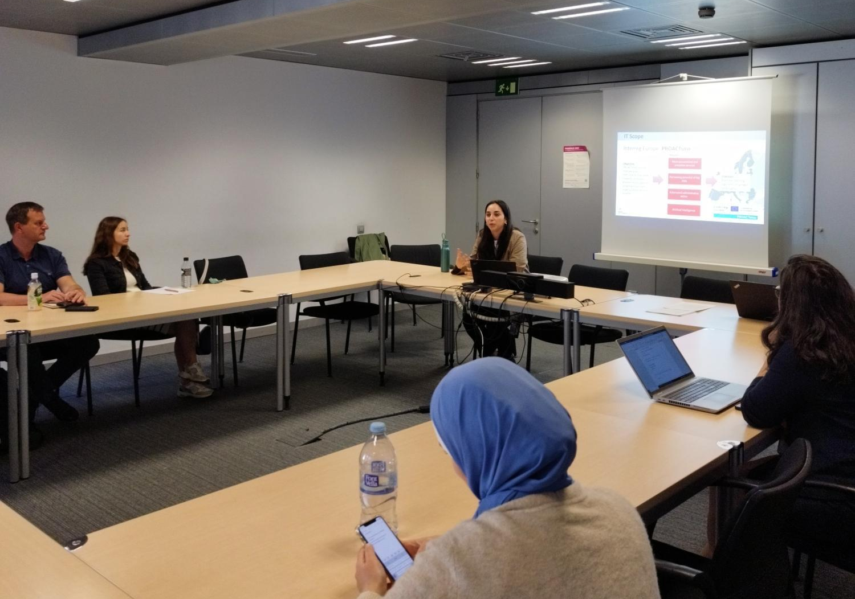
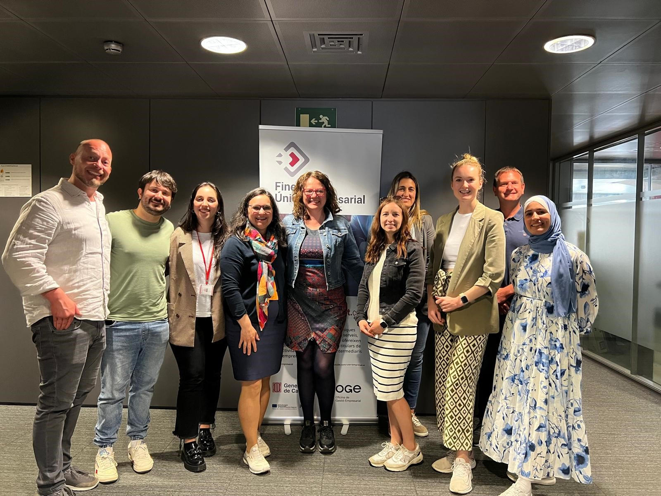
SEMESTER 2
Updates from semester 2 & 3 – media contents
Presentation Video for the PROACTsme project. Yumagic Media.
Presentation Video for the PROACTsme project. Yumagic Media.
Learning Journey with Austrian Public Management Students. 8th of May, 2024.
https://www.youtube.com/watch?v=FIVFh49Lu5o

Slide 11
#4.q&a

Slide 12
THANK YOU!
Paula Vergés
paulaverges@gencat.cat
Natalia Cantero
Natalia.cantero@gencat.cat

