Slide 1
Improving the role of youth policies for rural sustainable development

Slide 2
The project at a glance
RuralYouthFuture focuses on enhancing youth employment policies for sustainable rural development.
Aims to address the challenges faced by young individuals in rural areas, particularly in light of the COVID-19 crisis, which has exacerbated unemployment rates and created a demand for new digital skills.
Implemented through a collaboration of municipal, regional, and national entities from 7 countries: Spain, Bulgaria, Slovenia, Latvia, Portugal, Estonia, and Belgium.
Funded by INTERREG Europe.
9
partners

Slide 3
A few numbers
Duration
01 Mar 2023 - 31 May 2027
9 partners
7 countries
www.interregeurope.eu/ruralyouthfuture
TOTAL
1,681,884 EUR

Slide 4
Our team

Slide 5
What issue will the project address?
The COVID-19 crisis has resulted in a surge in unemployment rates, disproportionately affecting young individuals.
The RuralYouthFuture project specifically addresses the challenges faced by young people in rural areas who lack vocational training, digital skills, and viable employment prospects.
9
partners

Slide 6
Project Objectives
Reduce inequalities between rural and urban areas in terms of youth employment opportunities.
Combat depopulation and ageing in rural regions by attracting and retaining a talented and youthful workforce.
Empower young individuals in rural territories by providing them with abundant job opportunities and improved working conditions.
Foster sustainable rural development through the promotion of digital skills and emerging work models.
partners

Slide 7
Policy Instruments
Six policy instruments will be addressed, at municipal, regional and national level, to face a common challenge: responding to the needs of young people in rural territories, by reducing the inequalities with urban peers and fighting ageing and growing depopulation.
ESF+ Galicia 2021-2027 Operational Programme (Spain)
Integrated Development Plan 2021-2027 of Peshtera Municipality (IDP) (Bulgaria)
Local development strategy of Local action group Goričko 2020 for the programming period 2021-2027 (Slovenia)
Children, Youth, and Families Guidelines for 2021-2027 (Latvia)
National Youth Plan (Portugal)
Tartu County Development Strategy 2040 (Estonia)
9
partners

Slide 8
Main Activities
Core Phase
Technical seminars
Study visits
Partner-2-Partner exchanges
Reports
Road map
Exchange of good practices
Communication
Follow-up Phase
Online exchanges
Assessment of the improvements achieved at different levels
Follow-up surveys
High-level dissemination event

Slide 9
The project’s most important activities are the exchanges that lead to a fruitful interregional learning process.

Slide 10
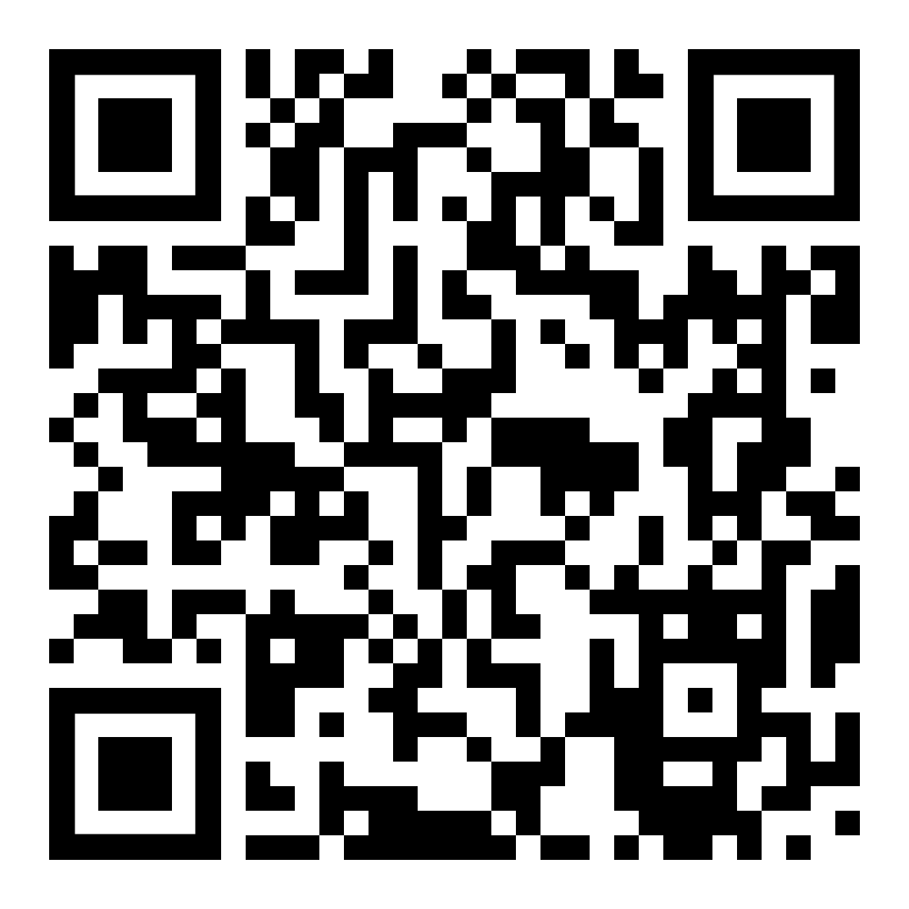
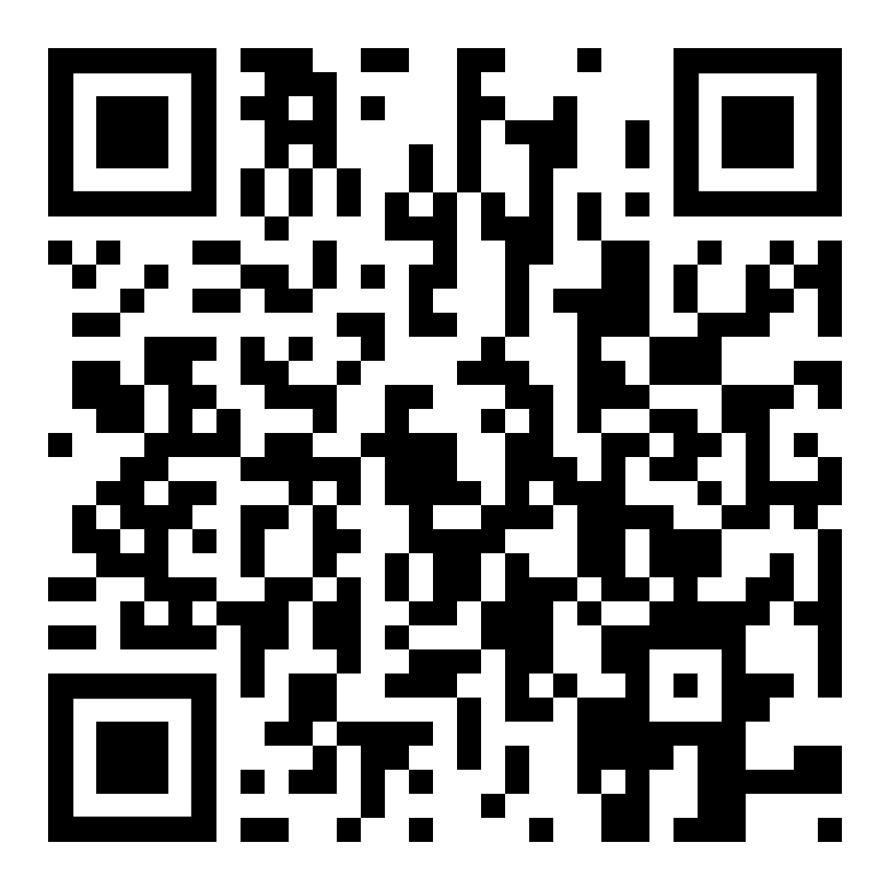
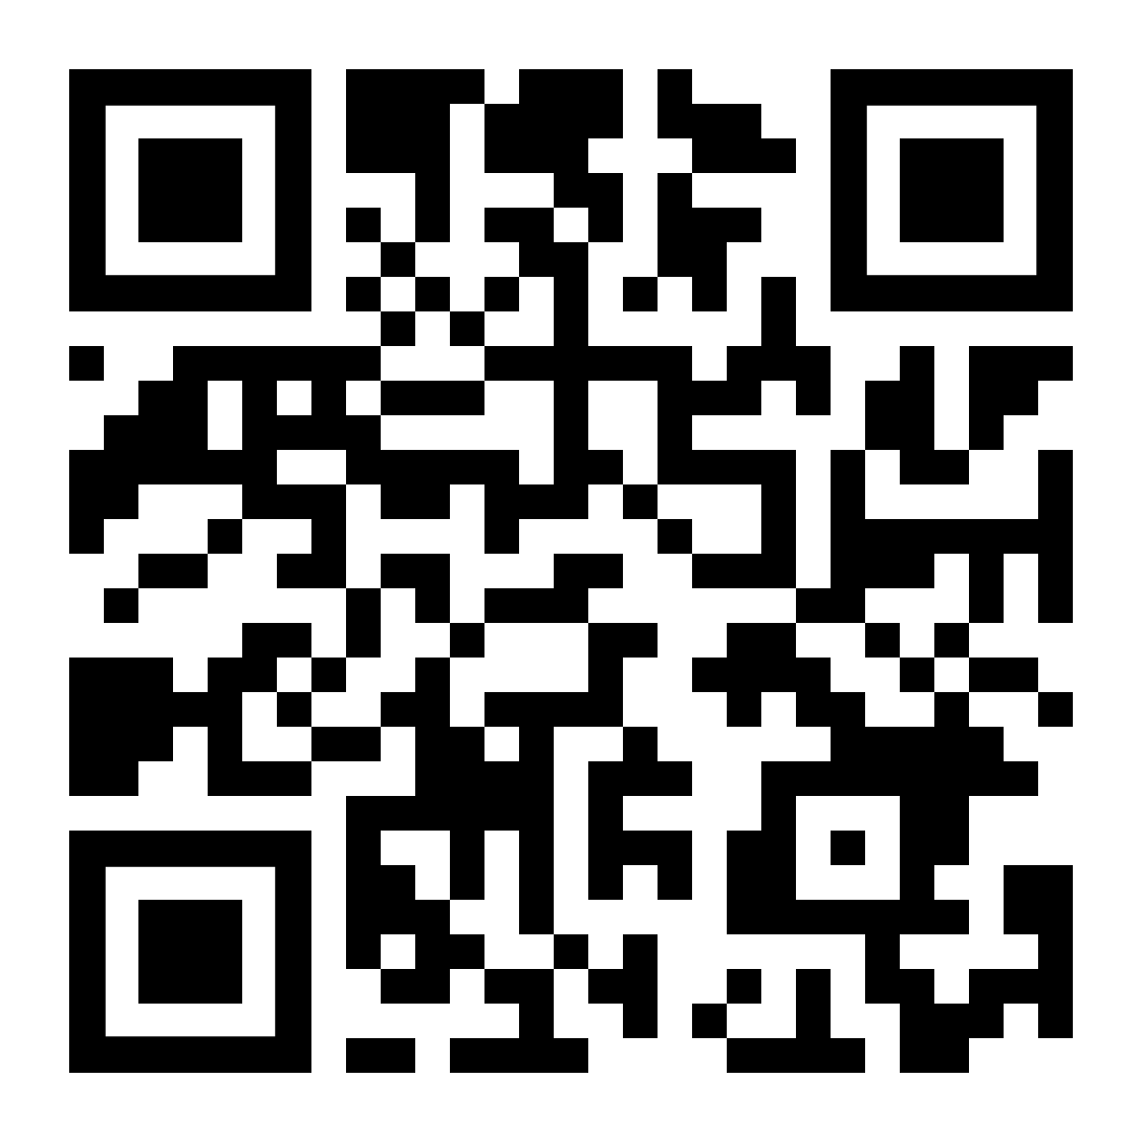
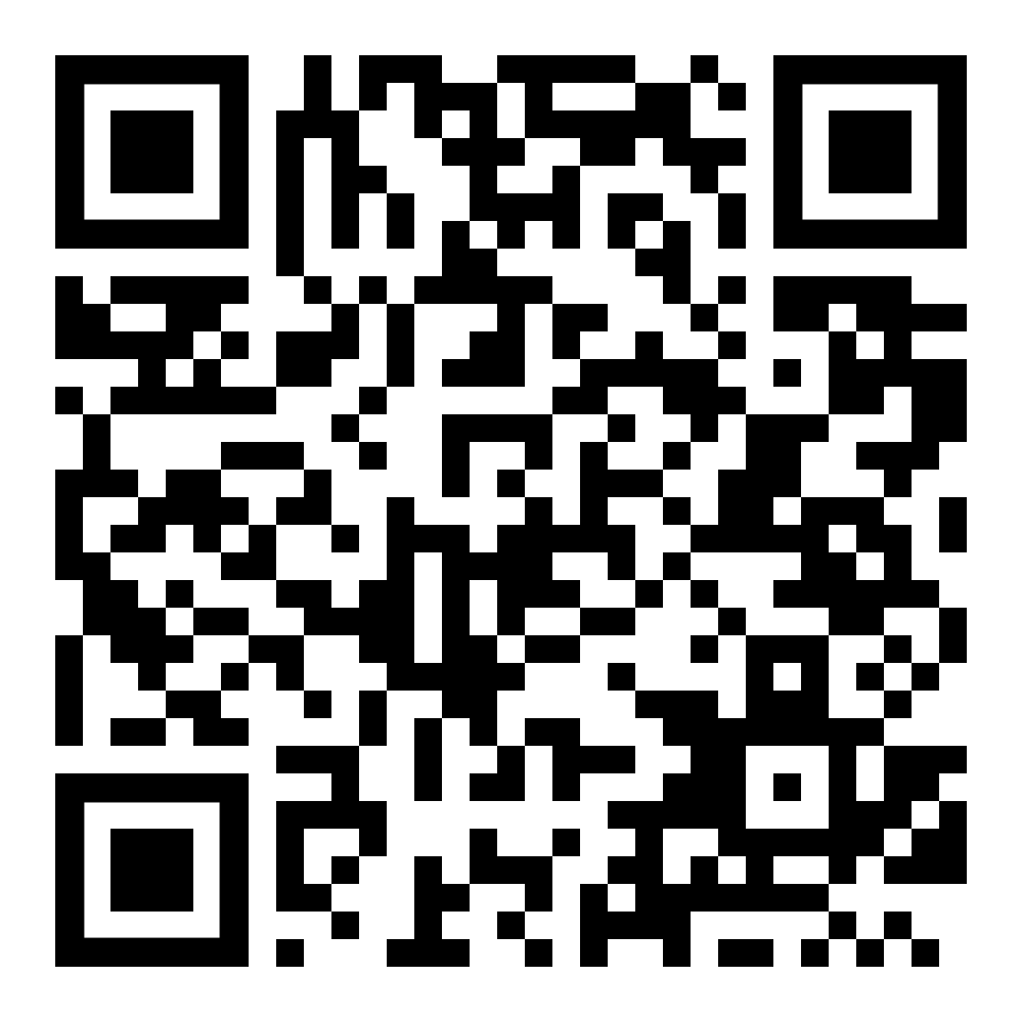
Thank you!
www.interregeurope.eu/ruralyouthfuture

