Slide 1
ENAIBLER
Enabling AI-driven public sector
Name of Presenter
Tittle of Presenter
email
07 JULY 2021 | Location

Slide 2
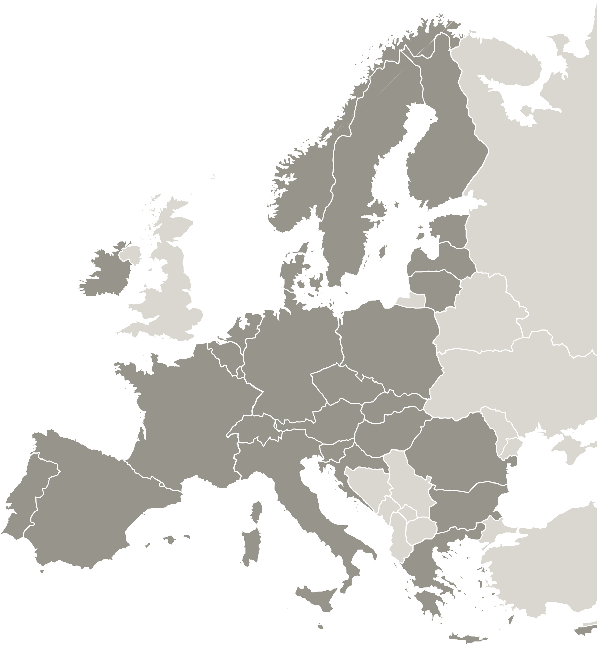
Enabling an AI-driven Public Sector
ENAIBLER
Artificial intelligence is acknowledged as one of the gamechangers in the digitisation of territories and the public sector can play a vital role if it is empowered in the use of AI which it is the main objective of ENAIBLER.
ENAIBLER contributes to “A Smarter Europe of the EU Cohesion policy” and in the digitisation for citizens, companies, research organisations and public authorities.
ENAIBLER brings together 9 partners from 6 EU regions to work in the digital transformation of their area.
9
Partners

Slide 3
Aim & Budget
ENAIBLER aims to build, empower and assist the public sector organisations to unlock the benefits of AI and the implementation of more open, transparent and ethical policies and services.
www.interregeurope.eu/ENAIBLER
TOTAL
1.84 MEUR

Slide 4
Partnership
European Regions Network for the Application of
Communications Technology (ERNACT) (IE)
Donegal County Council (IE)
Digital Nièvre Joint Authority (FR)
Burgundy-Franche-Comté Regional Council (FR)
Opolskie Centre for Economy Development/Opolskie Voivodeship (PL)
Umeå University (SE)
Skellefteå Municipality (SE)
Fomento de San Sebastián (ES)
Regional Agency for Socio-Economic Development – Banat Ltd (RS)
ENAIBLER brings together 9 partners from 6 EU regions to work in the digital transformation of their area.
9
Partners
Skellefteå Municipality
Umeå University
ERNACT
Donegal County Council
Opolskie Centre for
Economy Development
Burgundy Regional Council
Nièvre Numérique
Fomento de San Sebastian
Banat

Slide 5
"ENAIBLER is very timely due to the current AI revolution with an explosion of AI tools, solutions and concerns on it’s use and impact. We aim to use the project to help unlock the benefits of AI balanced with ethical, fairness and safety considerations and to empower the public sector to be an early adopter of AI”
Margaret Quinn
ENAIBLER Project Leader

Slide 6
Objectives
The overall objective of this project is to enable regional and local public sector organisations to adopt artificial intelligence (AI) as an effective way of supporting them in their task of digitally transforming their territories.
ENAIBLER brings together 9 partners from 6 EU regions to work in the digital transformation of their area.
This brings implicit the following sub-objectives:
Build the capacity of the public sector organisations to unlock the benefits of AI balanced with ethical, fairness and safety considerations.
Empower the role of the public sector as early-adopter and promoter of AI-driven solutions
Assist the public sector in the implementation of more open, transparent and ethical policies and services

Slide 7
Approach
Team Formation:
Create stakeholder teams.
Brief on project benefits & roles.
Ensure knowledge transfer & regular meetings.
Learning Process:
Context AI Analysis: Data, resources, strategies.
Identify Good Practices: Ongoing support for learning.
Structured Knowledge Transfer: Seminars, site visits, workshops.
Policy Improvement & Monitoring:
Implement actions based on project learnings.
Conduct peer reviews for best practice application.
Continuous monitoring from semester 4 onwards.
ENAIBLER brings together 9 partners from 6 EU regions to work in the digital transformation of their area.

Slide 8
?
Time for questions

Slide 9
Thank you!
www.interregeurope.eu/ENAIBLER

Slide 10
ENAIBLER to enable regional and local governments to lead AI-driven policies supporting the digital transformation of their territories.
www.interregeurope.eu/ENAIBLER

