Slide 1
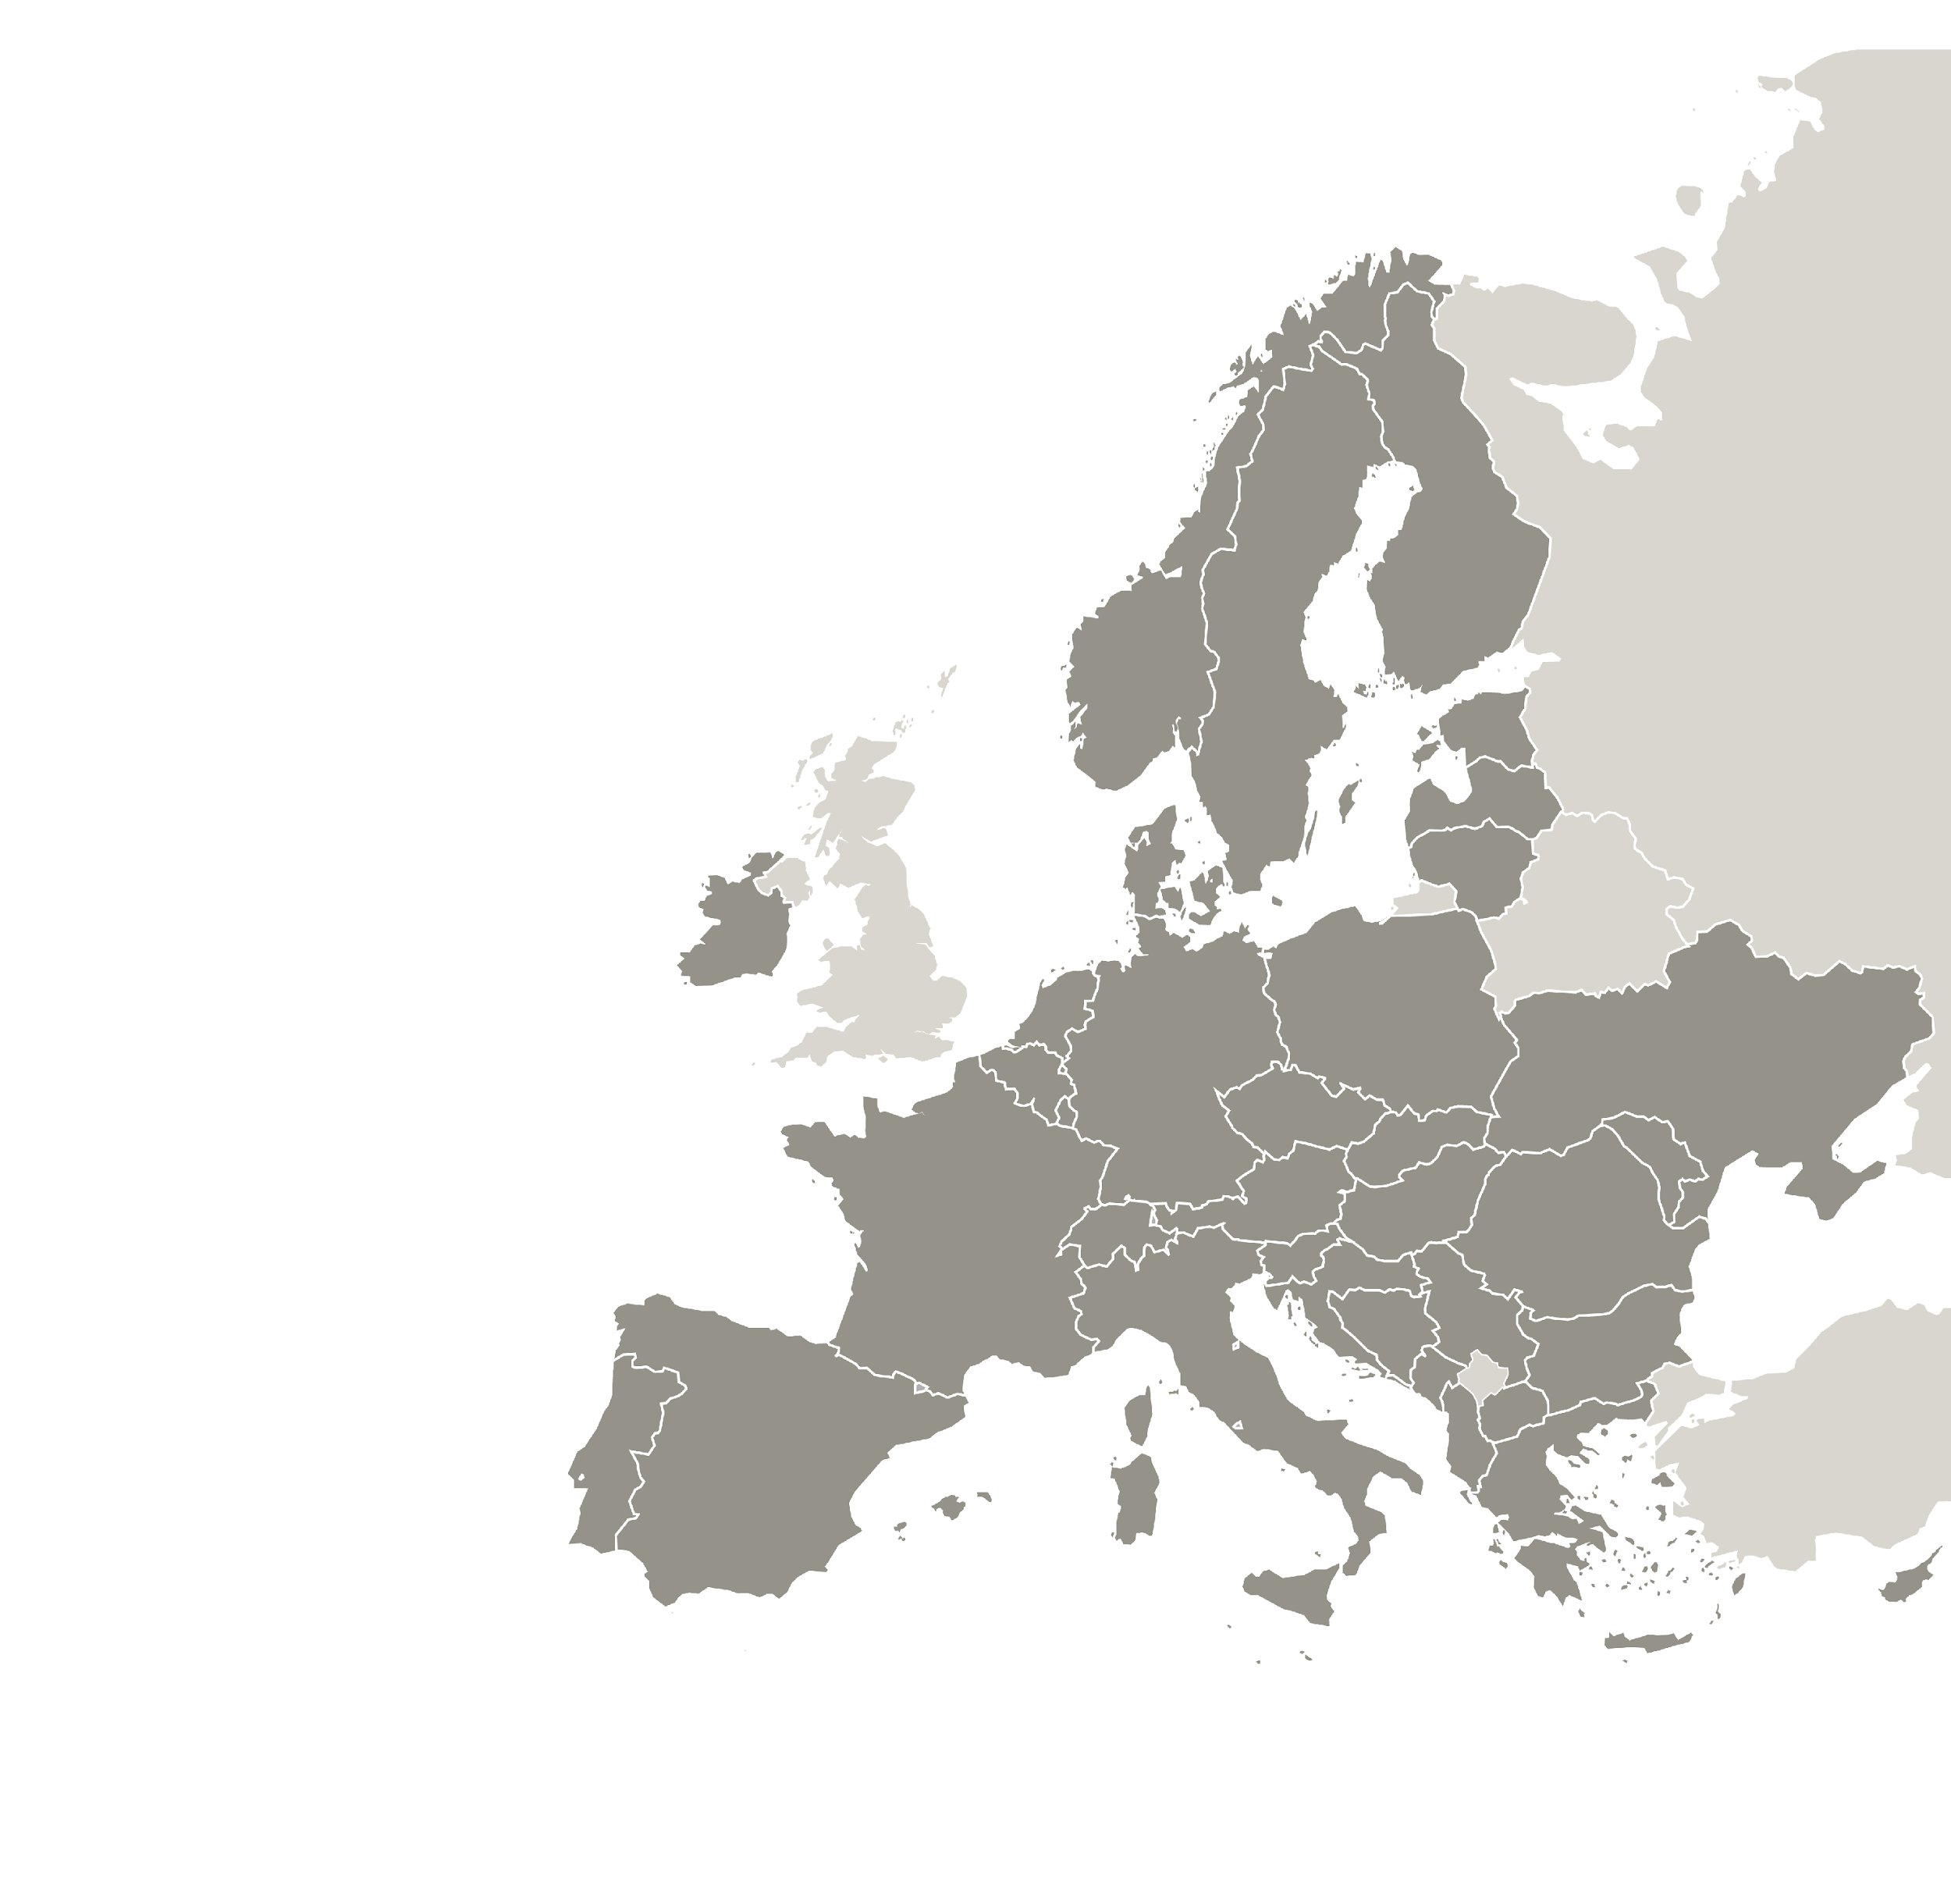
7 COUNTRIES
Poland
Germany
Hungary
Ireland
Italy
Latvia
Spain
8
Partners Project
Introduction to the
INSPIRE project & achievements
Gianluca Lentini (SR) & Andrea Mora (R)
Consorzio Poliedra, Communications Manager
gianluca.lentini@polimi.it
andrea.mora@polimi.it
26 August 2024 | Milan

Slide 2
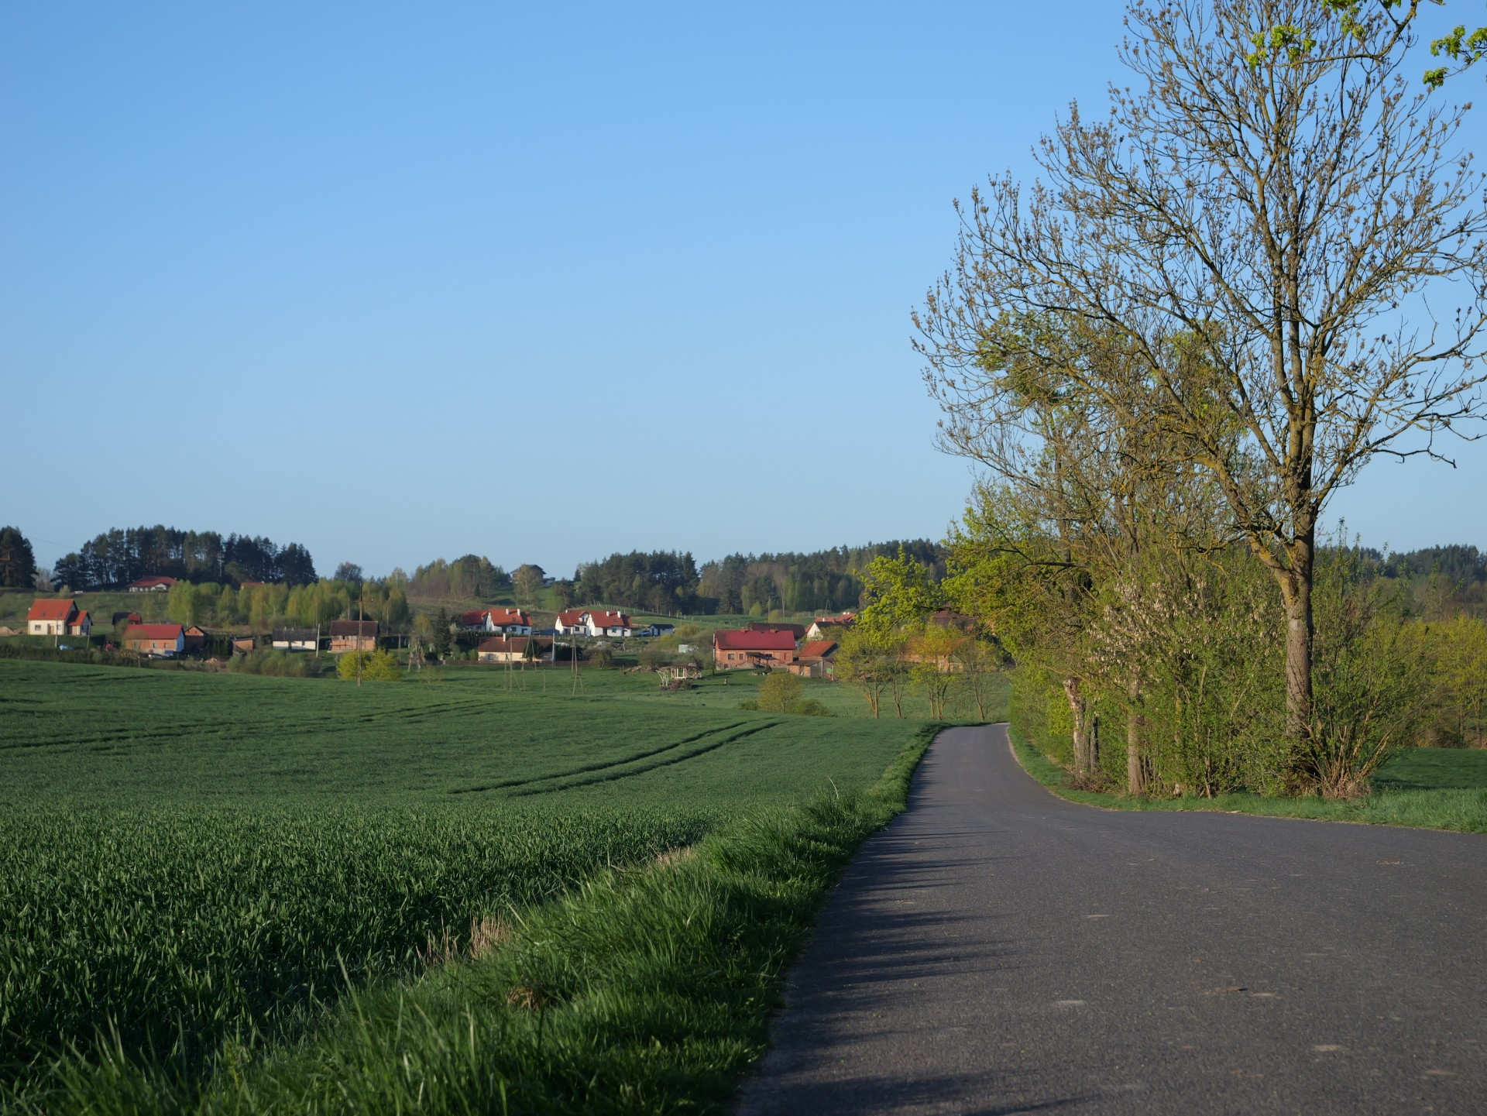
What is INSPIRE project about?

Slide 3
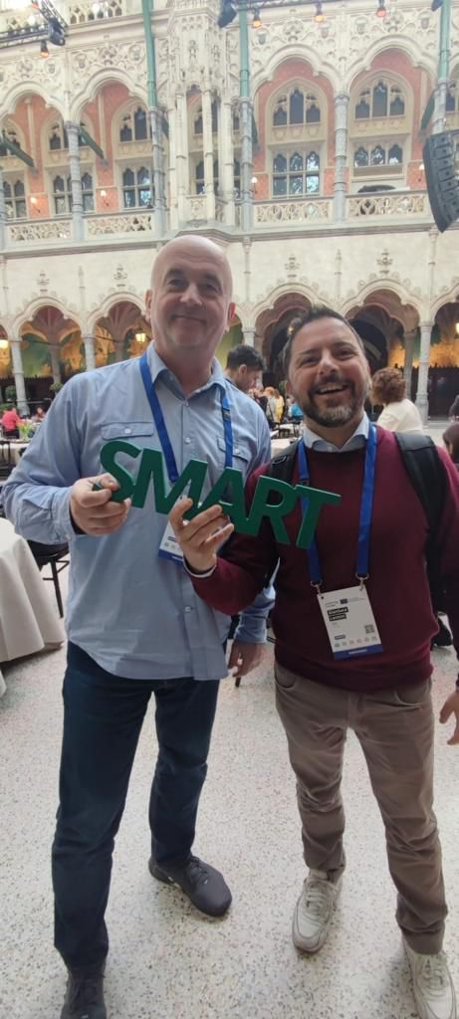
INSPIRE project
INSPIRE: Innovative and Smarter Policy Instruments for Rural Europe
Policy objective:
Smarter Europe (policy objective 1)
Specific objective:
Digitisation

Slide 4
INSPIRE project
Main aim
The INSPIRE project's overall objective is to making full use of the opportunities arising from digitisation and ICT in rural areas.
This will be achieved through creating stronger territorial policy instruments (PIs) enabling smarter planning for the future of rural areas, PIs that may go beyond the sectorial aspects of ERDF/EAFRD/ESF and embrace a more focused and holistic vision for rural areas.

Slide 5
INSPIRE project
Smart Villages Rationale
Smart Mobility
Smart Governance
Smart Economy
Smart Environment
Smart Living
Smart People
presence of creative and innovative enterprises and business models in the area, level of employment and unemployment, level of economic attractiveness, penetration of ICT in the local economic system
participation of local citizens to the job market, the decision-making and the involvement in associations, and the education level of people
the level of smartness of the governance systems, the penetration of green public procurement, e-governance, propensity to networking
he quantity and quality of sustainable transport and mobility systems in the area.Often found in ERDF, but also EARDF and local strategies
the quality of the environment in terms of air, water, soil and biodiversity
the quantity and quality of services to the population in the area, and the degree of satisfaction in them

Slide 6
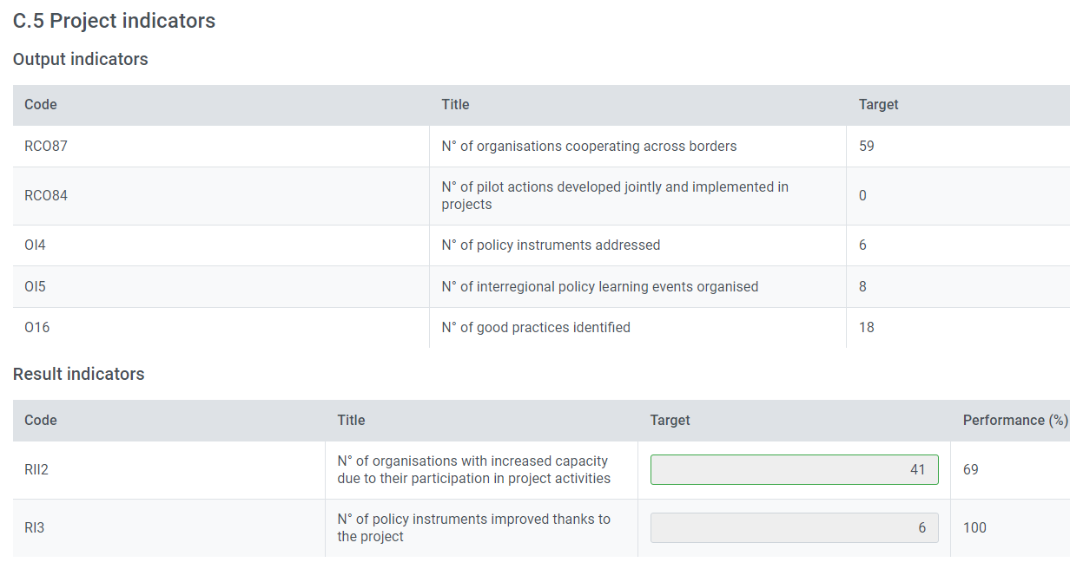
INSPIRE project
Outputs

Slide 7
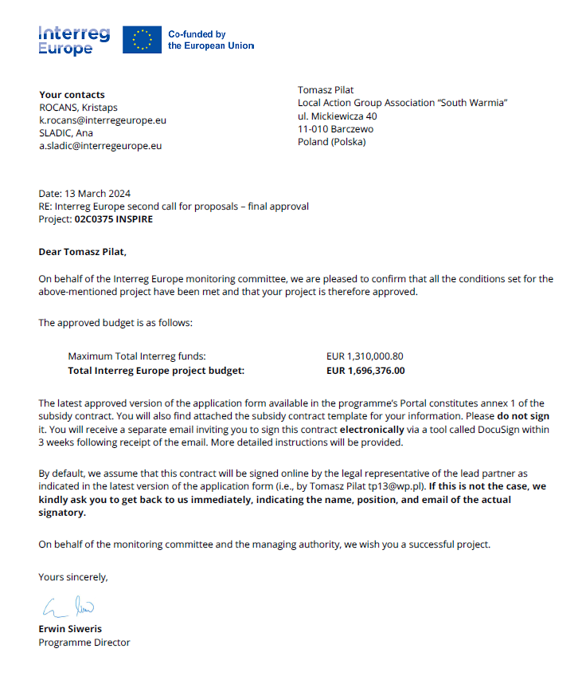
INSPIRE project
History
Poliedra generated and presented the project idea: November 2021
Project proposal prepared and submitted in the 1st call for proposals (closed on 31.5.2022)
Project proposal prepared and submitted in the 2nd call for proposals (closed on 9.06.2023)
Project approved under conditions on the 12.12.2023
Conditions fulfilled on the 13.03.2024
Subsidy contract signed on the 11.04.2024
Implementation of the project: 1.04.2024 - 30.06.2028
Timing: 36 months + 12 months project implementation

Slide 8
INSPIRE project
Lifetime and deadlines
30 Sep 2024
End of semester 1
Signed partnership agreement!
Within 4 weeks after progress report approval
ERDF reimbursement by accounting body to lead partner
31 March 2028
End of activities Beginning of closure period
12 Dec 2023
Beginning of eligibility of expenditure
Sep 2024
Reporting seminar
30 June 2028
End of eligibility of expenditure Submission of last progress report
Beginning of 2026 Project midterm review
1 Apr 2024 Beginning of semester 1
31 Dec 2024 Submission of
progress report 1

Slide 9
INSPIRE project
Partnership
Poland
Germany
Hungary
Ireland
Italy
Latvia
Spain
7 COUNTRIES
8
Partners Project
LP Local Action Group “South Warmia”
AP02 Poliedra
PP03 Ballyhoura Development CLG
PP04 Zemgale Planning Region
PP05 MGFÜ Public Benefit Non-profit Ltd
PP06 Institute for Rural Development Research at Goethe University Frankfurt/Main (IfLS)
PP07 European Projects Office of the Government of Cantabria
PP08 Regional Ministry of Economy and Finance of the Government of Cantabria
APA01 Region Lahn-Dill-Wetzlar
APA02 Olsztynek Municipality

Slide 10
INSPIRE project
Customised Participation Learning for Action:
Where are we now?
The present situation of the Policy Instruments
Where are we going?
Analysing the megatrends that may lead to changes (climate,AI…)
Where do we want to be?
The planned Policy Improvements
How do we get there?
The Interregional Knowledge Exchange
Are we getting there?
The 3rd and 4th year of INSPIRE

Slide 11
INSPIRE project
Policy instruments
Strategy for the Development of Olsztynek Municipality 2022-2030
Ballyhoura Development Social Inclusion Community Activation Programme (SICAP) 2024-2028 Strategy and Action Plan for north Cork and east Limerick
Zemgale Planning Region Development Programme 2021-2027
National SME Strategy - Model Factory Programme
Programme Cantabria ERDF 2021-2027
LEADER - Local development strategy (LDS) of the Lahn-Dill Wetzlar region 2023 – 2027

Slide 12
INSPIRE project
Outline of the Policy Instrument (PI)
Strategy for the Development of Olsztynek Municipality 2022-2030
Objective: The vision and strategic objectives of the strategy were envisaged in relation to four thematic areas: spatial, social, economic and environmental. The main objective for the municipality of Olsztynek is sustainable economic development and increasing the quality of life of its inhabitants.
Management: Olsztynek Municipality
Services Offered: the strategy consists of four parts: 1) Socio-economic diagnosis, 2) Vision, strategic and operational objectives, key actions, 3) Consistency with other planning documents, 4) Implementation of the strategy, together with financial data and funding sources.
Development: is the main planning document in the Municipality of Olsztynek and is consistent with other strategies and plans at regional and local level. It is an update of an earlier document that takes into account the impact of the pandemic and the changing socio-economic situation.
Ballyhoura Development Social Inclusion Community Activation Programme (SICAP) 2024-2028 Strategy and Action Plan for north Cork and east Limerick.
Objective: SICAP is the national Social Inclusion Programme to reduce poverty and promote inclusion and equality
Management: Current Strategy will run from 2024 – 2028 by Ballyhoura Development
Central Coordination:
Ballyhoura Development designs, develops and delivers the 5-year SICAP Strategy and Annual Implementation Plan for North Cork and East Limerick using community development methods which focus on inclusion, colaboration, equality and anti-discrimination.
Zemgale Planning Region Development Programme 2021-2027
Objective: The Strategic Part determines the medium-term strategic settings and actions of the Sustainable Development Strategy of the Zemgale Planning Region for 2015-2030 (hereinafter referred to as Strategy) to achieve the long-term strategic setting - vision, strategic goal, long-term development priorities. The strategic part of the development program defines nine medium-term development priorities, sets directions for action to achieve the development priorities and results to be achieved. Three horizontal priorities taken into account when implementing development priorities.P1 Quality, accessible, multifaceted lifelong learningP2 Social inclusion and health promotionP3 Competitiveness and growth of enterprises

Slide 13
INSPIRE project
Outline of the Policy Instrument (PI)
Model Factory Program (National SME Strategy 2019-2030)
Objective: Enhance SME competitiveness through advanced technologies and organizational development.
Management: Operated by MGFÜ Public Benefit Non-profit Ltd.
Services Offered:
Technological Demonstrations: Showcasing 16 advanced technologies including cloud solutions, robotics, automation, IoT, 5G, hydrogen tech, and cybersecurity.
Consultation & Training: Organizational diagnostics, development plans, individual consultations.
Development: Support for SME development plans, technology adoption, and improved business processes.
Central Coordination:
Managed by MGFÜ for coordination, strategic planning, and administration. Collaboration with technology providers, industry experts, and successful companies.
Programme Cantabria ERDF 2021-2027
Objective: This instrument is designed to support a set of integrated actions in the Besaya’s geographical area in order to respond to its specific needs and challenges. The ITI Strategy is articulated through 5 strategic axes (Industrial transition, Environmental resources, People, Smart Besaya and Culture and heritage), which in turn contemplate strategic lines to be deployed through more specific actions.In particular, “Priority Axis 3 – Urban-rural linkage development: Smart Besaya” has a clear alignment with the Smart Village concept (e.g. “A3.1 – To promote a territorial development model that improves the cohesion between urban and rural areas, in a joint development process that takes advantage of the dynamic capacity of urban areas to provide value-added services through a smart perspective”).
Management: It is therefore a management instrument, as defined in Regulation (EU) No 2021/1060, which allows for a territorial approach to be applied in the design and implementation of public policies (i.e. combining fundings from different thematic objectives and operational programmes supported by different structural funds).
Development: ERDF operational programme is currently under definition in Cantabria for 2021-2027. For this programming period, it includes under its PO5 a new participative strategy for Besaya’s Basin territory to be materialised as an Integrated Territorial Investment (ITI), heavily aligned with other territorial strategies such as the S3 2021-2027, directly linked with ERDF PO1.
LEADER - Local development strategy (LDS) of the Lahn-Dill Wetzlar region 2023 – 2027 Objective: Promote employment, growth, gender equality involvement in agriculture, social inclusion and local development in rural areas, including circular bioeconomy and sustainable forestry Management: Local Action Group “South Warmia”
Services Offered:
LAG potential and capacity building, ensuring development of rural areas based on local needs, activation of local society, cooperation, creation of smart villages, remote co-working spaces and traditions;
Development: Current LEADER funding period: 2023-2027. Projects typically span multiple years, with regular assessments and adjustments and is led by a Local Action Group (LAG)
Central Coordination:
Managed by a regional management
Adheres to overarching guidelines based on state-level directives, ensuring alignment with Hesse’s regional development goals and policies

Slide 14
The Policy Instrument (PI) in the smart villages context
LEADER - Local development strategy (LDS) of the Lahn-Dill Wetzlar region 2023 – 2027 Aim to: use of digitalization and the dynamics behind digital applications. Digitalization also plays a role in the lighthouse projects, such as digital presentation of the regional culture or the establishment of the region as a co-working region
Focus on: Strengthening the capacity of communities.
- Building smart villages, communities;
- Emphasis on green thinking communities;
- Green energy and building and support of energy communities;
Specific to: Service of general interest; Economy, Bio-economy, Rural tourism
Expected improvements:
Expected Learning from other partners Experience in policy instruments used by other partners.
Best practices for smart village and rural initiatives.
New projects and project ideas.
Model Factory Program (National SME Strategy 2019-2030)
Aim to: Gain insights into effective policy instruments and strategies used by other partners; Learn and adapt successful models and practices for smart village and smart rural initiatives.
Collaborative Innovation: Foster collaboration to develop innovative solutions that address the unique challenges of rural digital transformation.
Focus on : Facilitate the adoption of IoT, automation, and other smart technologies to support sustainable rural development and community-led digital initiatives.
Specific to: Leverage advanced technologies to promote smart village concepts, enhancing digital inclusion and economic opportunities in rural areas.
Expected improvements:
Digital Solutions and improved awareness of digital opportunities Enhance digital literacy in rural areas Promote a smart and sustainable economy for rural enterprises. Implement recommendations
Ballyhoura Development Social Inclusion Community Activation Programme (SICAP) 2024-2028 Strategy and Action Plan for north Cork and east Limerick.
Aim to:
1- Support communities and engage with them in identifying/ addressing social exclusion/ equality issues
2 -Support disadvantaged people to improve their quality of life via life long learning and labour market support
Focus on:
Goal 1; Supporting Communities, Action 5 – Renewing Community Skills
Goal 2; Supporting Individuals, Action 8 – Removing Barriers, Overcoming Obstacles
Specifically to:
Support digital awareness, knowledge and capacity improvements among vulnerable groups
Use digital tools in an accessible
Encourage use of digital tools
Support wider community led digital inclusion
Expected improvements:
Experience in policy instruments used by other partners.
Best practices for smart village and rural initiatives.
New projects and project ideas.
Strategy for the Development of Olsztynek Municipality 2022-2030
Zemgale Planning Region Development Programme 2021-2027
Programme Cantabria ERDF 2021-2027

Slide 15
INSPIRE project
Management structure
Lead Partner: Local Action Group Association “South Warmia” (Tomasz Piłat, Iwona Hudź, Magdalena Karczewska, Joanna Czułowska)
Project Manager: External expert (Małgorzata Steckiewicz)
Advisory Partner, knowledge exchange, communication: POLIEDRA (Gianluca Lentini, Andrea Mora)

Slide 16
INSPIRE project
Communication strategy
What has been done?
Creation of INSPIRE Partnership mailing list - LP
Creation of INSPIRE GoogleDrive + Communication shared folder LP + CM
PPs registration to the Interreg Platform, profile updating and connection to the project website, to be displayed on the INSPIRE’s Contacts webpage PPs (ongoing)
INSPIRE website initialization
Poster with information about the project (minimum size A3), including the financial support from the Union, at a location readily visible to the public PPs
INSPIRE roll up
INSPIRE social media channels (Linkedin, Facebook, Instagram, Linkedin)
Publication of information about the project on the PPs institutional websites and social media - PPs
Feedback on the Communication plan draft by the end of July - PPs
What next?
Nomination of Local communication manager - PPs
Creation of INSPIRE national/international target groups First press releases (locally) - PPs
Video Inception: collecting materials, assemblage and post productions for 6 short videos
Connections between INSPIRE and the New European Bauhaus
Final Video

Slide 17
INSPIRE project
Main abbreviations
LP Local Action Group „South Warmia” – LAG SW
AP02 Poliedra
PP03 Ballyhoura Development CLG - BD
PP04 Zemgale Planning Region - Zemgale
PP05 MGFÜ Public Benefit Non-profit Ltd - MGFU
PP06 Institute for Rural Development Research at Goethe University Frankfurt/Main (IfLS)
PP07 European Projects Office of the Government of Cantabria - OPECAN
PP08 Regional Ministry of Economy and Finance of the Government of Cantabria - Cantabria
APA01 Region Lahn-Dill-Wetzlar
APA02 Olsztynek Municipality
JS – Joint Secretariat
MA – Managing Authority
LP – Lead Partner
PP – Project Partner (PP02, PP03…)
APA – Associated Policy Authority
PR – Progress Report (JPR – Joint Progress Report)
PI – Policy Instrument
RP – reporting period (semester)
CC – Cost categories (Staff costs, Administration, etc.)
SG – Stakeholders Group (SGM – Stakeholders Group Meeting)
SC – Steering Committee
PA – Partnership Agreement
SC – Subsidy Contract

Slide 18
Thank you!
www.interregeurope.eu/INSPIRE

