Slide 1

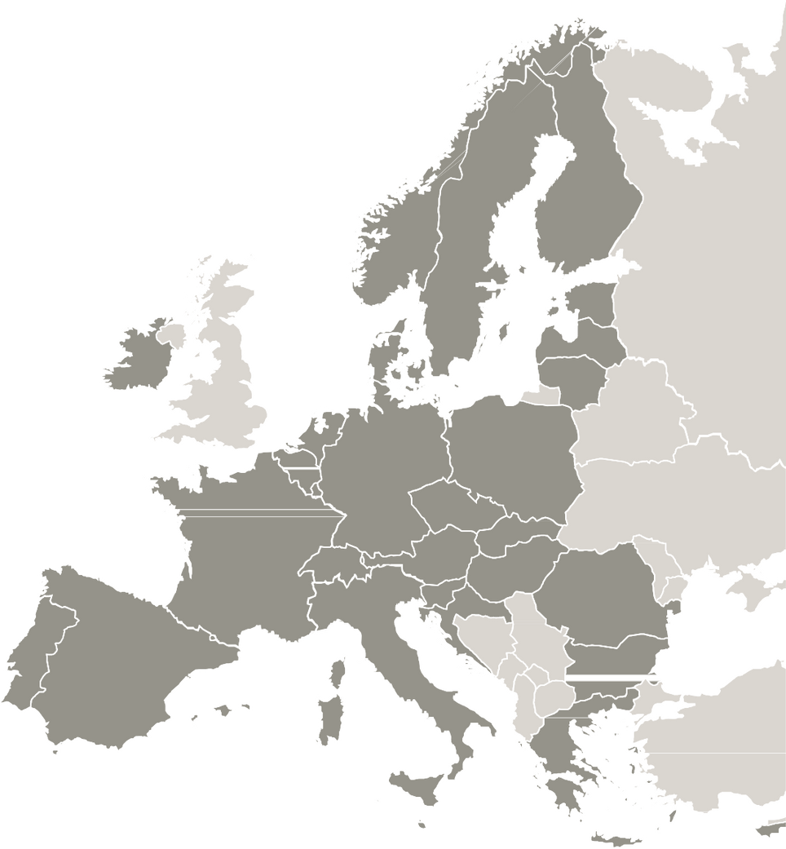

OD4GROWTH
OD4GROWTH project presentation

Slide 2

OD4GROWTH
AVAILABILITY AND USABILITY OF OPEN DATA TO SUPPORT LOCAL DEVELOPMENT AND URBAN TRANSFORMATION
Program | INTERREG EUROPE
Duration: | March 1, 2023 – May 31, 2027 (50 months)
Call: | N.1 – deadline 05/31/2022
Acronym: | OD4GROWTH
FAMP Budget | 218.036,00€
ERDF co-financing | 80%

Slide 3

OD4GROWTH aims to strengthen the availability and usability of open data to support local development, and especially SMEs, in relation to the advantages offered by the Data Economy, and to improve accessibility and public services aimed at citizens by part of local actors.
The partnership will work to improve local policies and action plans aimed at increasing the availability of local and regional data, on the one hand, and improving the services offered by public actors based on this public data, especially those referring to health and urban planning. The partners that make up the partnership are regional authorities, metropolitan areas, and municipalities involved in open data issues.

Slide 4

General objective:
Support local, regional and national authorities in improving their policies and financial instruments to strengthen the availability and usability of open data by public and private entities with the aim of promoting both entrepreneurship and urban transformation.
Specific objectives:
  Support policy makers/legislators to increase their knowledge and skills around the availability and exploitation of open data; as well as increase their knowledge about the most advanced instruments to ensure the quality and quantity of this open data.
  Support policy makers and sector agencies to increase the exploitation of open data in favor of more innovative public and private services, particularly those focused on the health, mobility and environment sectors.
  Disseminate information and organize campaigns dedicated to strengthening knowledge and attitude towards publishing higher quality open data by public authorities.
OD4GROWTH

Slide 5
TYPE OF ACTIVITIES
  Thematic surveys / studies / analysis
  Interregional study visits
  Interregional thematic seminars/workshops
  Interregional peer review sessions
  Interregional personnel exchanges
  Stakeholder meetings
  Pilot actions
  Participation in the Political Learning Platform
  Preparation of action plans

Slide 6
COUNTRY | ENTITY NAME
ITALY | VENETO REGION DEPARTMENT OF DIGITAL AGENDA AND NEW INFORMATION TECHNOLOGIES
HUNGARY | PANNON BUSINESS NETWORKS ASSOCIATION
HUNGARY | SZOMBATHELY COUNTY MUNICIPALITY
POLAND | MAZOVIA DEVELOPMENT AGENCY
SPAIN | ANDALUSIAN FEDERATION OF MUNICIPALITIES AND PROVINCES (FAMP)
FRANCE | GRAND E-NOV+
LATVIA | LIEPAJA CITY MUNICIPAL GOVERNMENT ADMINISTRATION
LITHUANIA | SILUTE DISTRICT ADMINISTRATION
GREECE | EAST MACEDONIA-THRACE REGIONAL DEVELOPMENT FUND
PARTNERSHIP AND PARTNERS
6
Notes:
Ese reto ha sido asumido por el Grupo Motor Gobernanza Local de Andalucía.
Ocho grupos provinciales que como vemos han puesto en valor la diversidad de los agentes que conforman el Ecosistema. Agradecimiento a las Diputaciones Provinciales y labor de coordinación de estos GMPs
Auténticos foros de debate organizados en torno a los ámbitos de desarrollo inteligente que propone el Libro Blanco AndalucíaSmart.
6

Slide 7





ASSOCIATED POLITICAL AUTHORITIES
ORGANIZATION | COUNTRY
GREAT EAST REGION | FRANCE | https://www.grandest.fr/
EAST MACEDONIA AND THRACE REGION | GREECE | https://www.pamth.gov.gr
OFFICE OF THE MARSHAL OF THE MAZOVIAN VOIVODATE | POLAND | https://mazovia.pl/
DIGITAL AGENCY OF ANDALUSIA | SPAIN | https://www.juntadeandalucia.es/organismos/ada.html
7
Notes:
Ese reto ha sido asumido por el Grupo Motor Gobernanza Local de Andalucía.
Ocho grupos provinciales que como vemos han puesto en valor la diversidad de los agentes que conforman el Ecosistema. Agradecimiento a las Diputaciones Provinciales y labor de coordinación de estos GMPs
Auténticos foros de debate organizados en torno a los ámbitos de desarrollo inteligente que propone el Libro Blanco AndalucíaSmart.
7

Slide 8

The project will address the review of this political instrument taking into consideration the following challenges:
  Increase public-private technological cooperation and the use of open innovation to develop and improve the capabilities and implementation of research and innovation of advanced technologies, such as those based on data (in line with Specific Objective 1 of the Objective policy 1 of the European Structural and Investment Funds). This should be clearly reflected in the lines of action, paying more attention to public-private collaboration and public purchasing of innovation.
  Increase the training and digital specialization of companies and public institutions in the development of data-based solutions necessary for smart specialization, industrial transition and entrepreneurship (in line with Specific Objective 4 of Political Objective 1 of the Structural and Development Funds). European Investment).

Slide 9
ROLE OF THE AUTHORITY ASSOCIATED WITH THE DEVELOPMENT OF THE PROJECT
The participation of authorities responsible for the design and implementation of political instruments to which the project is directed is mandatory, as a partner of the project, or as an associate partner, as is the case in Andalusia, with the participation of the Digital Agency of Andalusia, attached to the Ministry of the Presidency, Public Administration and Interior of the Junta de Andalucía.
The function of the associated partner is to provide feedback on the Project's actions and validate its results in relation to the political instrument to which it is directed, ensuring that the final results are consistent and relevant to the political instrument and its objectives.

Slide 10
PROJECT METHODOLOGY
The general learning process of the project is organized following the following steps:
  CORE phase activities: needs analysis, mapping, identification of good practices, learning process at individual and organizational level, evaluation of the learning process.
  Activities of the FOLLOW UP phase: monitoring the impact of the policies under analysis and completion of the learning and knowledge exchange process.
  Additionally, the project's communication activities will cover both phases.

Slide 11
ANALYSIS
The main topic of the project, the availability and processing of open data, will be addressed from three different perspectives:
  Provide support for improving the availability (quantity and quality) of open data, mainly by public institutions.
  Support open data processing actions to improve the quality standards of public services aimed at citizens.
  Improve open data for the benefit of SMEs and entrepreneurship for the development of new products and services.
  THREE CROSS-CUTTING THEMATIC GROUPS

Slide 12
Thank you!

