Slide 1

What is JustGreen about?
Name of Presenter
Function
email
07 JULY 2021 | Location

Slide 2
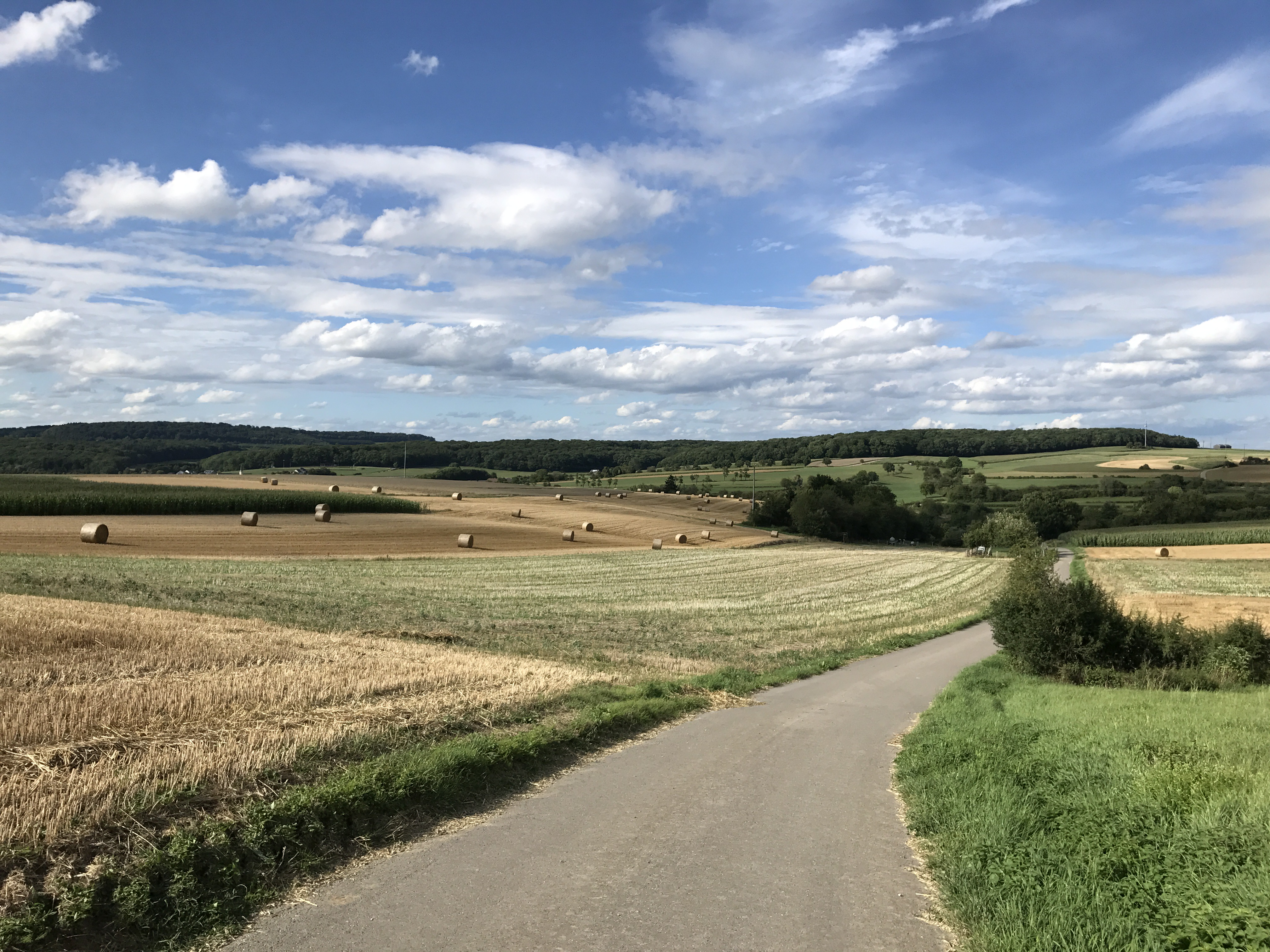



Justgreen challenge
Climate crisis
Surpassing the critical threshold of 1.5 degrees Celsius by 2030
Increasing urgency to act more decisively against climate crisis
European cities and metropolitan areas struggle with aligning their climate adaptation plans with their social objectives
Necessary to take equity into consideration
To prevent our policy interventions to further increase inequalities.
TOTAL
12.3 MEUR
www.interegeurope.eu/JUSTGREEN

Slide 3
Justgreen Goal
“JustGreen aims at ensuring that the most vulnerable communities are not only shielded from climate risks but also benefit from and are actively involved in shaking greening policies.”

Slide 4
JustGreen – No one being left behind in the transition to a climate-neutral EU by 2050
Focus on specific needs of communities most vulnerable to climate impacts
Elderly, low-income households and communities in deprived urban areas prone to extreme weather events.
Targeted climate action with engagement of vulnerable communities is crucial to prevent further inequalities.
Notes:
*npj Urban Sustainability study on the climate adaptation plans of 167 European cities, published in March 2023

Slide 5
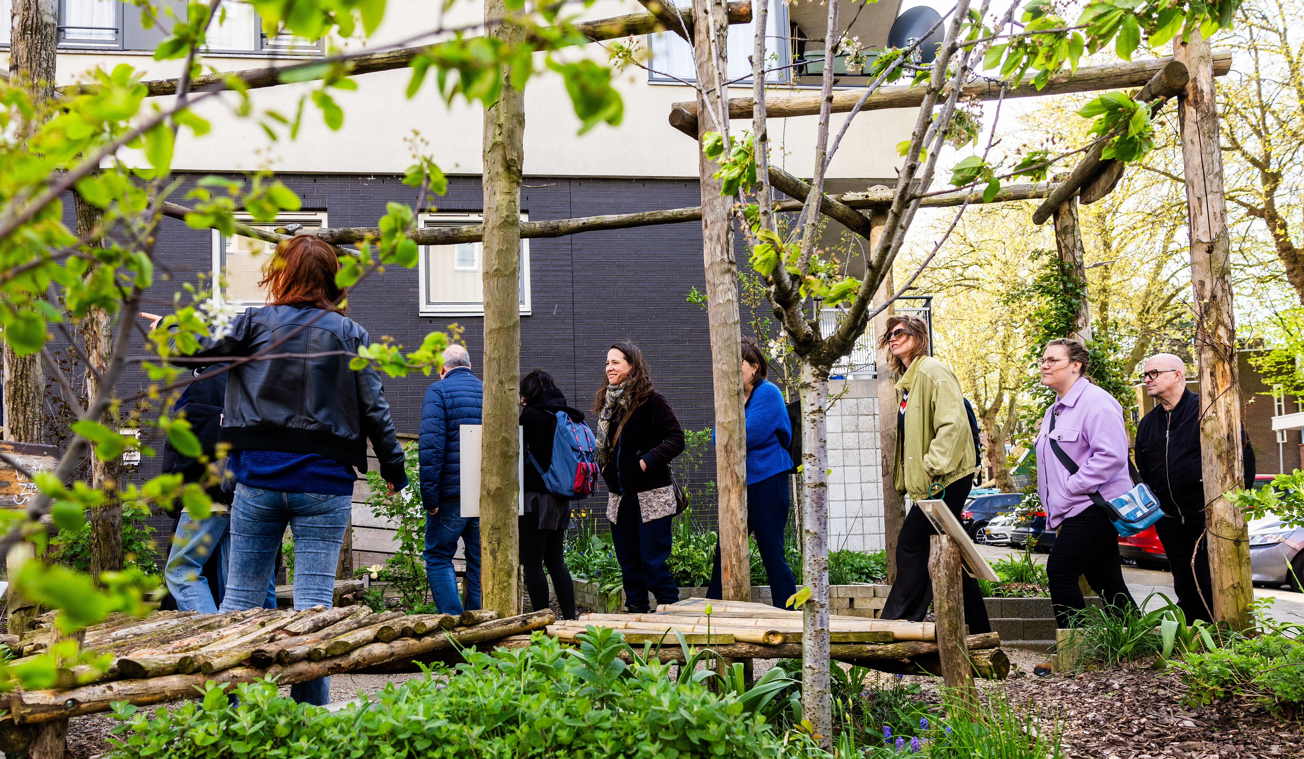
JustGreen three pillars
Distribution
We're looking to distribute greening efforts and funds more equitably, based on a careful analysis of socio-economic and spatial data.
Procedure
Our focus is on inclusive processes, where communities most affected by climate change are deeply involved in planning and implementing greening initiatives.
Recognition
We strive for a greater understanding and acknowledgement of diverse perspectives on greening and climate adaptation
www.interegeurope.eu/JUSTGREEN

Slide 6

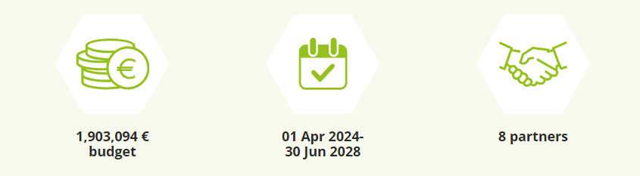
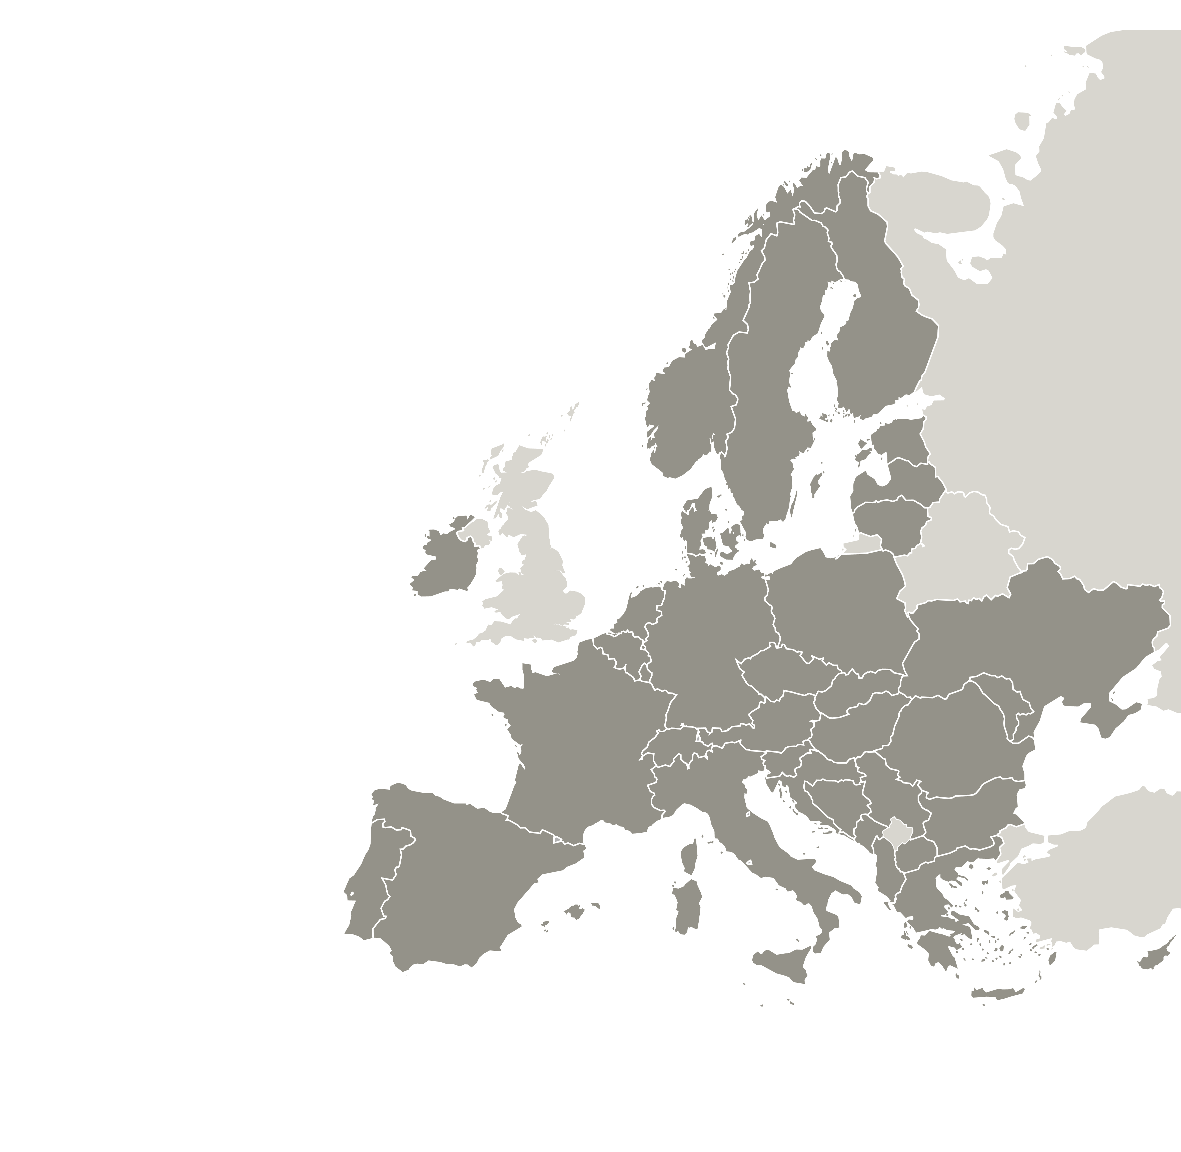

JustGreen Partners
Rotterdam, Burgas, Ghent, Katowice, Murcia, Tallinn, Regional Development Fund of Attica
A dedicated consortium of
Rotterdam (LP), Burgas, Ghent, Katowice, Murcia, Tallinn and Regional Development Fund of Attica
are committed to the success of the project.
Erasmus University is Advisory Partner facilitating optimal exchange of experience through among others the JUSTGREEN-scorecards, a transferability matrix with best practices and the new Gluon-procedure.
8
partners

Slide 7
?
Time for questions

Slide 8
Thank you!
www.interregeurope.eu/ACRONYM

Slide 9
The project ACRONYM is implemented in the framework of the Interreg Europe programme and co-financed by the European Union.
www.interregeurope.eu

Slide 10

























