Slide 1
REC4EU
In a nutshell
Project’s progress
Updated end of Semester 3 – 31/08/2024
LP : ARRR Spa

Slide 2
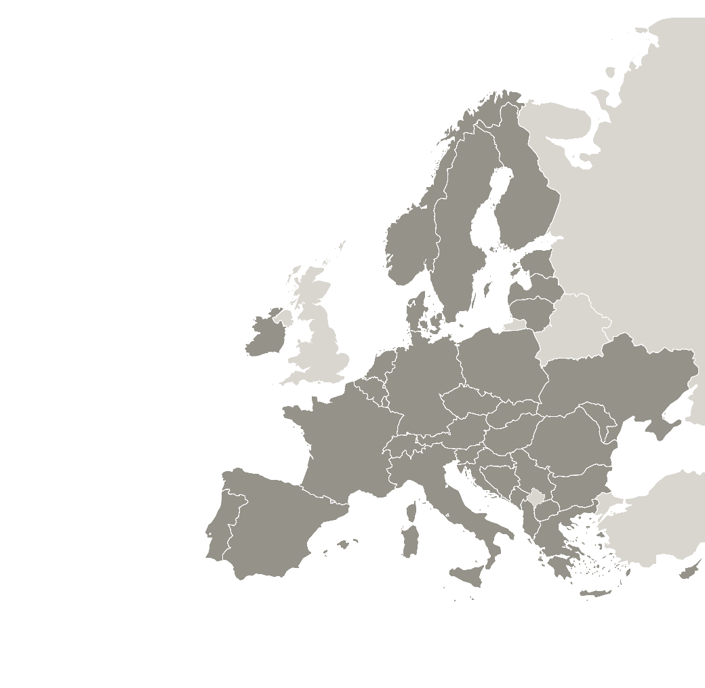
REC4EU partnership
10 project partners from 9 regions working together:
Regional Agency for Waste & Resource Management (ARRR) (Italy) – lead partner
Regional Government of Tuscany (Italy)
Slovak Innovation and Energy Agency (Slovakia)
Lubelskie Voivodeship (Poland)
Council of Tampere Region (Finland)
Energie Commune (Belgium)
Andalusian Energy Agency (AEA) (Spain)
Energy and Climate Local Agency (France)
Regional Development Agency Srem (Serbia) (*)
Milieukontakt Albania (Albania) (*)
(*) Discovery partners since Semester N.3
FINLAND
POLAND
BELGIUM
SLOVAKIA
FRANCE
SERBIA
ITALY
ALBANIA
SPAIN
Lead partner
Project partners
Notes:
Associated policy authorities are not partners so they should not show as part of the ‘partnership’ – feel free to use another slide to show who the other key stakeholders are (APAs)

Slide 3
REC4EU overall objective
Thanks to impact on selected public policy instruments, the overall aim of REC4EU is to improve territorial level governance and connected services for the creation and development of Renewable energy communities (RECs).
www.interregeurope.eu/rec4eu
MEUR
2,003
Project budget
Mar 2023
May 2027
Notes:
Short summary of the issue addressed (in a form of a question) and what needs to be improved in the participating regions (text below)

Slide 4
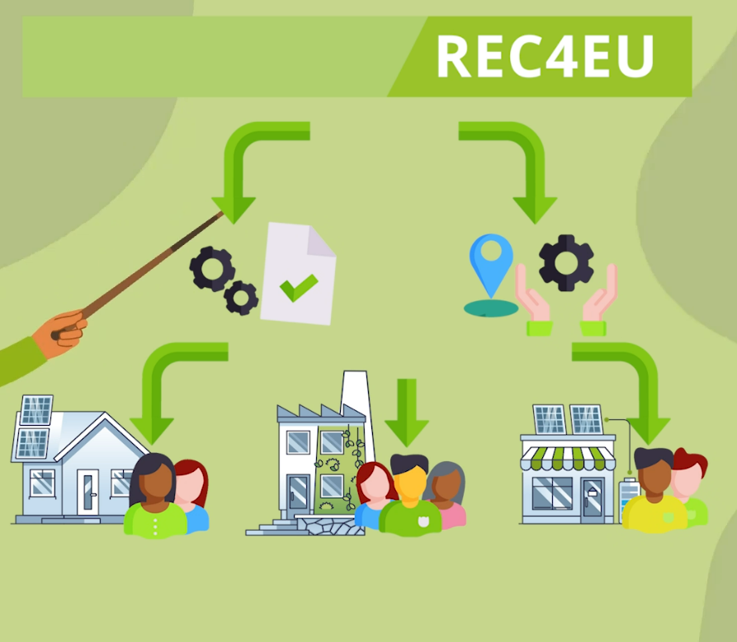
REC4EU specific objectives
Analyse and address technical, regulatory, economic, social barriers to RECs, focusing on territorial specificities (e.g. type of renewables, legal status of communities) and commonalities (e.g. means to involve stakeholders and deliver support);
Identify key regional policy aspects to set up an integrated governance and support framework for creation and development of RECs;
Design policy improvements to develop an integrated governance and support system at territorial level, helping overcome identified barriers;
Build capacity among public authorities and stakeholders to implement support services to RECs;
Implement policy improvements (using own resources) and monitor their progress and impact.

Slide 5
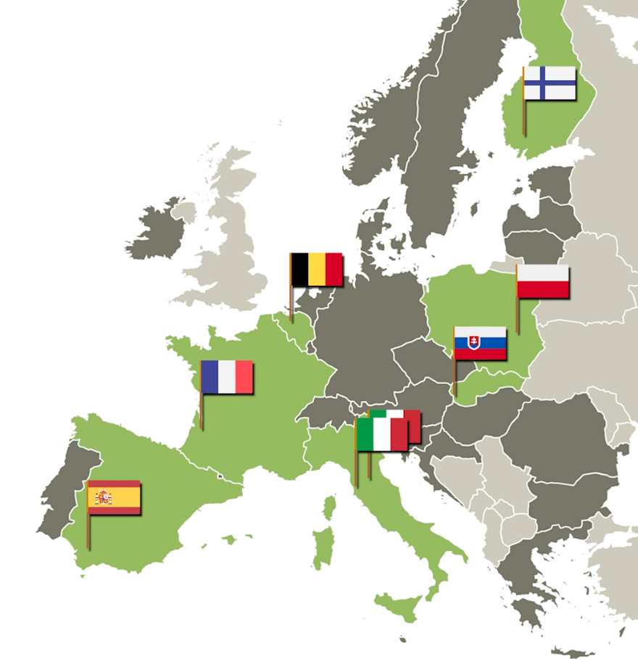
REC4EU addressing seven policies
Seven policy instruments:
Italy: ROP ERDF 2021 – 2027, PO2 Greener Europe
Slovakia: Programme Slovakia 2021 – 2027
Poland: Energy Development Program for the Lubelskie Voivodeship
Finland: Innovation and Skills in Finland 2021−2027 programme, including the priority area 2 Carbon neutral Finland (ERDF)
Belgium: Decree on Organisation of the Regional Electricity Market (2022)
Spain: ERDF Regional Operational Programme Andalucia 2021-2027
France: State-Region Plan Contract (2021-2027) - Action Line multiannual call “Citizen and participatory projects of energy transition”
Notes:
If you have more policies, feel free to remove the map and extend the field for policy instruments’ titles

Slide 6
Achievements so far (at the end of sem. 3 – Aug. 2024)
Partnership enlarged to include 2 Discovery partners from Serbia and Albania
Territorial Analysis
Interregional Exchange
Communication Activities
SWOT on 4 barriers (technical, regulatory, economic, social)
Identification of first set of Good Practices
3 Interregional events organised in Florence (IT), in Granada (ES) and in Tampere (FI)
Online meetings
1 project video in English
Versions of the project video with subtitle in partner’s languages
Participation in events

Slide 7
REC4EU Stakeholder Groups
Stakeholders are involved in all REC4EU’s steps and play a key role in reaching the policy improvement foreseen in the project.
REC4EU designs an engagement path targeting public administrations, businesses and citizens, to be adapted to the regional contexts and policy needs.
Without engagement of territories and communities, the necessary shift towards different energy production/consumption schemes cannot be achieved
OVER 100 stakeholders reached per semester

Slide 8
REC4EU key outputs
14
Good practices
Expected by the project
10 GP identified and uploaded in the Good practise database
CLICK HERE to read them
Notes:
Reflect the share of planned activities delivered – move the arrow according to the actual percentage

Slide 9
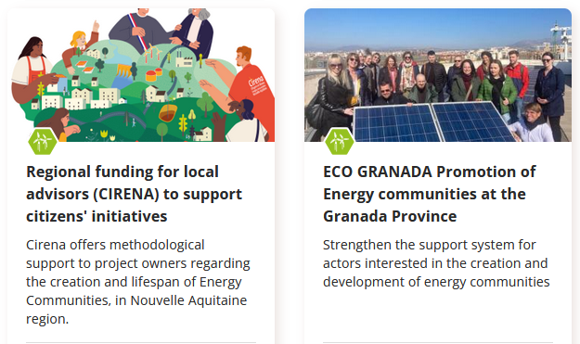
REC4EU Good Practices

Slide 10
REC4EU Plans for semester 4
Identify additional Good Practices
Design the REC4EU engagement path
Interregional learning events online and in Slovakia
Work with stakeholders on policy improvement

Slide 11
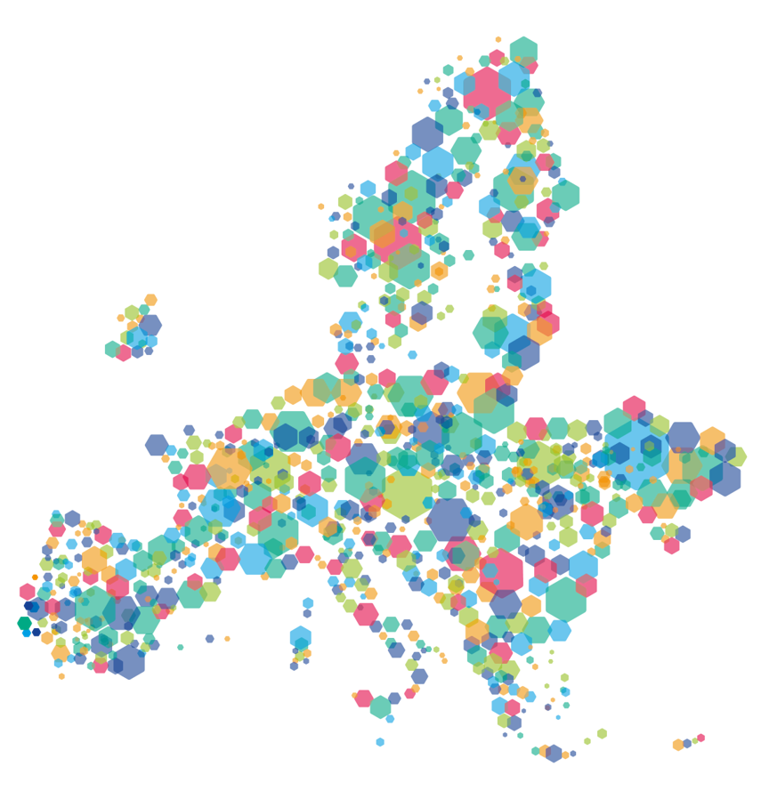
This project is implemented in the framework of the Interreg Europe programme and co-financed by the European Union.
www.interregeurope.eu
Notes:
Add links to your website and the two videos to be published on your website

Slide 12
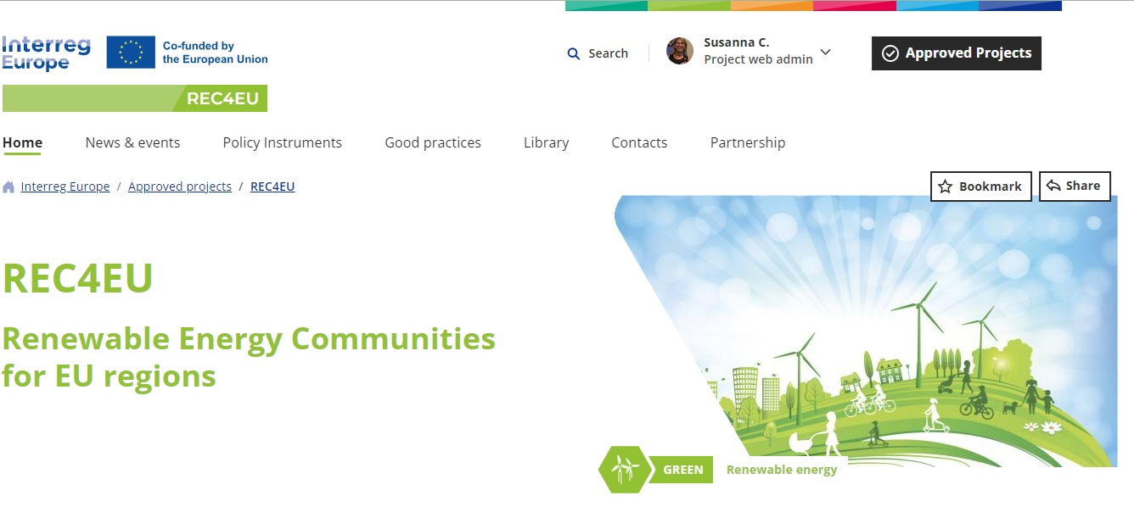
Want to learn more about REC4EU?
Key links
Project website
www.interregeurope.eu/rec4eu
Project videos
Introduction: https://youtu.be/dibdf3DgZJY
Linkedin page
Notes:
Add links to your website and the two videos to be published on your website

Slide 13
Thank you!
Visit the REC4EU website to watch our project video:
www.interregeurope.eu/REC4EU

