Slide 1

Stadtverwaltung Pfaffenhofen
Contribution and objectives
Dr. Peter Stapel
Head of department for Climate Protection and Sustainability
peter.stapel@stadt-pfaffenhofen.de
11 MAY 2023 | Ferrara

Slide 2

Stadt Pfaffenhofen a.d. Ilm
26.654
inhabitants
92,6 km²
Area
Center of the district
Landkreis Pfaffenhofen a.d. Ilm
Hallertau
Biggest hops growing area in the world
TOTAL

Slide 3
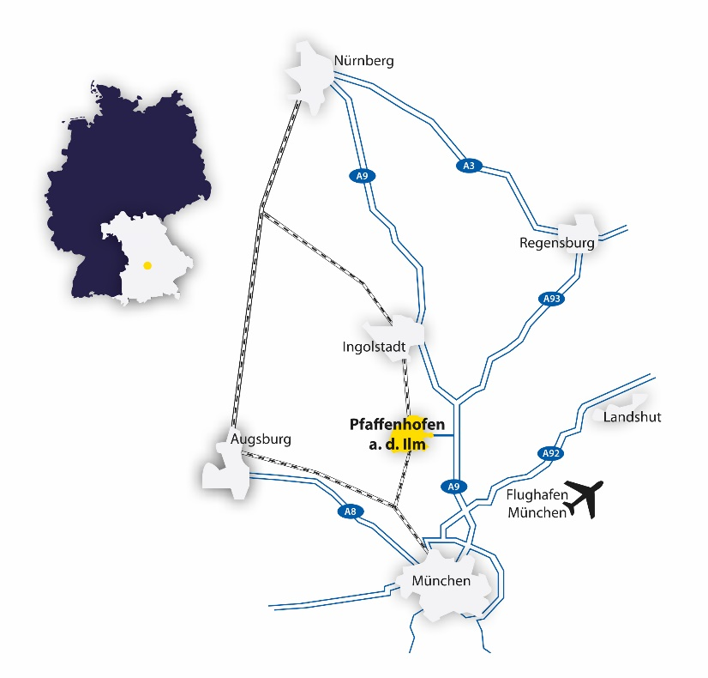
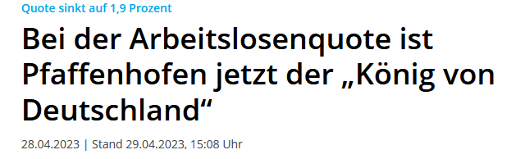

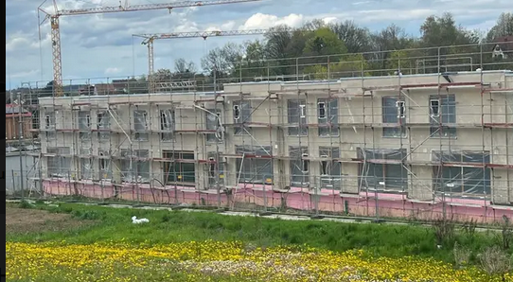
Stadt Pfaffenhofen a.d. Ilm
Location
Situated in the middle of Germany's No. 1 growth region
© Screenshot – Pfaffenhofener Kurier – 08.05.2023
© Screenshots – Immoscout 24 – 08.05.2023

Slide 4
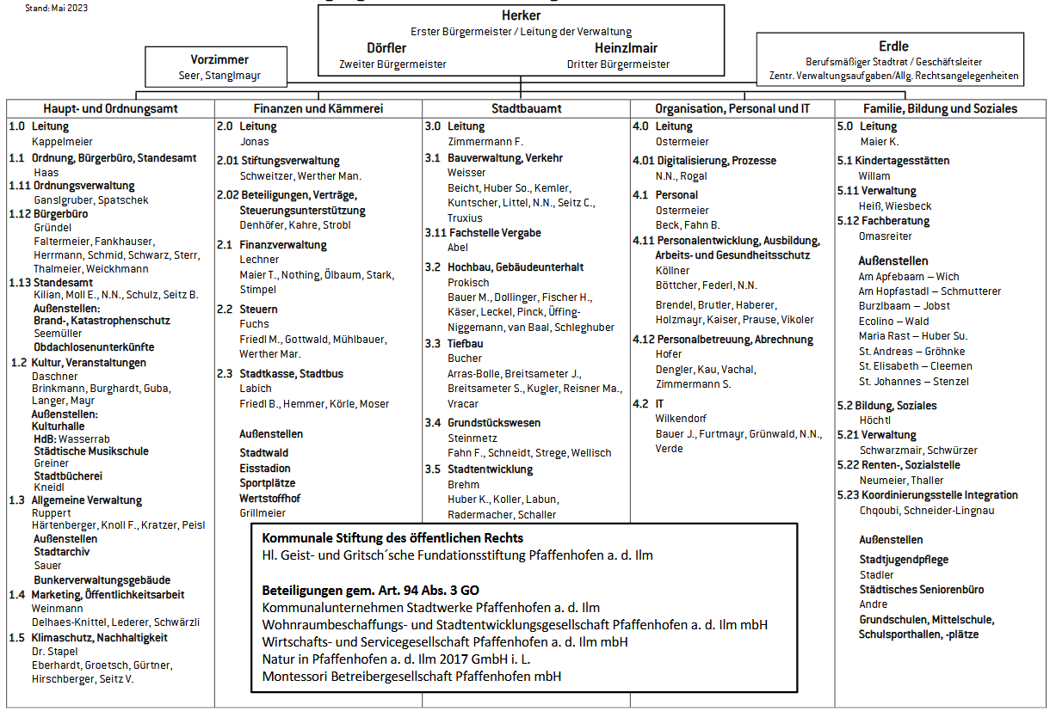
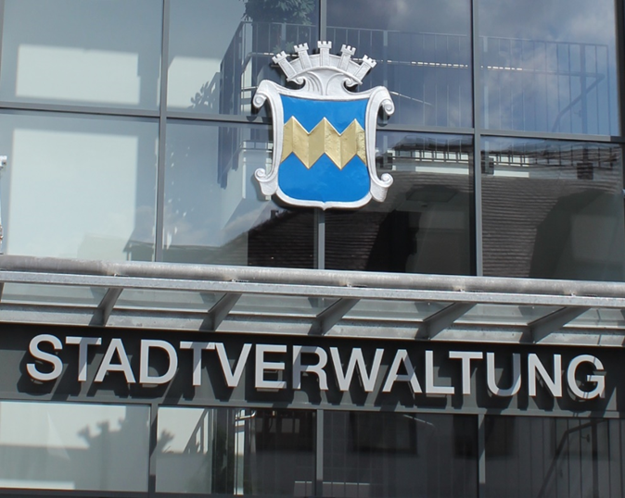


City council Pfaffenhofen a.d. Ilm
Staff &
Stakeholders
Department
Climate
Protection
N.N.
Gürtner
Hirschberger

Slide 5
Competences & Why we are here
Climate neutral
2035

Slide 6
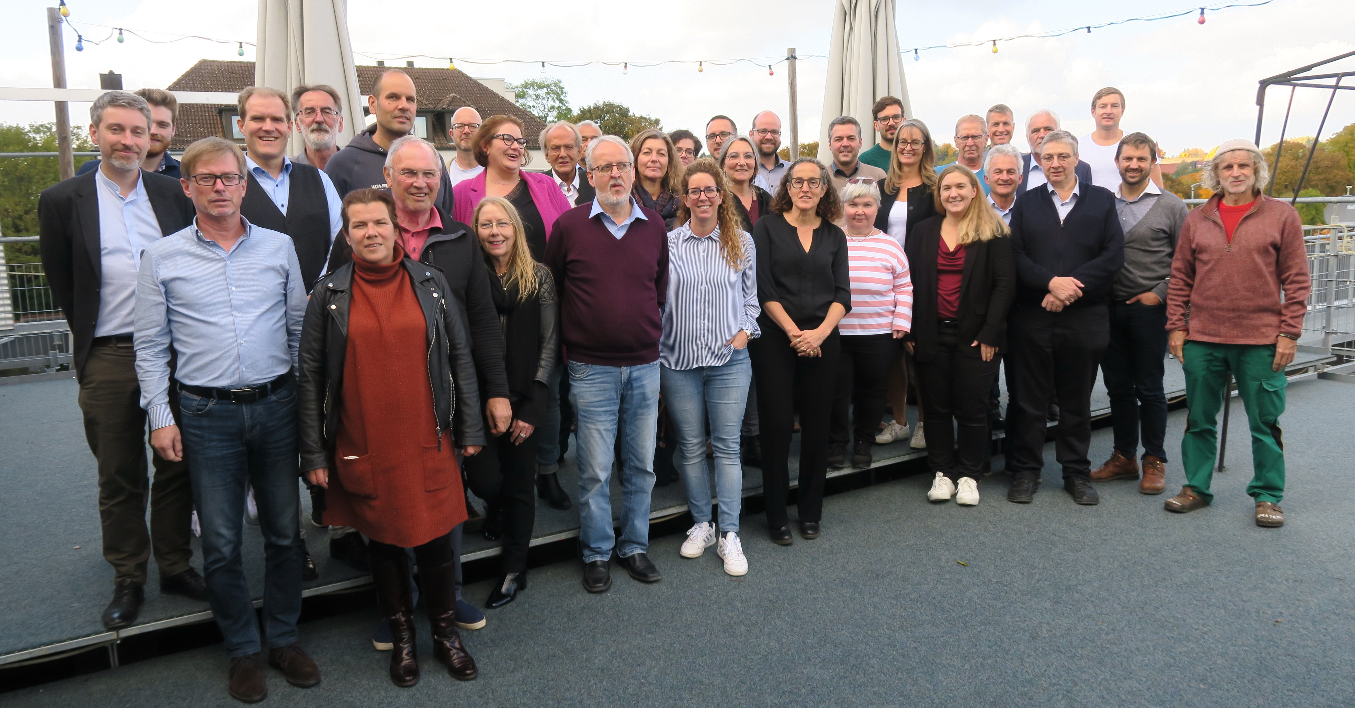

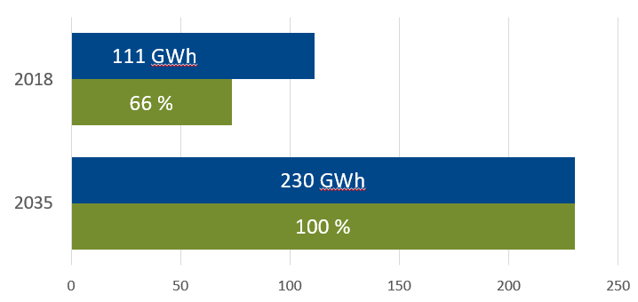
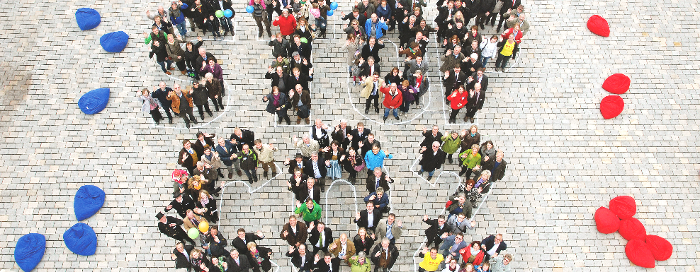
Competences

Slide 7
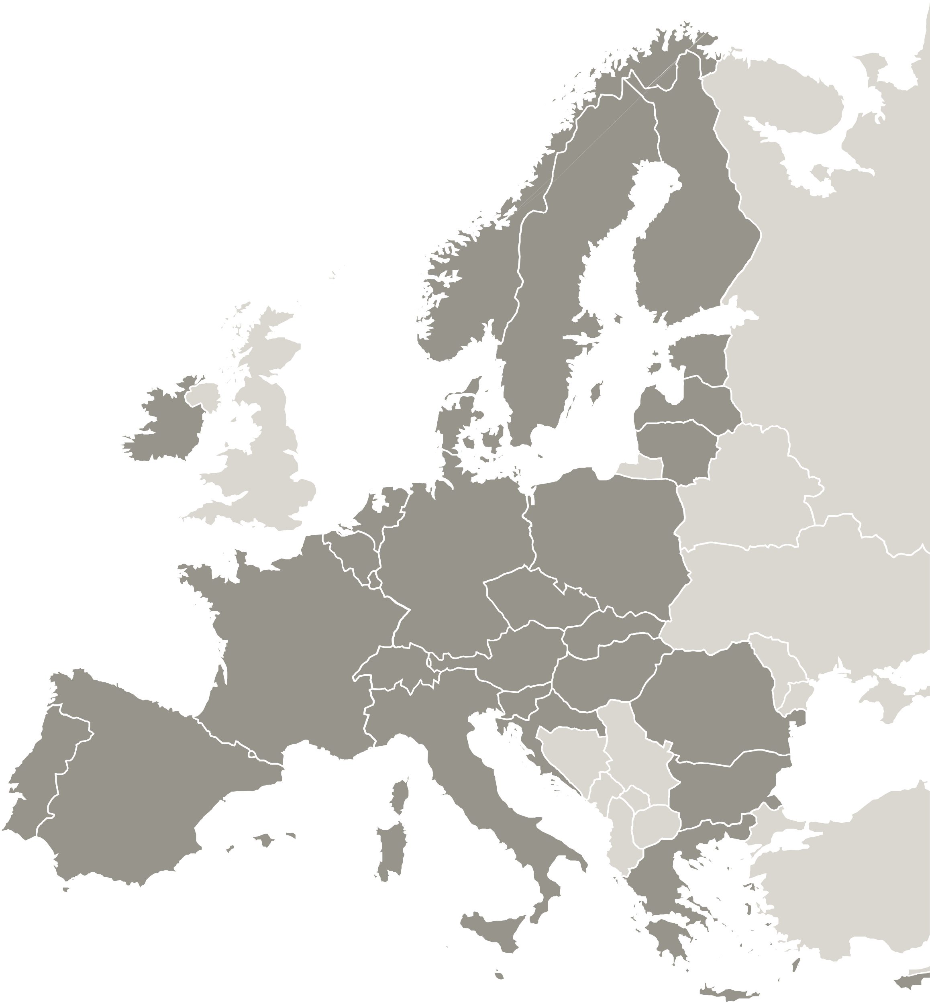
Expected results
Sharing
progress and obstacles
Disseminate
good ideas as quickly as possibly.
(e.g. climate protection plan – what are actually the good ideas)
Cooperation
Educational work
Networking (from regional to international level)
Future policy instruments

Slide 8
Thank you!
www.interregeurope.eu/LEEWAY

Slide 9
The project LEEWAY is implemented in the framework of the Interreg Europe programme and co-financed by the European Union.
www.interregeurope.eu

Slide 11


























