Slide 1
Project presentation
Last update on: 1 October 2024
Notes:
Use your project’s profile image (the one from the website)
Remember to use only images which meet the copyright criteria set by the regulation

Slide 2
CITICESS objective
How can we improve social policies to better support vulnerable groups in our cities?
The CITICESS project aims to enhance social policies by sharing innovative practices and developing targeted solutions to improve the lives of the most vulnerable populations.
MEUR
www.interregeurope.eu/citicess
1.94
Project budget
Mar 2023
May 2027
Notes:
Short summary of the issue addressed (in a form of a question) and what needs to be improved in the participating regions (text below)

Slide 3
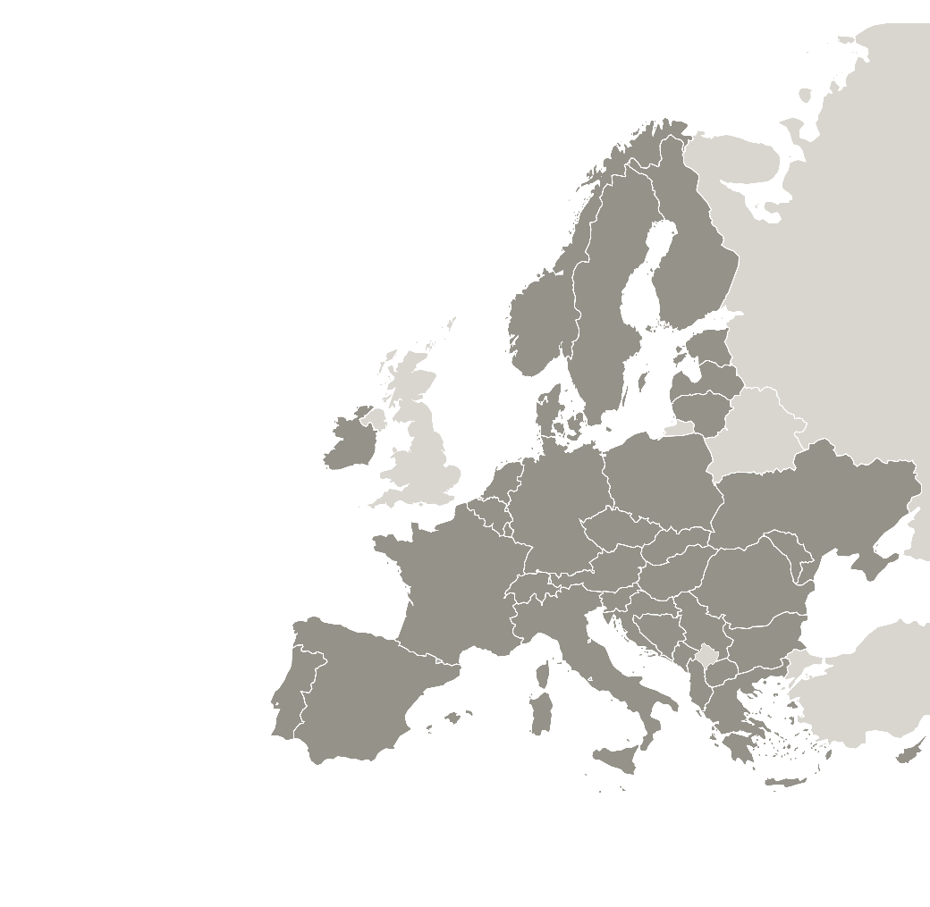
CITICESS partnership
8 project partners working together:
Municipality of Heerlen– lead partner (The Netherlands)
Municipality of the 18th District of Budapest (Hungary)
Municipality of Galați (Romania)
Sofia Municipality (Bulgaria)
Ballyhoura Development CLG (Ireland)
City of Aarhus (Denmark)
Zaragoza City Council (Spain)
Municipality of Pordenone (Italy)
Ballyhoura
Heerlen
Budapest
Galati
Pordenone
Zaragoza
Sofia
Lead partner
Project partners
Notes:
Associated policy authorities are not partners so they should not show as part of the ‘partnership’ – feel free to use another slide to show who the other key stakeholders are (APAs)

Slide 4
CITICESS addressing eight policies
Eight policy instruments:
Heerlen: National Program of Liveability and Safety - Heerlen-North
Budapest: Social Services Planning Concept
Galati: Galați Municipality Sustainable Development Strategy 2021-2027
Sofia: Action Plan of Sofia Municipality in implementation of the regional strategy for inclusion of Bulgarian citizens of Roma origin and other citizens
Ballyhoura: SICAP (Social Inclusion Community Activation Programme) Strategy and Action Plan
Aarhus: Aarhus Compass
Zaragoza: Operational Program for European Social Fund Plus Aragón 2021-2027ű
Pordenone: DUP Single Planning Document 2022-2024 / DUP documento unico di programmazione 2022-2024
Ballyhoura
Heerlen
Budapest
Galati
Pordenone
Zaragoza
Sofia
Lead partner
Project partners
Notes:
If you have more policies, feel free to remove the map and extend the field for policy instruments’ titles

Slide 5
CITICESS key outputs
14
7
Good practices
identified
Policy-learning
events
14 in Good practice database
70%
of initially planned
43%
of initially planned
Notes:
Reflect the share of planned activities delivered – move the arrow according to the actual percentage

Slide 6
Learn more about CITICESS
Key links
Project website
https://www.interregeurope.eu/citicess
Project videos
Introduction: https://www.youtube.com/watch?v=zbAhgyPux-s

Slide 7
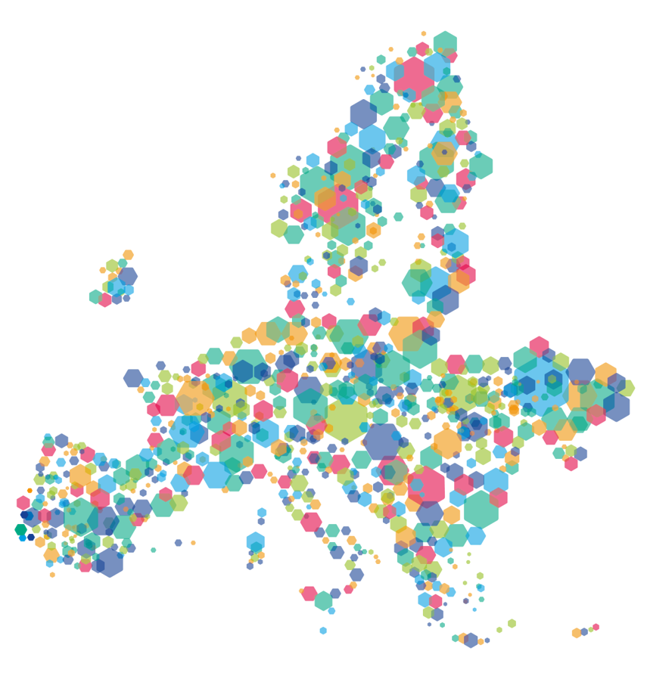
This project is implemented in the framework of the Interreg Europe programme and co-financed by the European Union.
www.interregeurope.eu
Notes:
Remember to include this slide!

