Slide 1


Kick off meeting
LP - SIPRO presentation
Giada Spadoni – project officer
giada.spadoni@siproferrara.com
11 MAY 2023| Ferrara

Slide 2

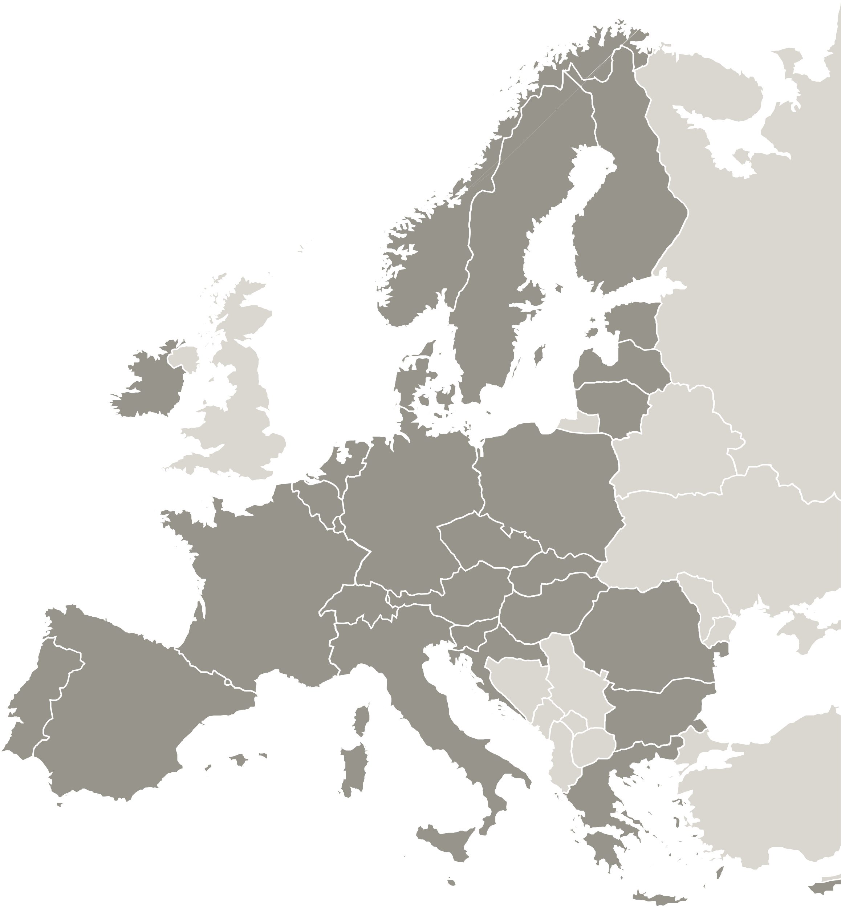

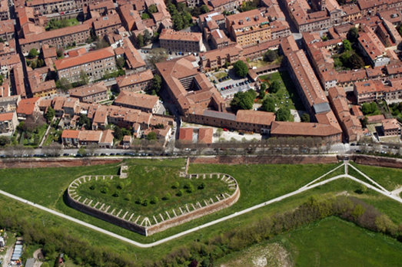
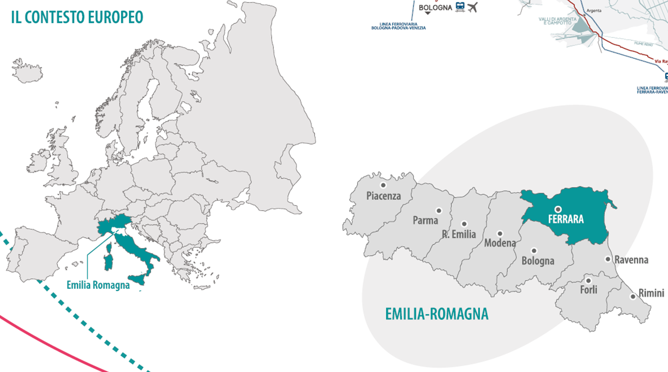
Where is Sipro?
Ferrara, City of Renaissance and UNESCO World Heritage, is strategically located in the Eastern Europe, well linked also to the South and to the North of the continent through the Adriatic corridor
The district of Ferrara is the hinge between the Adriatic Basin and the Emilia-Romagna Region, leader for its high quality investments and for its actions against climate change and improvement of environmental sustainability.

Slide 3
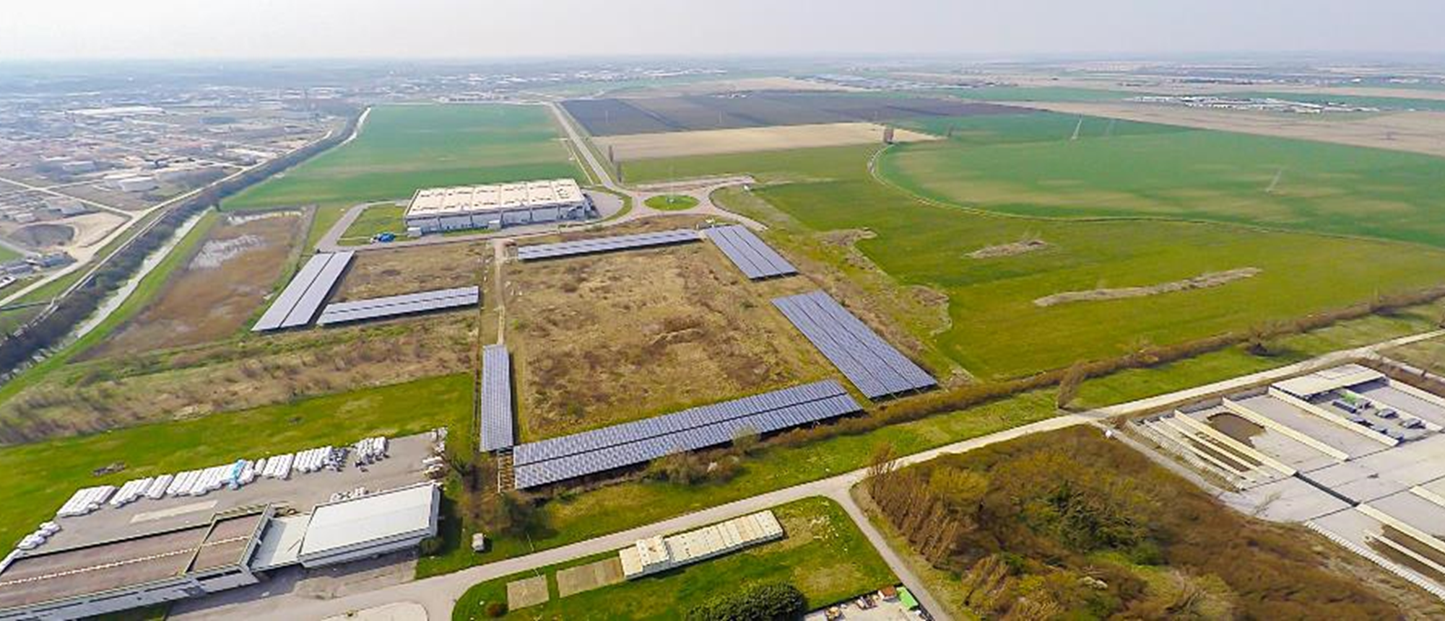
About Sipro
S.I.PRO. - Società Interventi PROduttivi, was set up on November 17th 1975 and in 1999 it was renamed SIPRO Agenzia Provinciale per lo Sviluppo SpA (Ferrara Development Agency)
Active since more than 45 years for the economic development of the Emilia Romagna Region and related territories
The Agency deals with the promotion of sustainable development for its shareholders, in particular all the Municipalities of the area and the Province Authority as well.

Slide 4

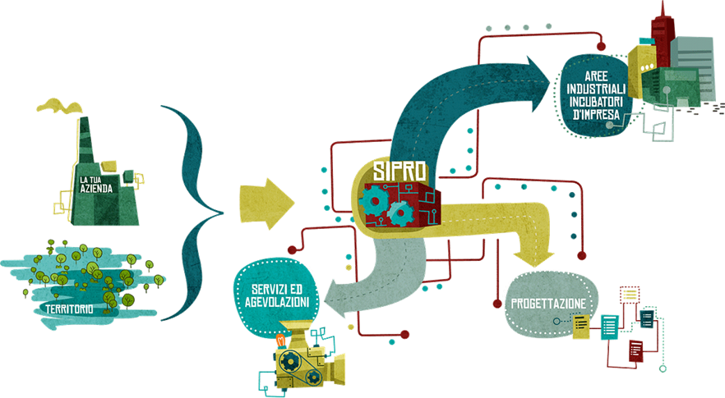
About Sipro
From 2001 it is the main referent for the territory for the management of European Funds and the planning of targeted initiatives
Since 2010 it’s active in several European networks for cooperation and has been working at energy related issues, at the beginning addressed to enterprises and industrial sites, then as operative body acting on behalf of some Municipalities
SIPRO is currently involved in technical working groups and Climate Alliance about energy management within Public Administrations and in the technical tables of the provincial council of the economy for REC and energy solutions for local development

Slide 5
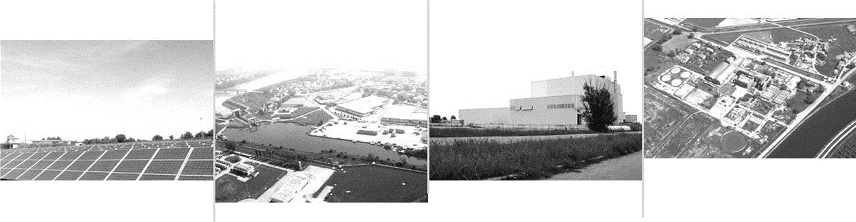
What we do
At present the activities are mainly focused on the following areas:
Sustainability, green economy and enhancement of tourism heritage (EU funds):
Specific measures and solutions for green energy, intermodal mobility, smart and sustainable solutions for PA
Actions aimed at promoting the cultural and natural heritage, even less known, through the enhancement of the uniqueness of the territory and secondary tourist routes
Investment attraction:
Opening up to new markets to encourage exchange and dialogue between countries
Promotion of the territorial systems of the province of Ferrara by networking with the local stakeholders
Valorization of territorial specificities with high impact projects, redevelopment and territorial marketing activities for industrial areas

Slide 6

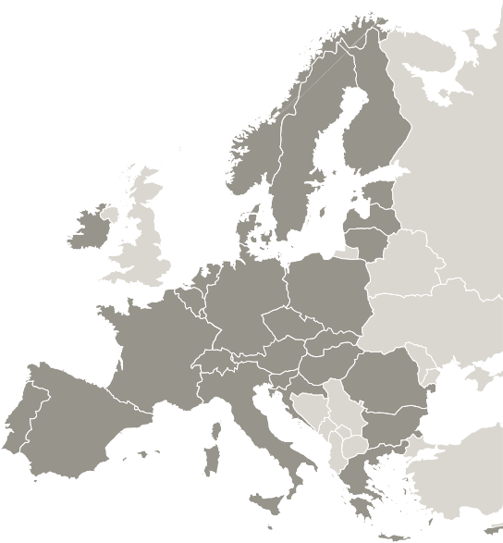
Activities
Focus on renewable energies and energy efficiency
In 2010 SIPRO was appointed as Manager of «Ecologically and Environmentally Equipped Industrial sites» by the Emilia Romagna Region
Renewable Energy
photovoltaic systems management
Energy efficiency for business
analysis and action plan for reducing energy consumption;
Energy efficiency for public entities
analysis and action plans outline for the reduction of energy consumption;
SEAP and SECAP for the Terre Estensi Association (Municipalities of Ferrara, Voghiera, Masi Torello)
corporate energy audit
setting up of 6 photovoltaic plants (overall 3,3 MWp) within industrial estates;

Slide 7
Activities
EU projects
SIPRO has 15 years of experience in EU funded projects, both in terms of management coordination as well as implementation, test and knowledge transfer.
The projects in which SIPRO is involved must:
Aim at the enhancement of the local economy;
Have a clear impact on the territory;
Enable SIPRO to implement tools tailor-made to local enterprises needs.
The topics in which SIPRO acquired extensive experience are: energy efficiency, green mobility and innovative solutions, often supporting the public administration in the development of sustainable policies.

Slide 8





Activities
The latest EU projects on sustainability
The most recent projects dealing with energy efficiency, RES and smart solutions for sustainability:
-LP of the Interreg CE – CitiEnGov: improve a better management of sustainable energy (energy efficiency and renewable energy) and climate change mitigation amongst public administration in Central EU
-LP of the Interreg MED - Green Mind: support SMEs in exploiting the market opportunities for green & smart mobility products and services in MED area
-PP of the LIFE – Iris: support SMEs in becoming more resilient to climate change through implementation of climate adaption plans
-PP of the INTERREG CE TARGET-CE : capitalizing and exploiting energy efficiency solutions throughout cooperation in Central European cities
-PP of the UIA – Air Break: improve air quality in Ferrara through innovative actions on clean commuting and sustainable mobility and the involvement of citizens and stakeholders of the territory
-PP of the Horizon2020 – USAGE: provide solutions to make available environmental and climate data at city level

Slide 9




What we want to achieve?
Tackle energy poverty and climate change through awareness-raising actions for citizens and policy makers on renewable energies
Inform on actions and measures to support and promote collective consumption and energy communities, as instruments to reduce energy costs
Disseminate and share best practices, experiences exchanges
How? Active collaboration
with stakeholders
Trade
associations,
public services providers
Education
and training organisations (University)
Regional development agencies, enterprises
Local authorities (municipalities, province)

Slide 10



Sipro team for LEEWAY
Giada Spadoni
Luca Bianchi/Anna Fregnan
Project and policy officer
Claudia Marzola
Communication officers
Giulia Righetti (external expert)
Financial
officer
Coordinator

Slide 11
Thank you!
Giada Spadoni – Project and Policy Officer
giada.spadoni@siproferrara.com

