Slide 1
KEY FACTS ABOUT
NEBA
Get to know the project!

Slide 2
Supporting the integration of New European Bauhaus values and principles into the regional planning processes

Slide 3
NEBA at a glance
Empowering regions with enriching, sustainable, and inclusive territorial planning for a resilient future, inspired by New European Bauhaus.
NEBA aims to incorporate the values and principles of NEB into territorial planning processes to maximise benefits for local communities and the environment.
As the impacts of climate change become increasingly evident, there is a growing imperative not only to devise environmentally friendly technological solutions but also to ensure the active involvement of citizens and communities in addressing these challenges, thereby promoting social justice and fostering local participation in addressing global issues.
TOTAL
1.649 M EUR

Slide 4
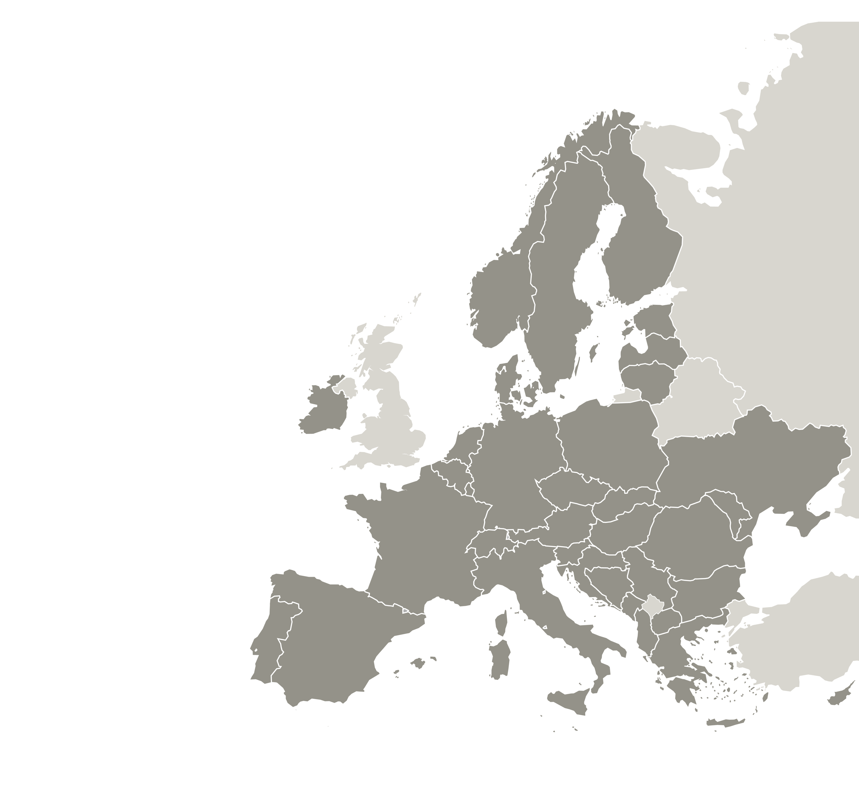
PARTNERSHIP
LEAD PARTNER:
🇱🇹 LITHUANIAN INNOVATION CENTRE
PARTNERS:
🇮🇹 CITY OF TURIN
🇧🇬 STARA ZAGORA MUNICIPALITY
🇳🇴 ELVERUM MUNICIPALITY
🇮🇹 UNIVERSITY OF TURIN
🇱🇹 PANEVĖŽYS CITY MUNICIPALITY ADMINISTRATION
🇧🇪 CITY OF GEEL
🇮🇪 GALWAY CITY COUNCIL

Slide 5
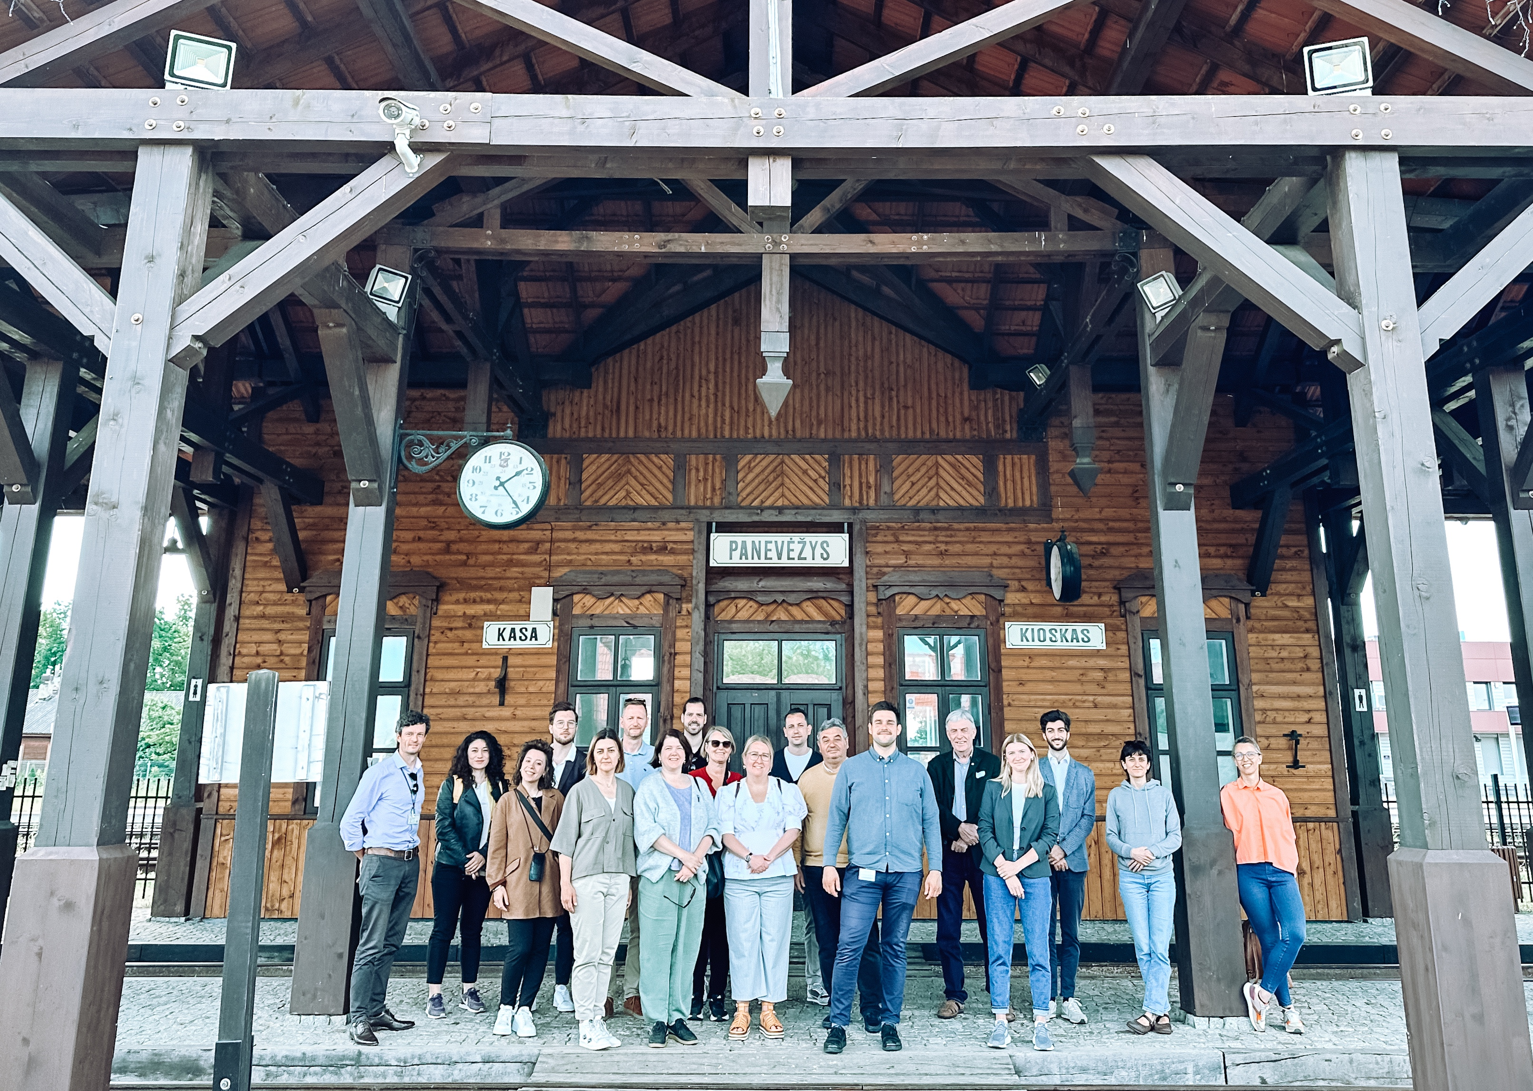
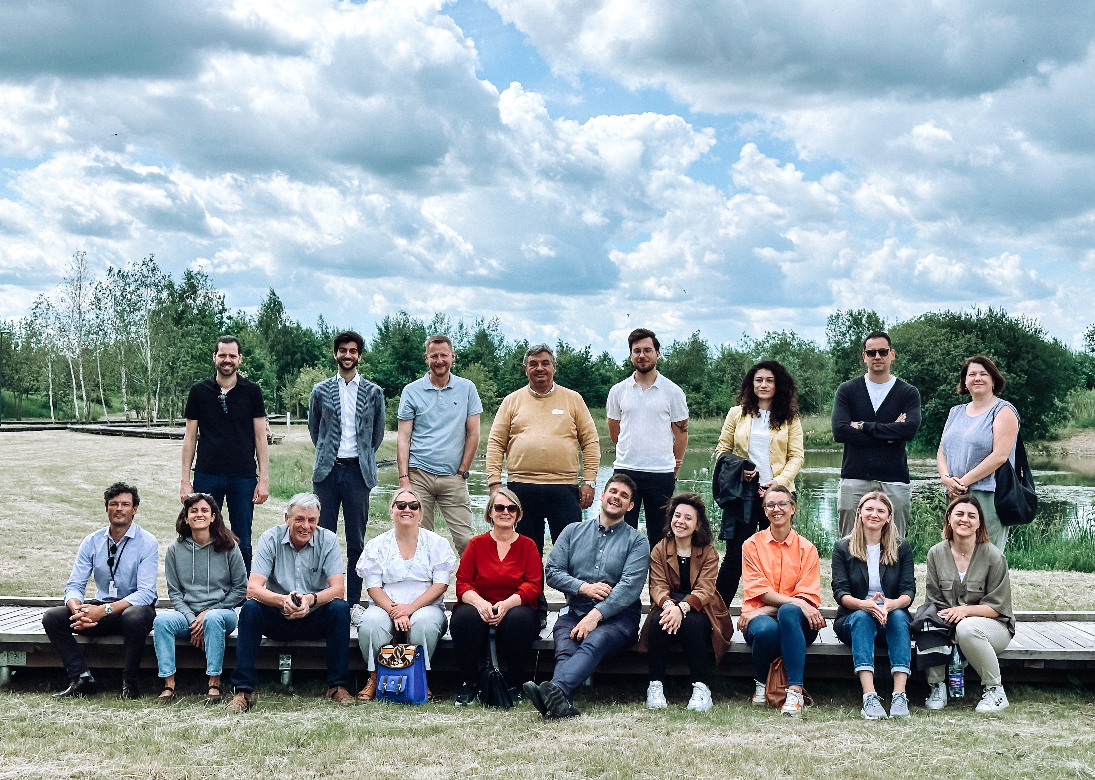
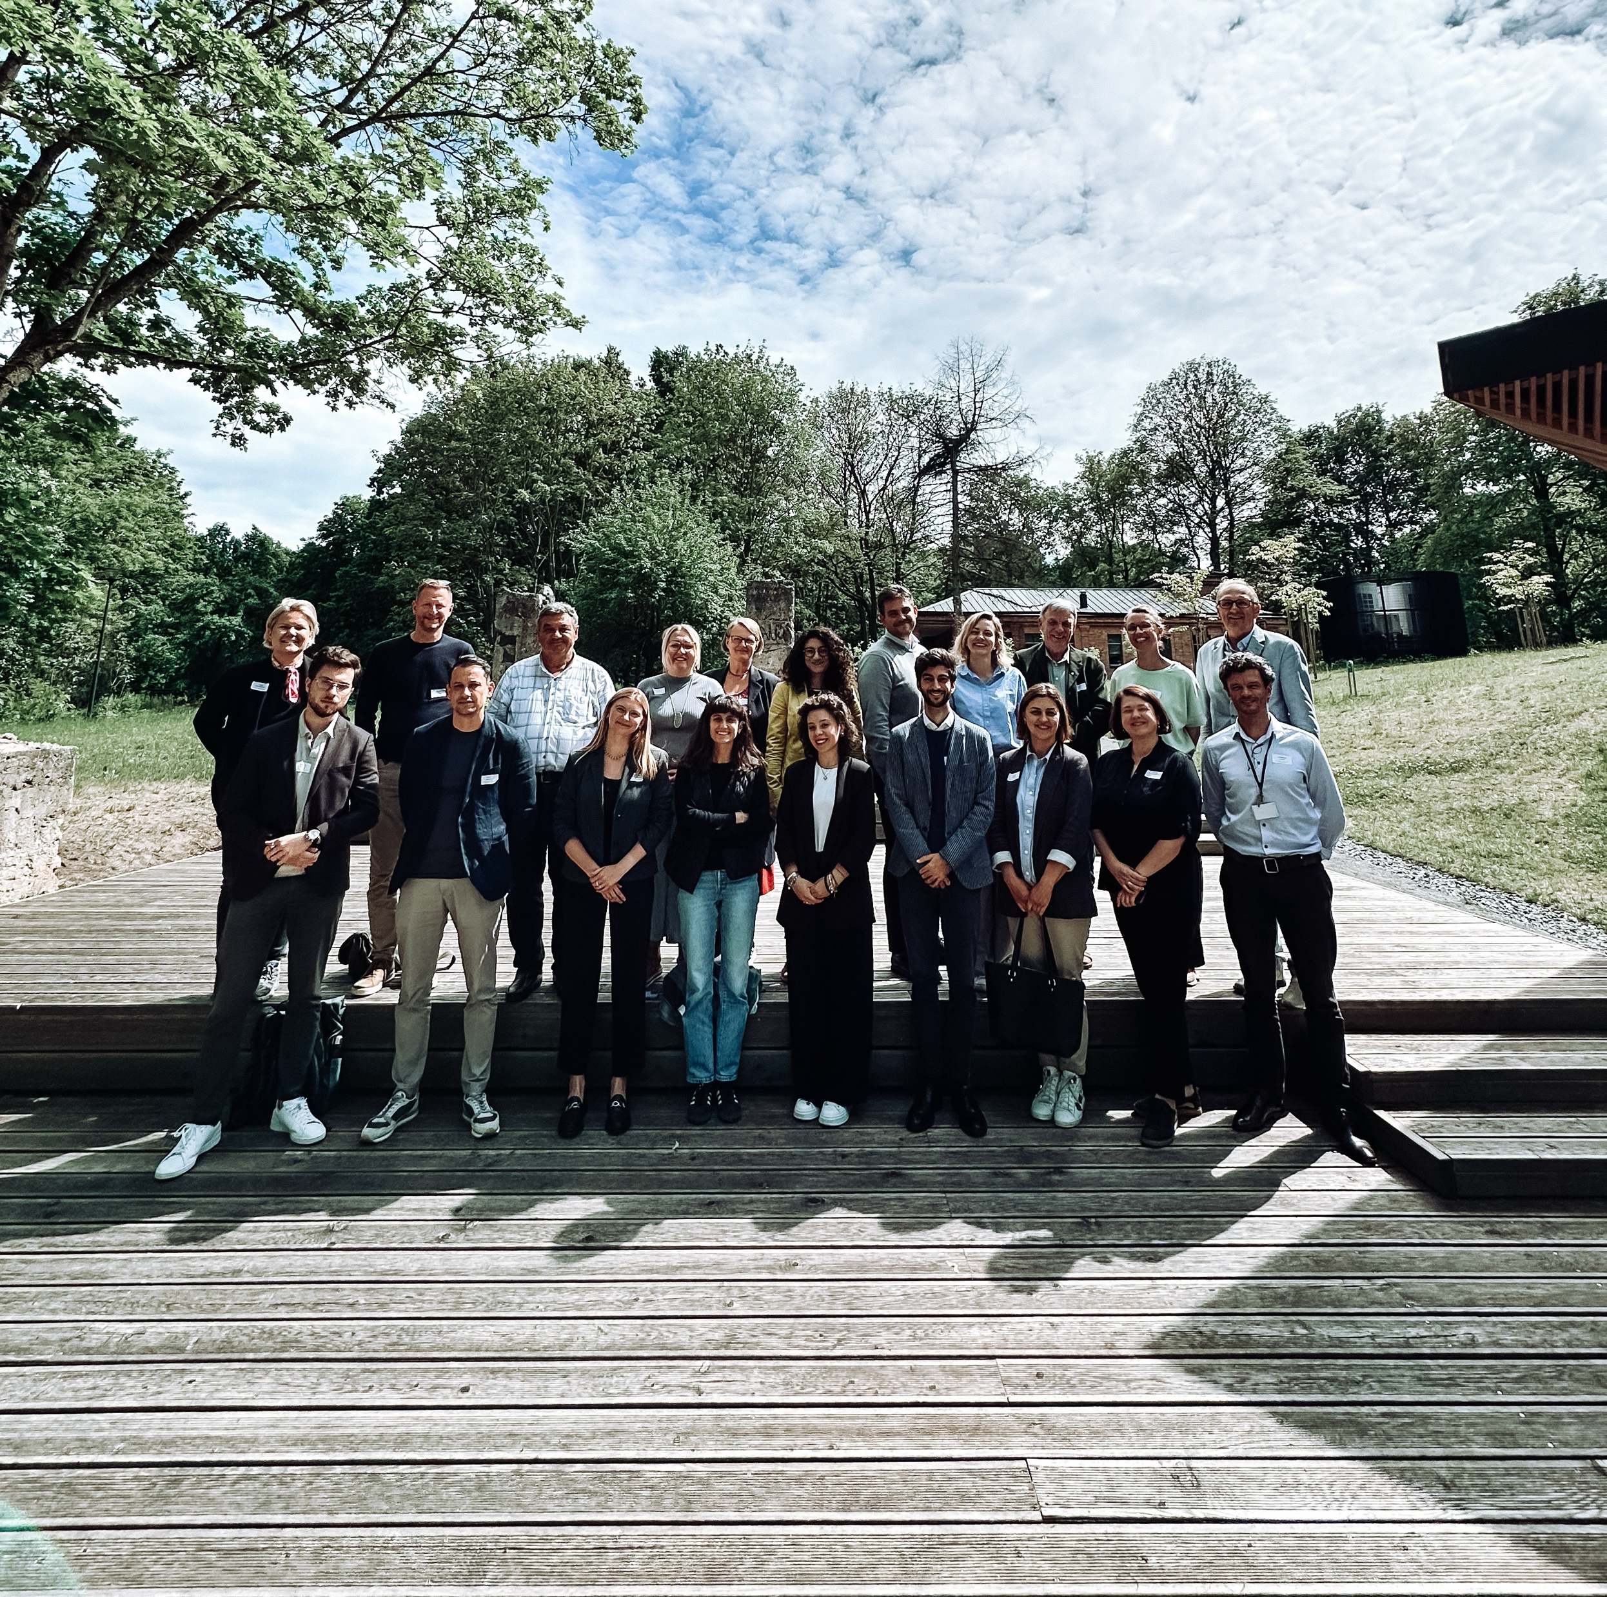
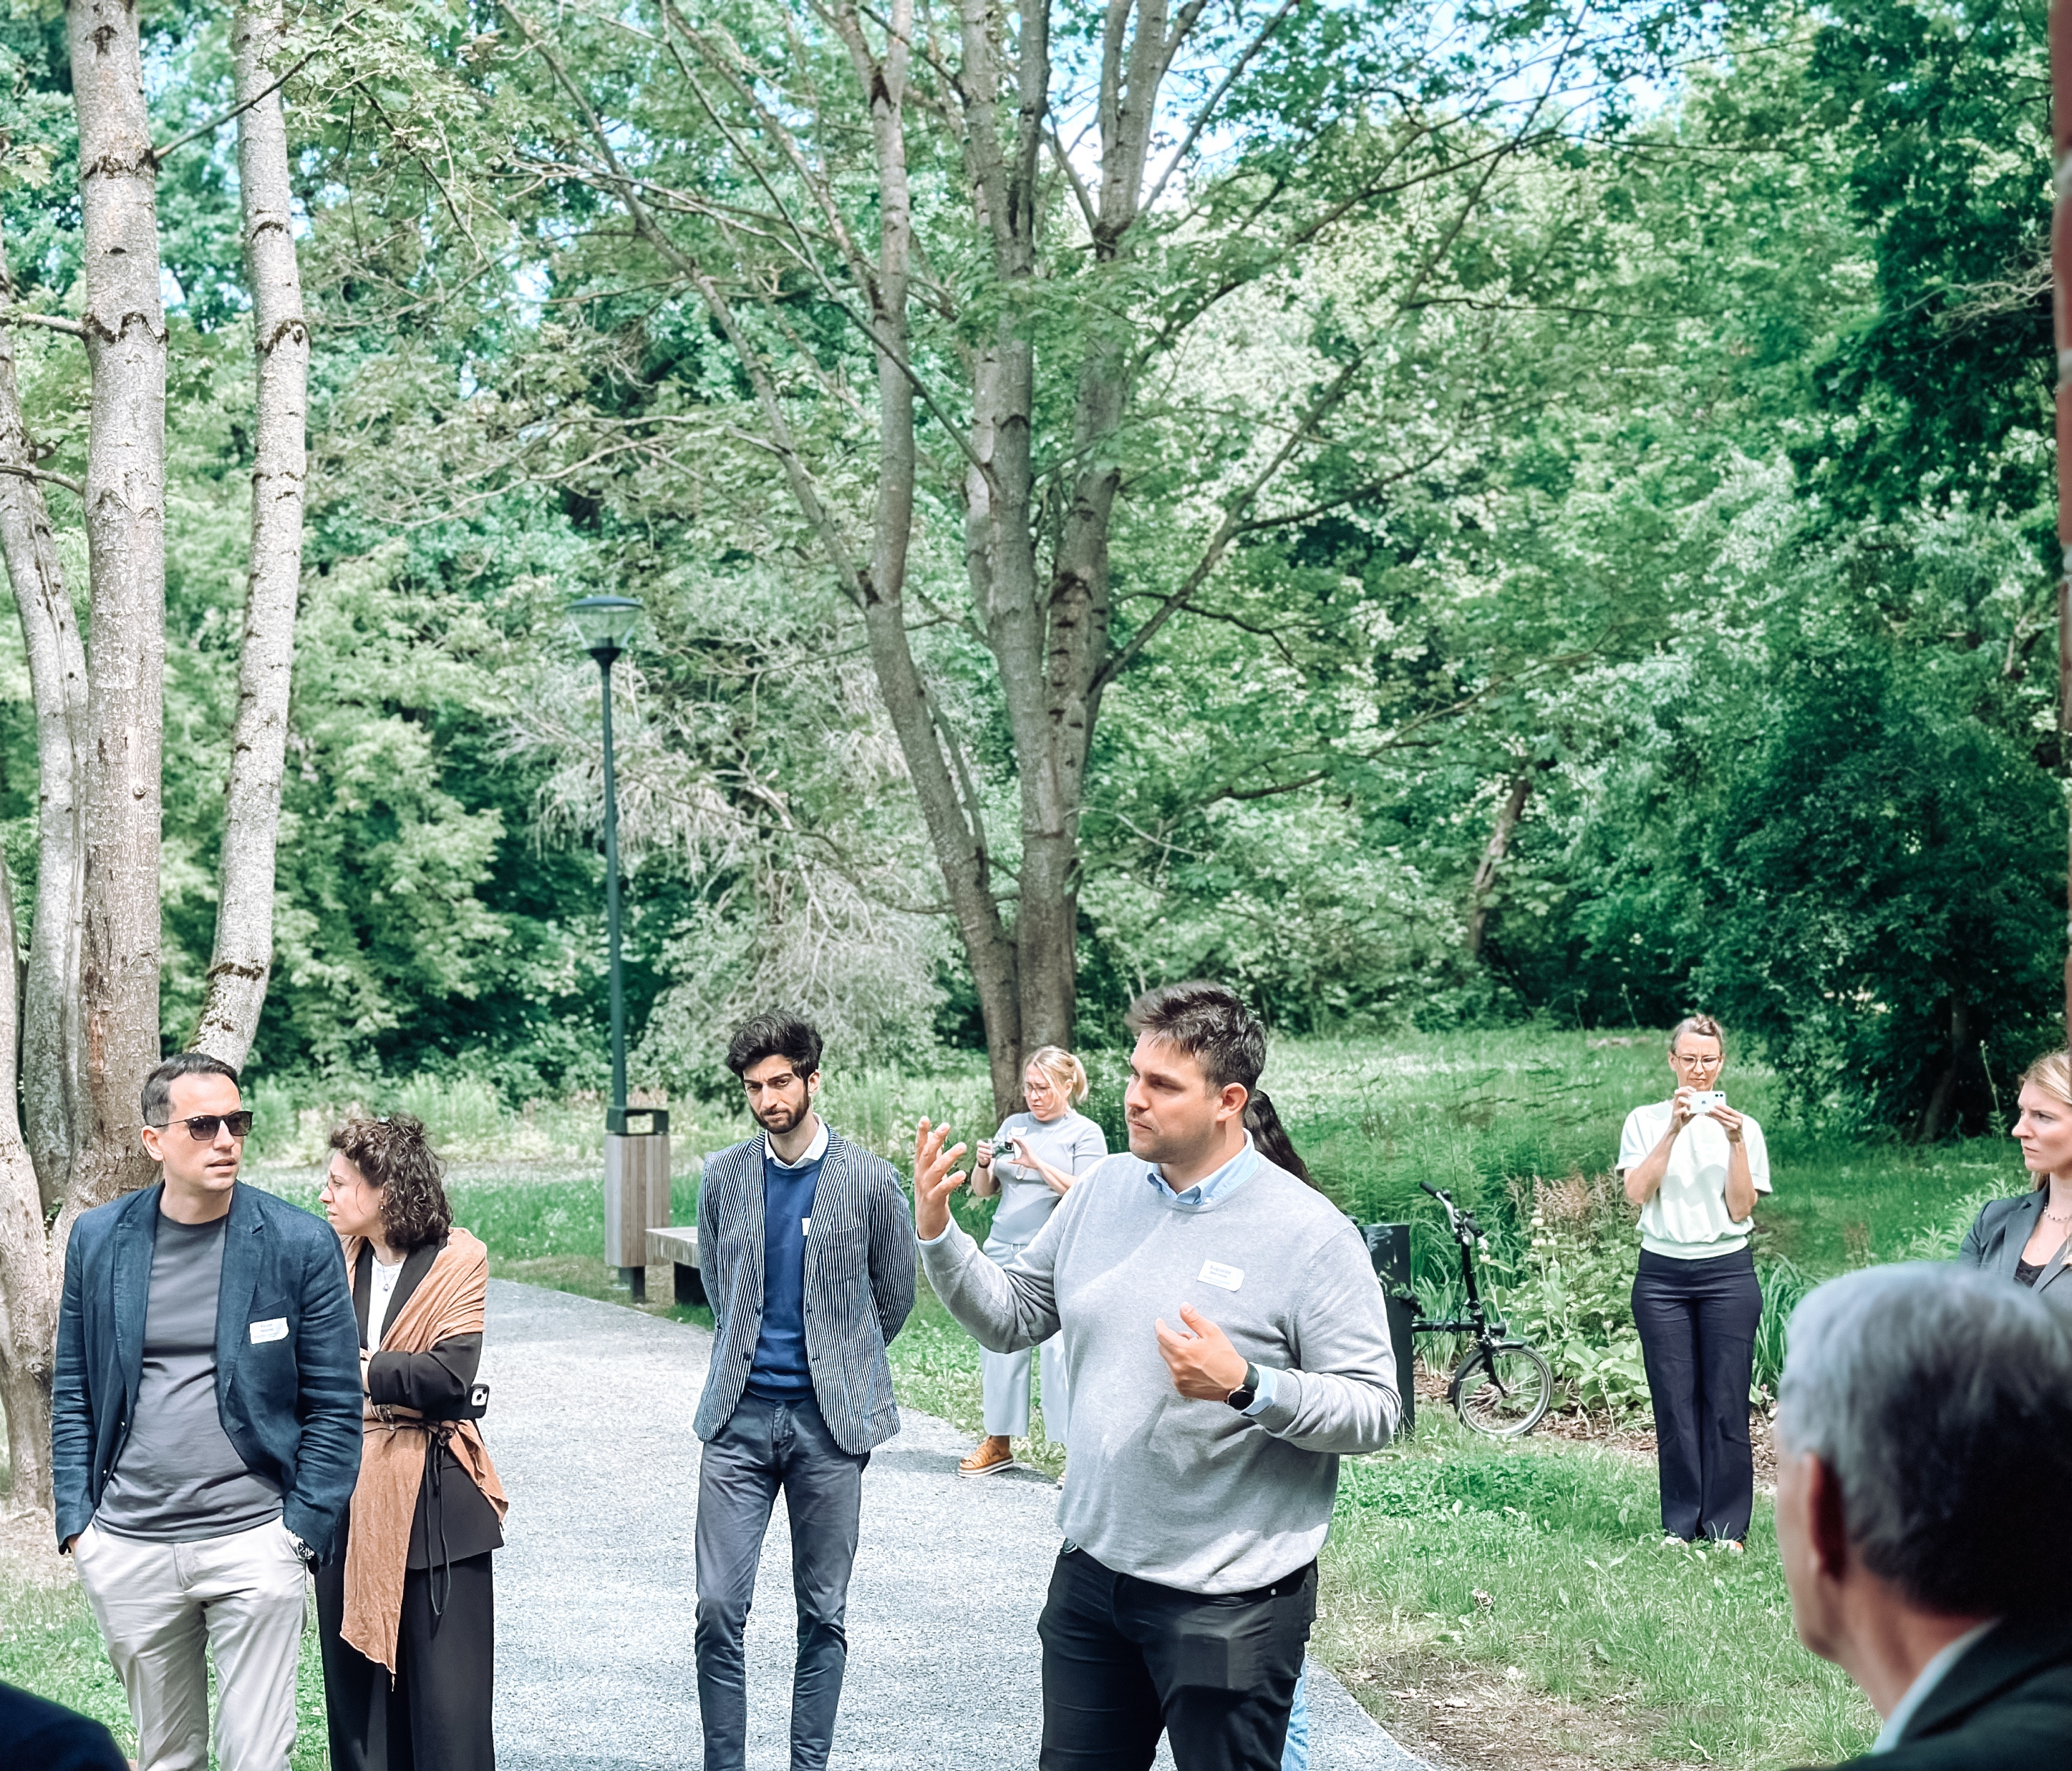
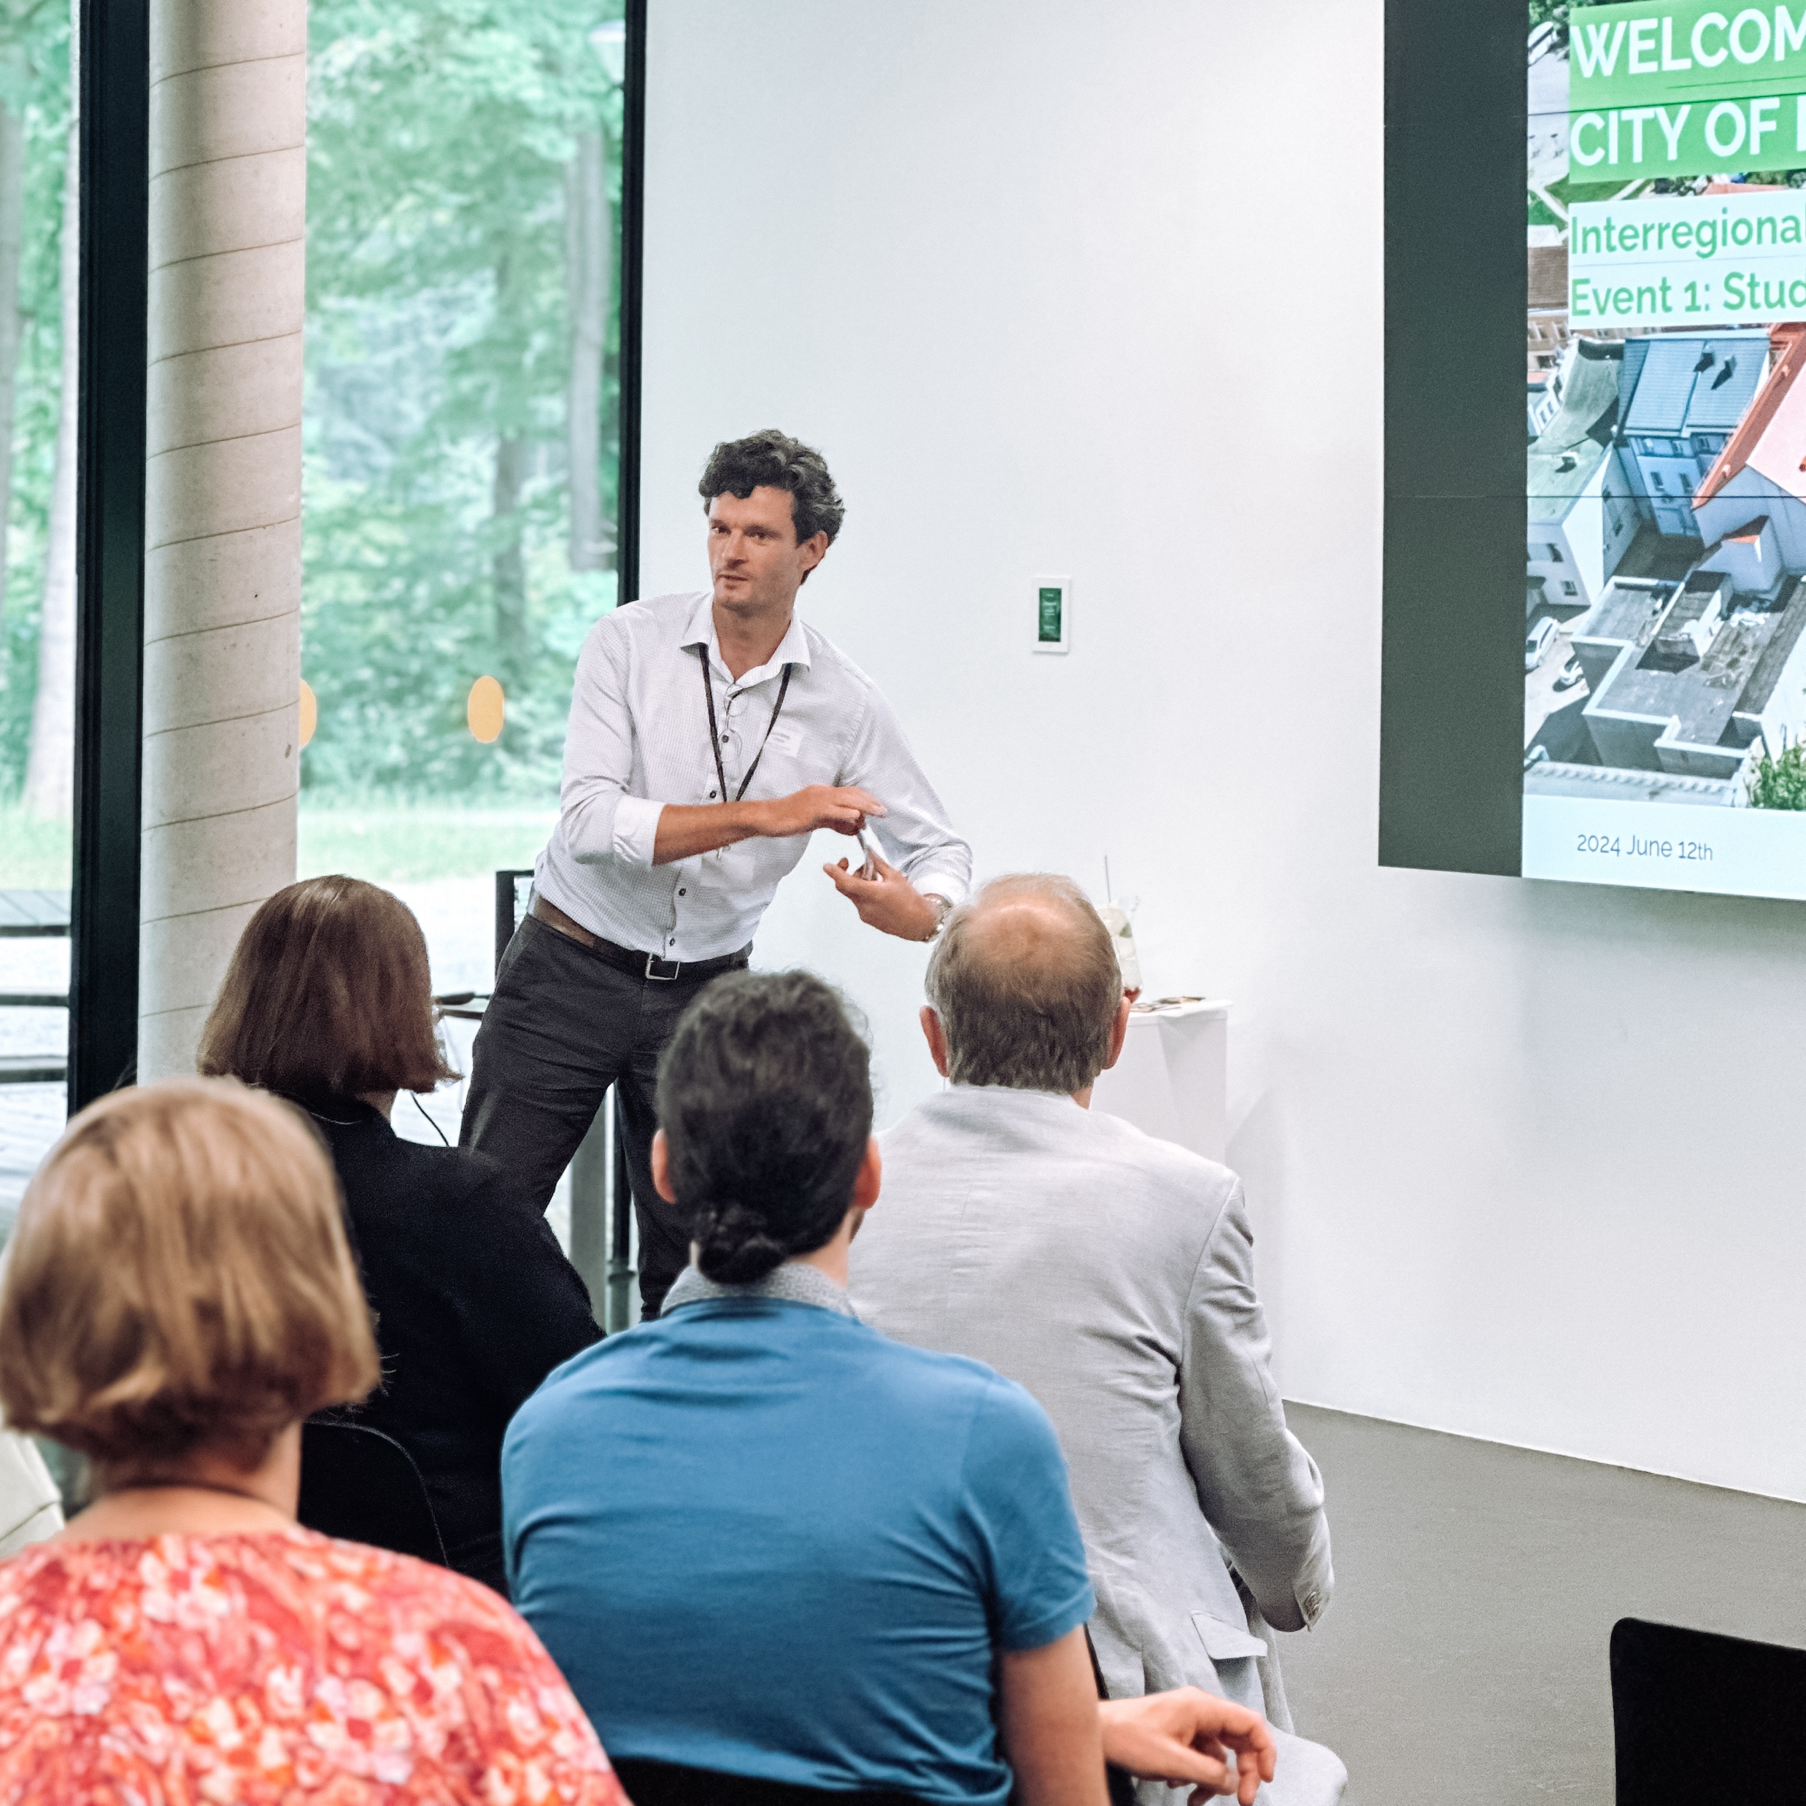
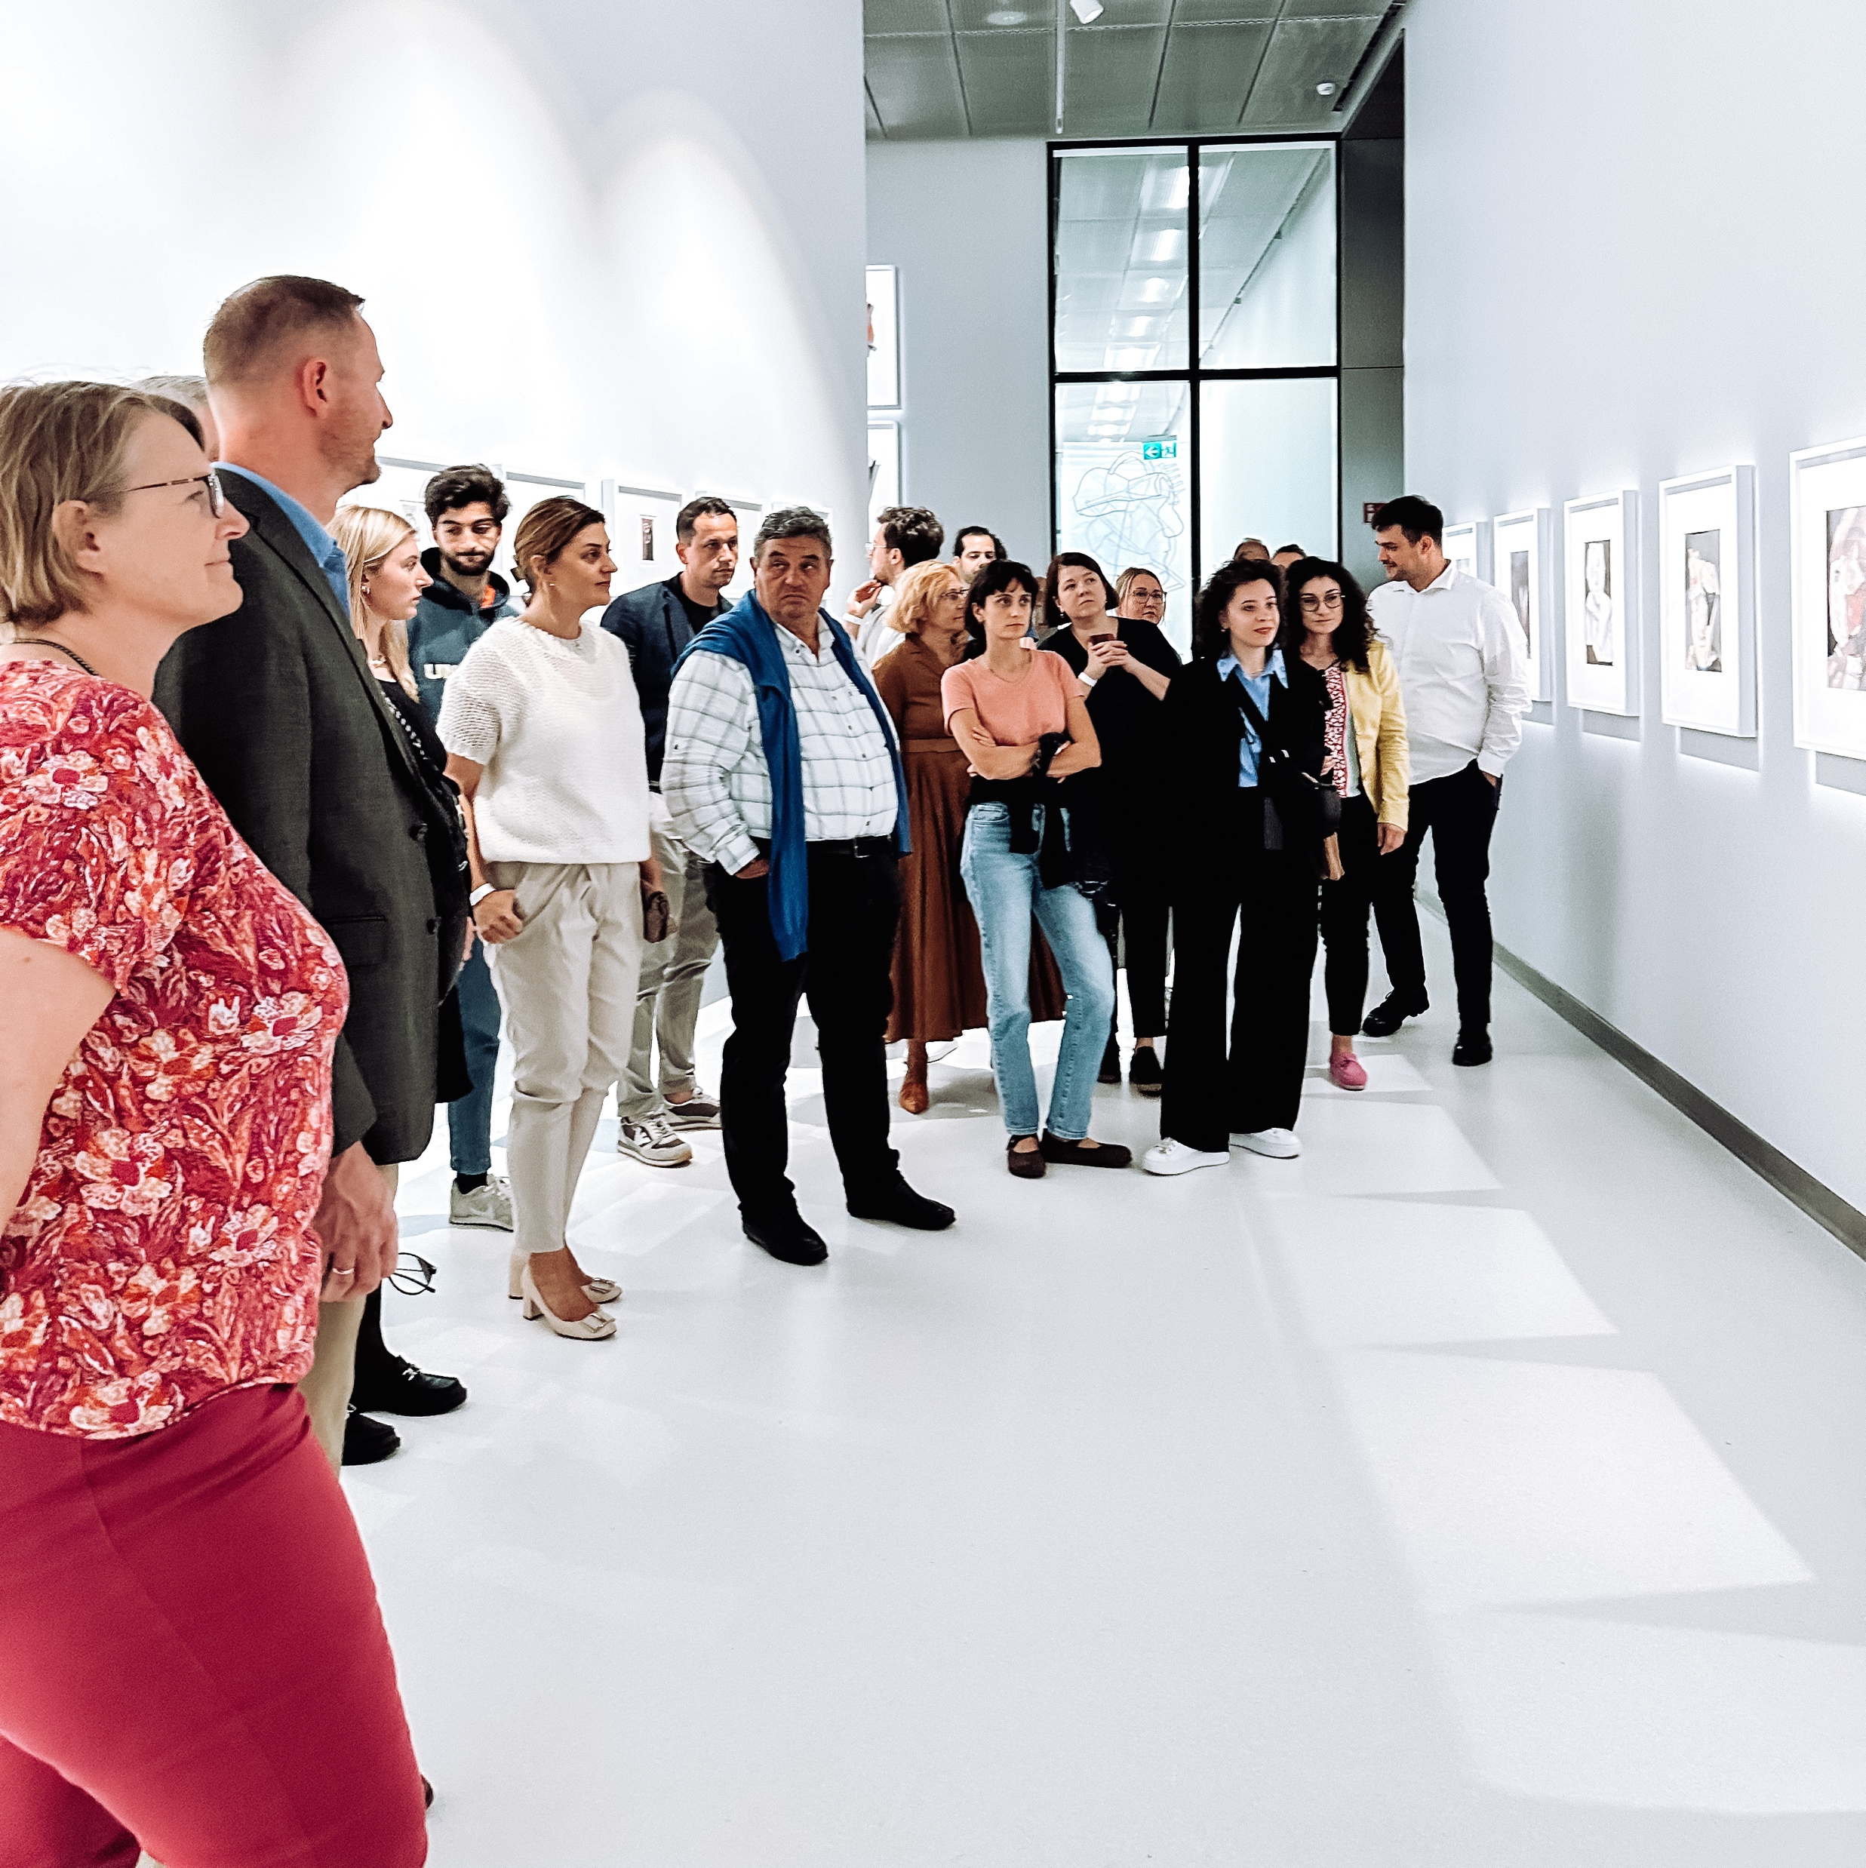
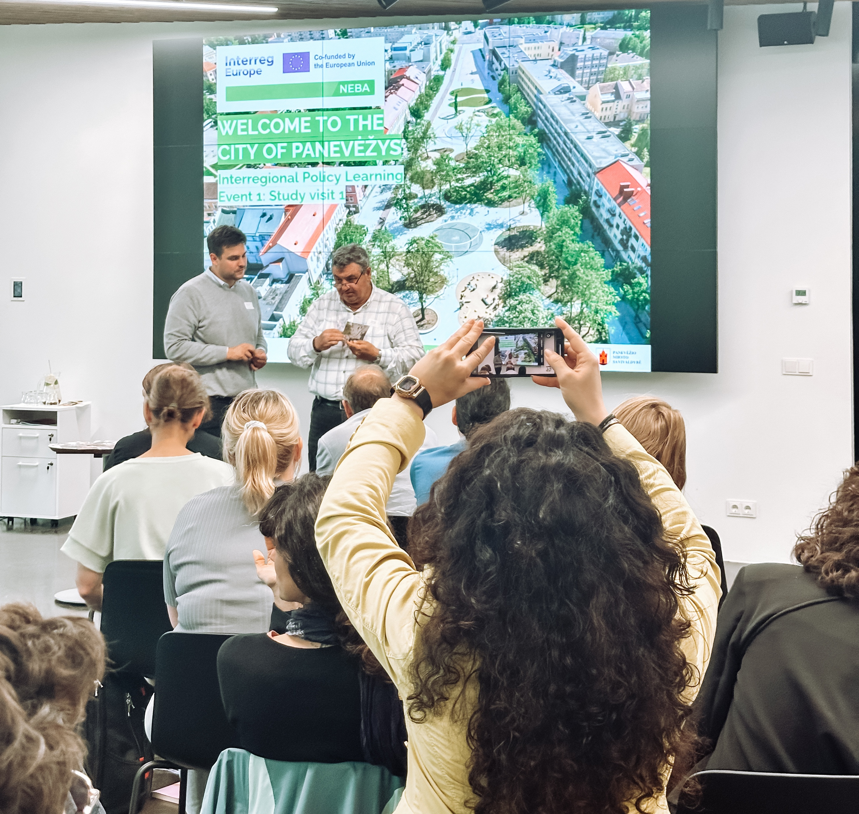
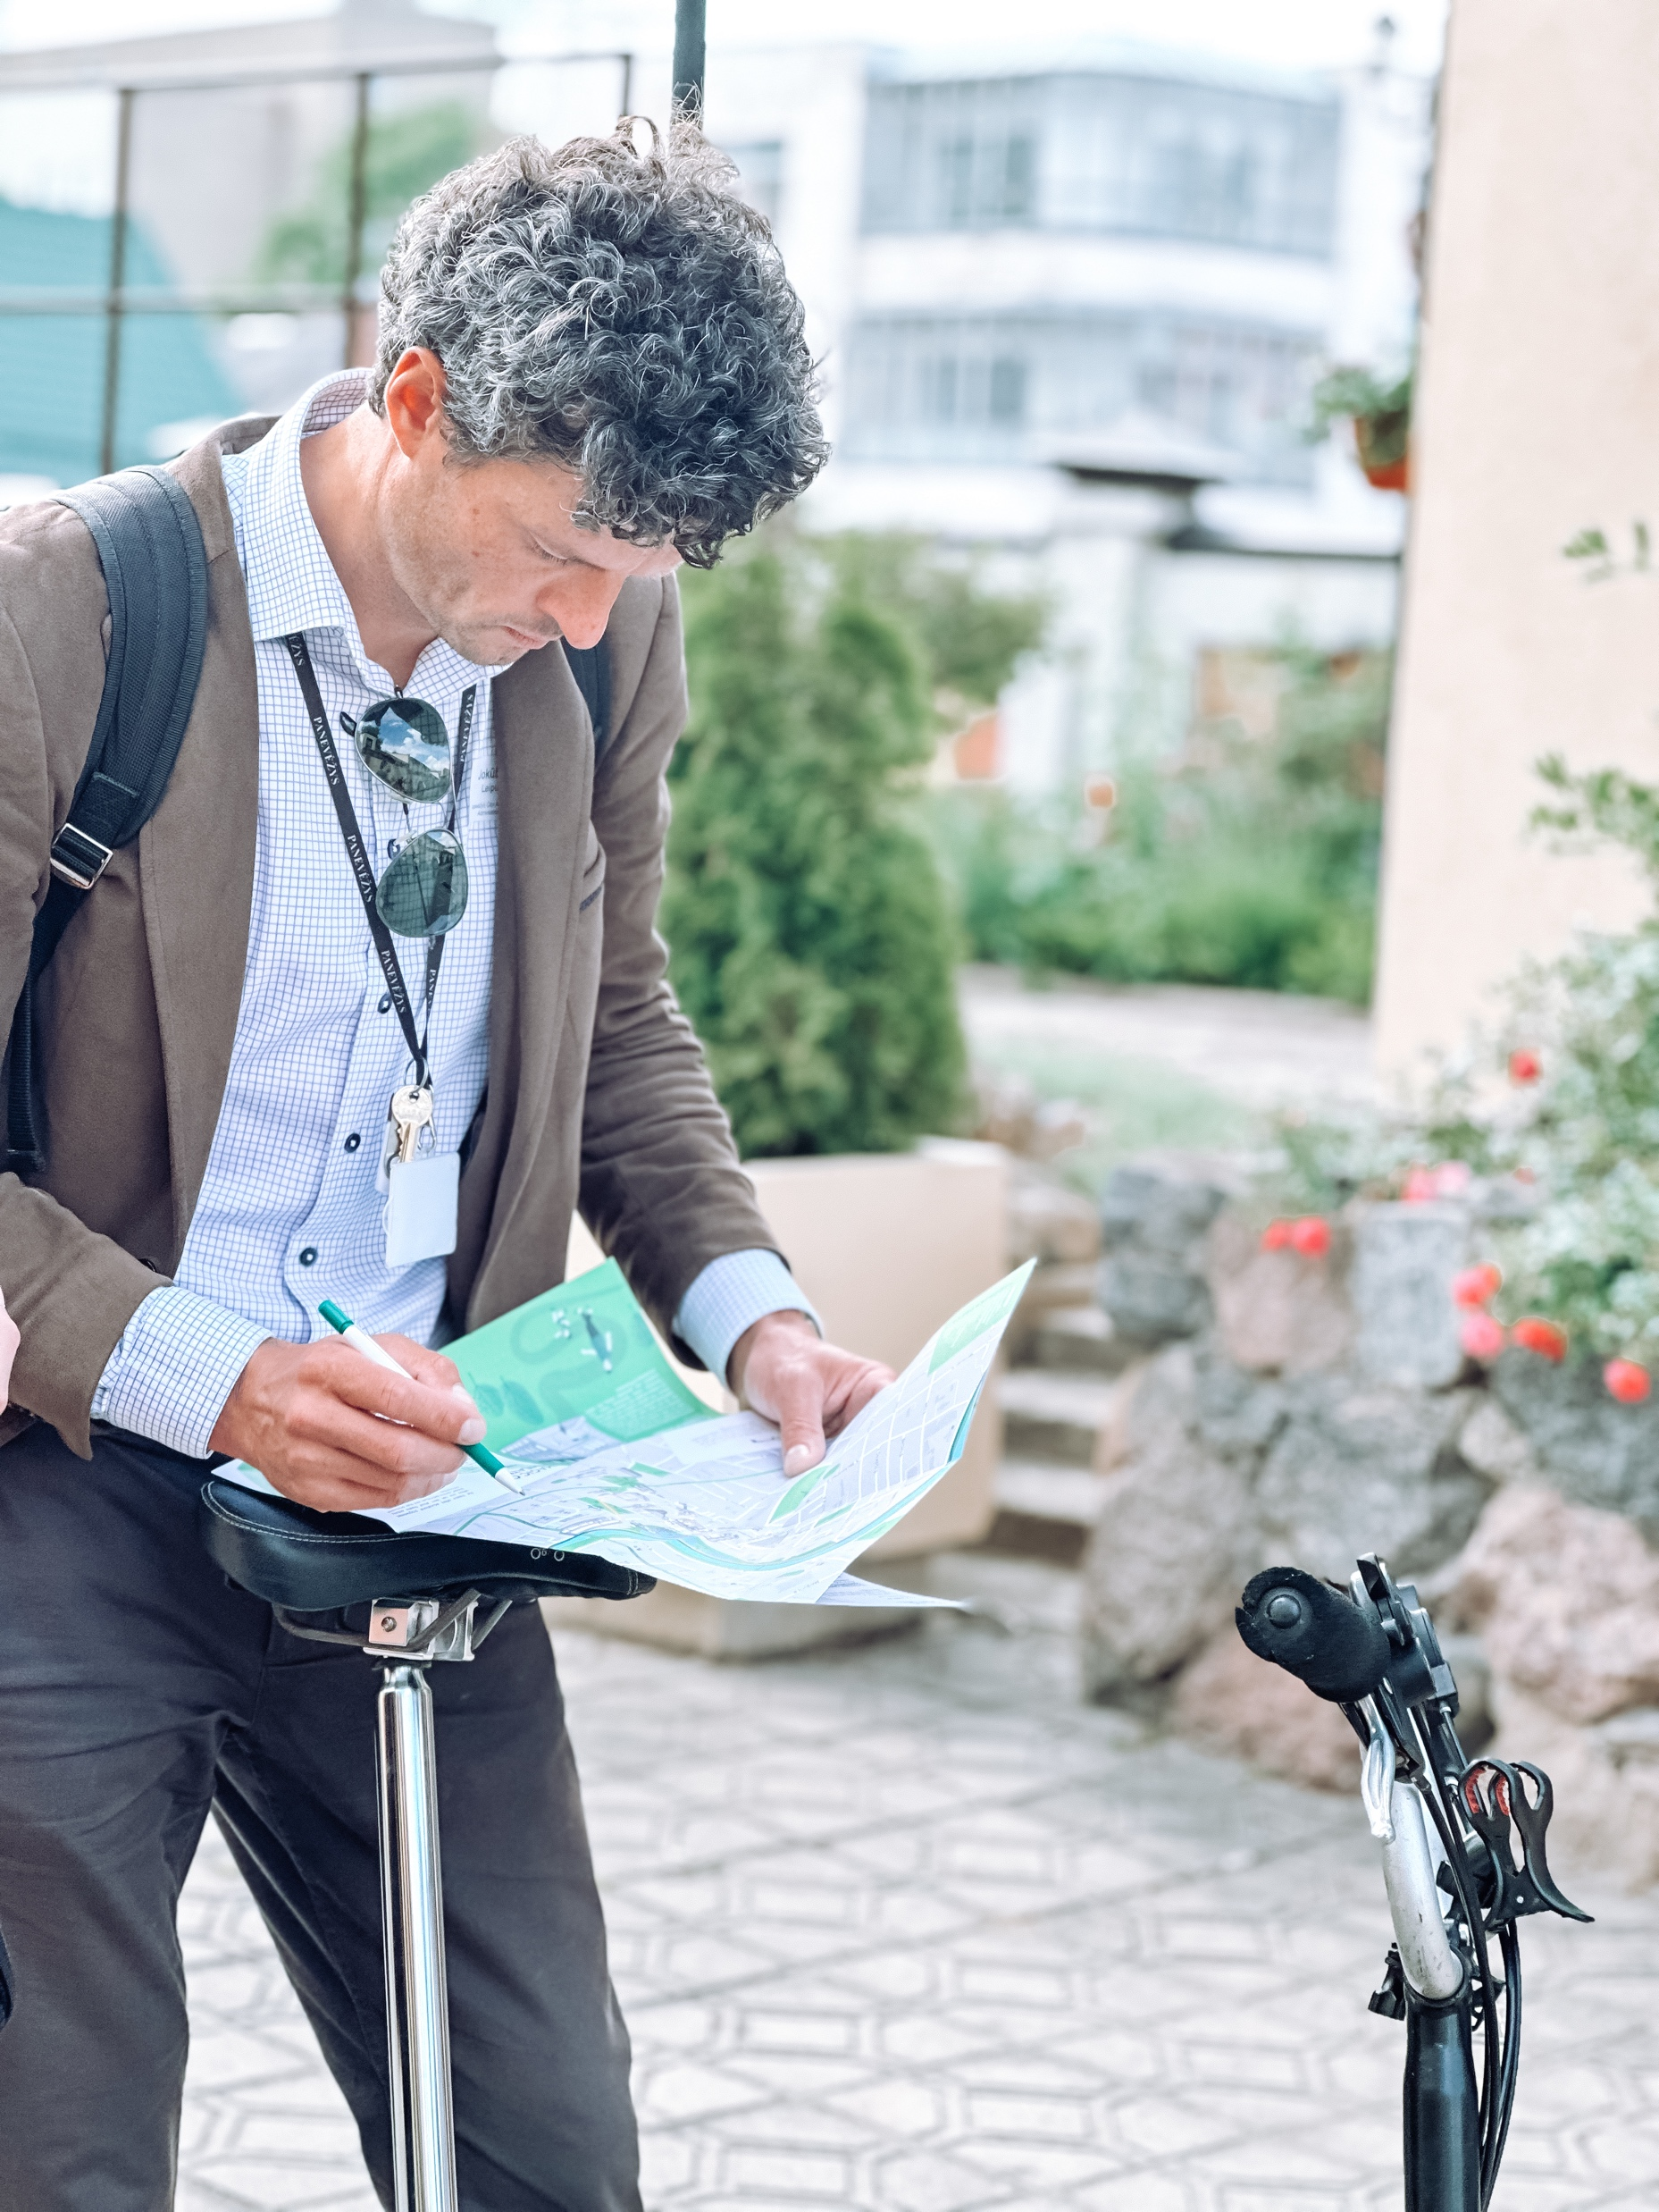
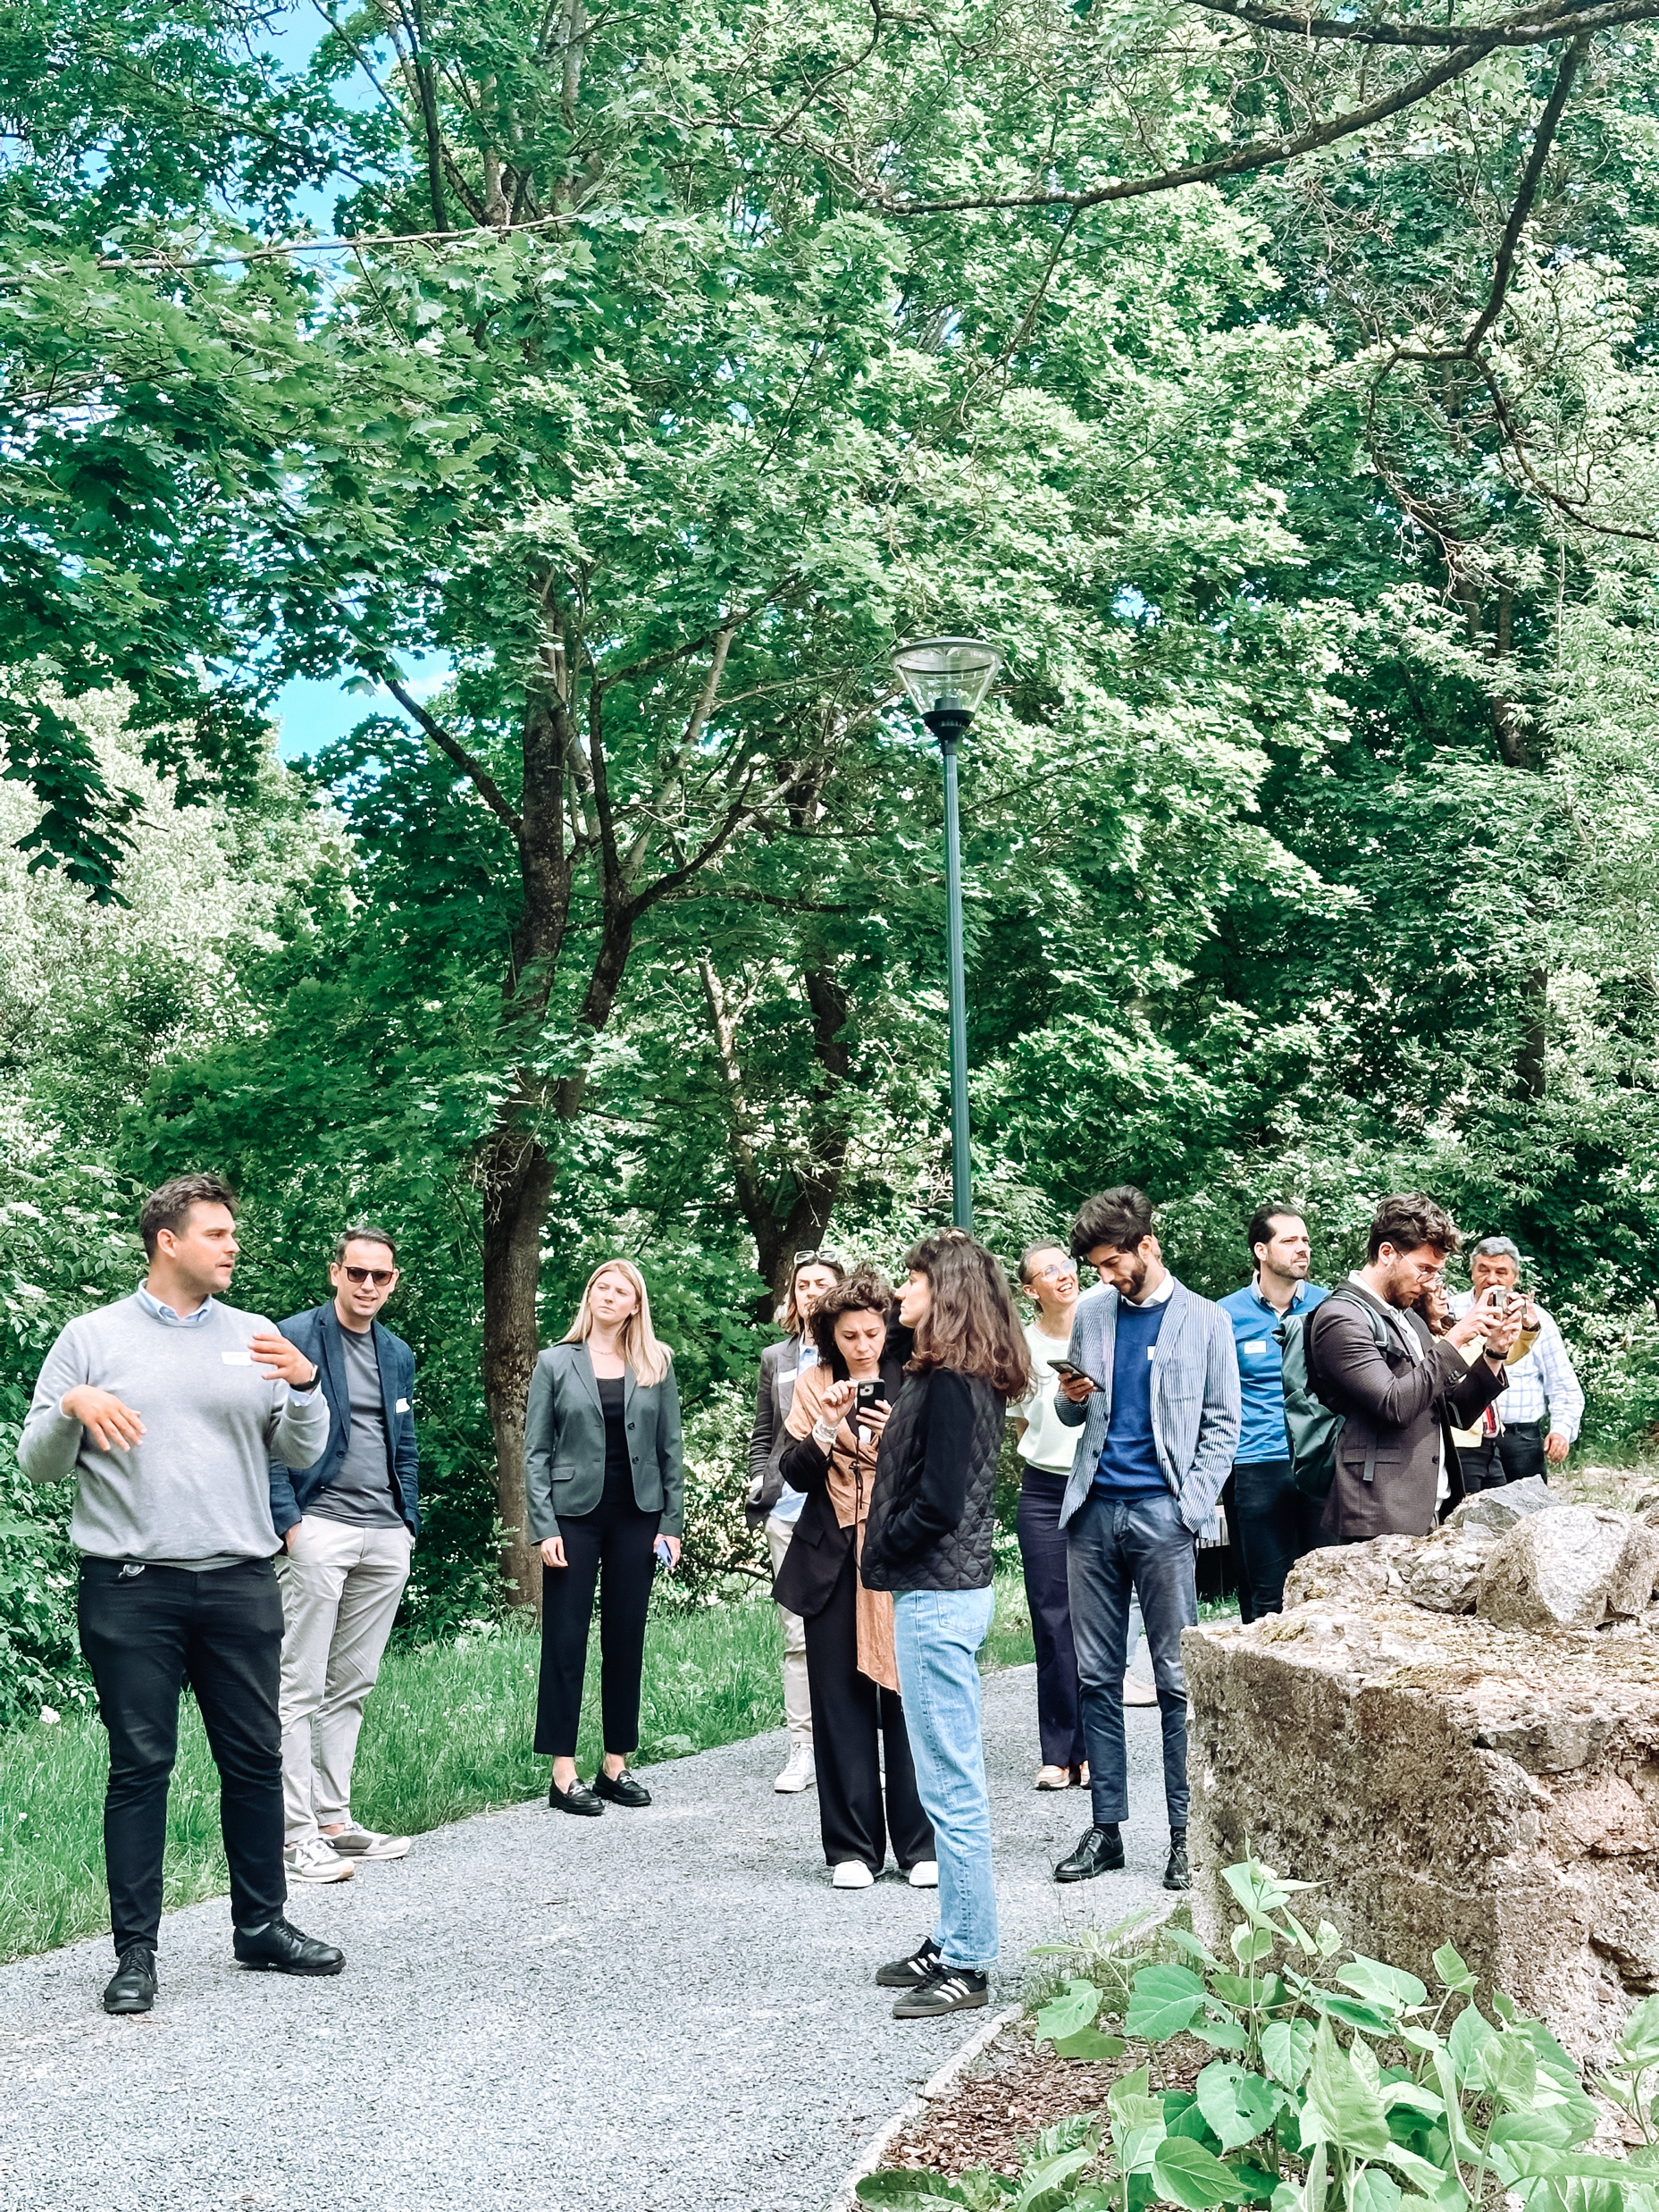
MEET THE TEAM

Slide 6
WHAT will NEBA change?
By bringing together regions with different experiences of NEB application and their unique local backgrounds, NEBA will explore the best practices and ensure interregional cooperation synergies in integrating NEB values and principles into regional planning processes.
NEBA will empower regions to rethink their territorial planning instruments and improve them so that new initiatives are enriching, sustainable and inclusive.
TOTAL
1.649 M EUR

Slide 8
Thank you!
Keen to learn more?
Find us online
www.interregeurope.eu/NEBA
https://www.linkedin.com/company/neba-new-european-bauhaus-initiative/

