Slide 1
About us!
Ferrara, May 2023

Slide 2
Marshal’s Office of the Silesian Voivodeship /
Regional Development and Transition Department /
Regional Innovation Strategy Unit
Marshal’s Office of the Silesian Voivodeship is a responsible body for the regional policy (formulates its strategic directions of the Region)
since 2007 Marshal’s Office of the Silesian Voivodeship is a Managing Authority and coordinates implementation of RIS3 and EU Funds (ERDF/ESF)
from over 15 years the Regional Innovation Strategy Unit is involved in implementing EU co-financed projects
since 2013 we are a Lead partner of the Network of Regional Specialized Observatories (jointly implementing partnership projects)
since 2017 we have been implementing international cooperation projects
since 2019 we cooperate with regions from Brazil (Minas Gerais, Paraná) implementing projects aimed at establishing cooperation between regional innovation ecosystems and exchanging experiences in the field of smart specializations

Slide 3
International cooperation – building internal capacities
Interreg Europe 2014-2020 Design4Innovation
40 Ready
InnoHEIs
LOTTI
Interreg Europe
2021-2027
SO RIS in EDP – 2nd edition
ROP 2014-2020
Cooperation with Brasil
IUC LAC / IURC
LEEWAY
Interreg Europe
2021-2027
Notes:
2nd

Slide 4
Strong Silesian Ecosystem
The network of regional stakeholders is built on the strong potential of the regional ecosystem, made of leading institutions in the Silesia region.
The high quality of scientific institutions and research and development units as well as strong base of large, medium and small enterprises guarantee the creation of sustainable partnerships for innovation.

Slide 5
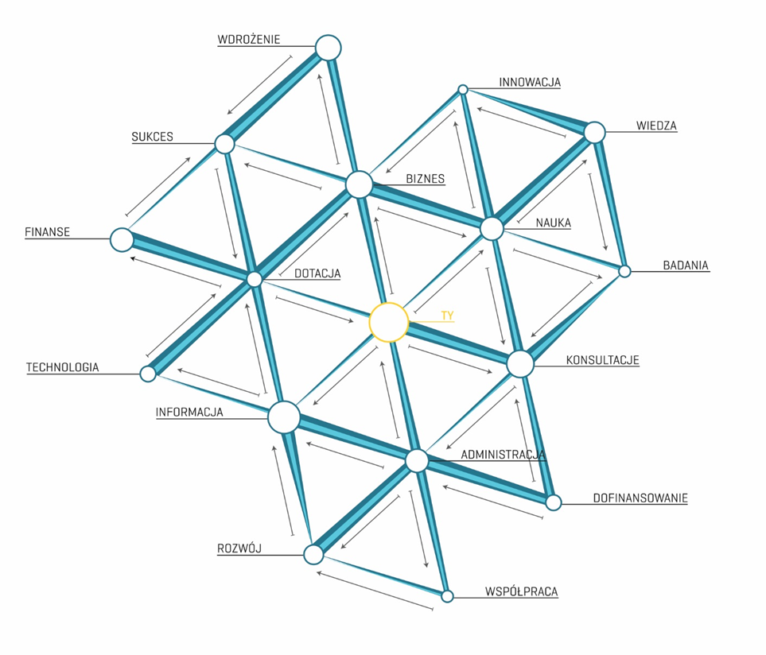
Network of Regional Specialized Observatories –
the cooperation network to support the Regional Innovation Strategy
Strong cooperation of Regional Partners in the Silesian Voivodeship inspired to create the 'Network of Regional Specialized Observatories’ – cooperation model supporting technological development of the region.
The Network has worked free of charge since 2013.
Cooperation network between local authorities, business support organizations, the R&D sector and business based on technological specializations diagnosed in the Technological Development Programme for Silesia Voivodeship (2010-2020, 2019-2030)
It’s main aim is to monitor, measure and analyse areas of specialization, identify growth sectors of the economy, which may update regional smart specializations.

Slide 6
Network of Regional Specialized Observatories
Energy Observatory – Euro-Centrum Science and Technology Park
Medicine Observatory – partnership agreement between Upper Silesian Accelerator for Commercial Enterprises (the leader), Professor Zbigniew Religa Foundation of Cardiac Surgery Development, Institute of Medical Technology and Equipment in Zabrze ITAM, Silesian University of Technology, Medical University of Silesia
ICT Observatory –Technopark Gliwice Science and Technology Park
Environment Observatory – Central Mining Institute
Nano Observatory – partnership agreement between University of Silesia, Fundation of Nanotechnology and Nanoscience Support NANONET, Centre of Polymer and Carbon Materials Polish Academy of Science, Institute of Non-Ferrous Metals in Gliwice
Materials Observatory – partnership agreement between Silesian University of Technology, Institute of Non-Ferrous Metals in Gliwice
Aviation Observatory – Silesian Science and Technology Centre of Aviation Industry
Notes:
The Network is involved in identifying, monitoring and evaluating technological areas in order to diagnose potential of industry in each of the areas: medicine, ICT, energy, environment, nanotechnology, materials production and processing and aviation area.
The Observatories are able to observe trends and draw solid conclusions and recommendations for the future.
Thanks to involvement of Regional Partners the Silesian Government has got the recent data’s to prepare the programs which have got the biggest influence on market mechanism and create interventions via regional policy tools.
The activities carried out by Marshal’s Office of the Silesian Voivodeship related to implemented projects help SMEs to benefit more from the opportunities offered by the Single Market , promote the upgrading of skills in SMEs and all forms of innovation , enable SMEs to turn environmental challenges into opportunities and encourage and support SMEs to benefit from the growth of markets.

Slide 7
Smart Specializations
Energy
Medicine
Information and communication technologies
Emerging industries
Green economy

Slide 8
Expected results of cooperation
verify the existing policies regarding to renewable energy in Silesia
redefine and update the region's technological development directions (through the technological foresight within the project “The Network of the Regional Specialist Observatories in the Entrepreneurial Discovery Process in the Silesian Voivodeship” – 3rd edition)
increase the knowledge and competence of the units responsible for the implementation of the European Funds for Silesia Programme (in the scope of ESF and ERDF)
Notes:
The activities undertaken as part of the LEEWAY project will verify the existing policies regarding to renewable energy in Silesia. Thanks to the Observatory's activities (stakeholders in the project) in the field of energy and environmental protection and results of the technological foresight which is planned to undertake under the third edition of the project “The Network of the Regional Specialist Observatories in the Entrepreneurial Discovery Process in the Silesian Voivodeship”, it will be possible to redefine and update the region's technological development directions, and through this to update the European Funds for Silesia Programme.
The experience and new approaches gained through interregional cooperation in LEEWAY project will contribute to increasing the knowledge and competence of the units responsible for the implementation of the European Funds for Silesia Programme (in the scope of ESF and ERDF) and for defining continued improvements to the management of the policy instruments. This increased capacity can be used for the current programme, but also to better define future programmes.

Slide 9
Our stakeholders
Tauron – energy company
‘Technopark Gliwice’ Science and Technology Park
‘Euro-Centrum’ Science and Technology Park
Central Mining Institute Research Institute
Silesian University of Technology
University of Silesia in Katowice
University of Economics in Katowice
Institute for Ecology of Industrial Areas (IETU)
Silesian Centre for Entrepreneurship
Voivodship Labour Office in Katowice

Slide 10
Thank you for your attention
Barbara Szafir
Deputy Director of Regional Development and Transition Department
Marshal’s Office of the Silesian Voivodeship
barbara.szafir@slaskie.pl

