Slide 1
REVISION OF SECAP IN PRELOG
Kick-off Conference
Damijan Bermanec
Project coordinator, Town of Prelog
d.bermanec@prelog.hr
12 MAY 2023 | FERRARA

Slide 2
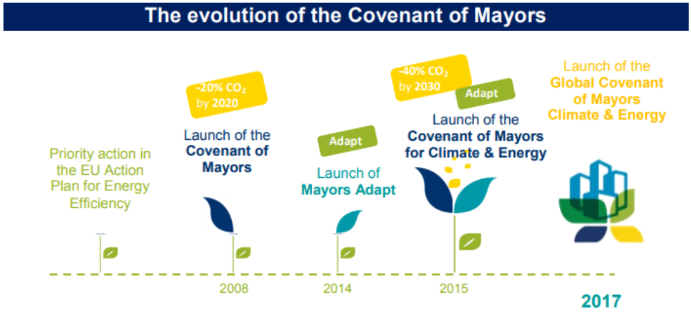
COVENANT OF MAYORS

Slide 3
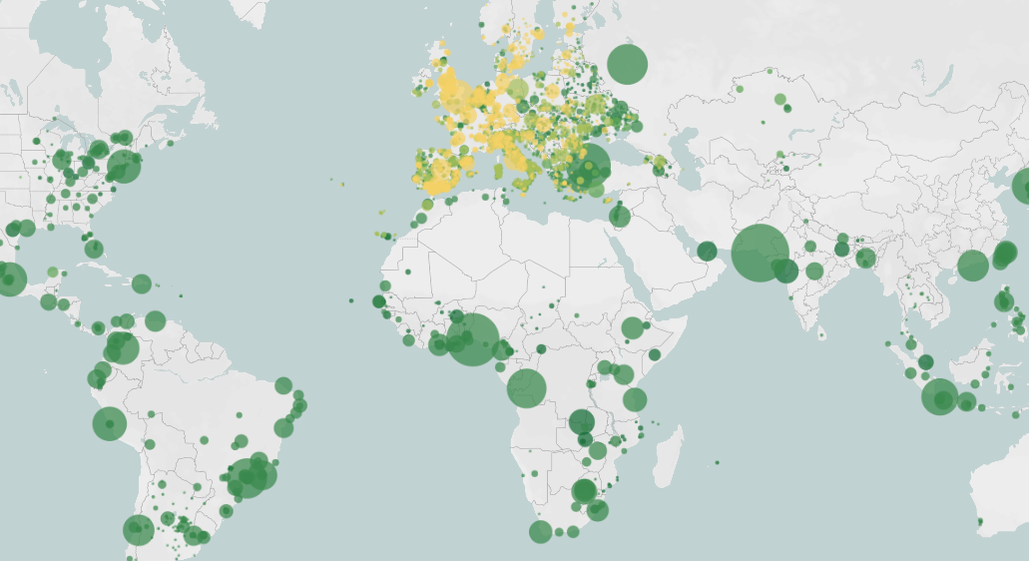
COVENANT OF MAYORS

Slide 4
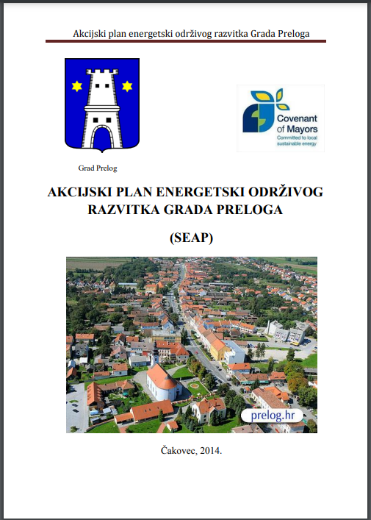
SEAP IN PRELOG
The Town of Prelog joined the Covenant of Mayors in 2013 and created its Sustainable Energy Action Plan (SEAP) in 2014.
The main goals stated in the Action Plan were:
Reducing CO2 emissions from all sectors by implementing energy efficiency measures, using RES, consumption management, education, and other measures;
Contribute as much as possible to the security and diversification of the town’s energy supply;
Reduce energy consumption in the building, transport, and public lighting sectors;
Enable the transformation of urban into ecologically sustainable areas.

Slide 5
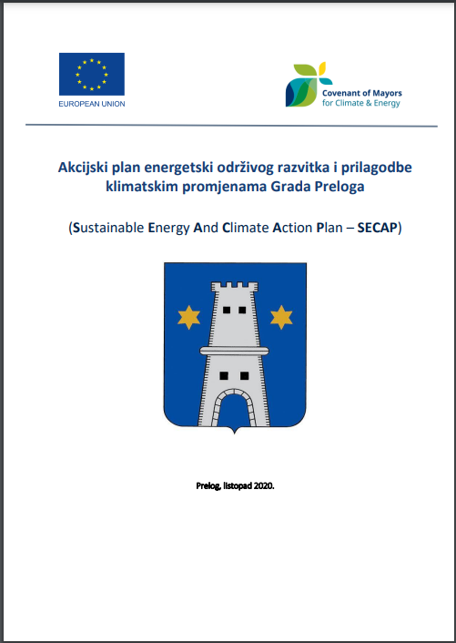
SECAP IN PRELOG
In 2020 the Town of Prelog created its Sustainable Energy and Climate Action Plan (SECAP):
The main goals are:
Reduction of CO2 emissions by 40% by 2030 compared to the baseline year 2011;
Adoption of an integrated approach to climate mitigation and adaptation;
Ensuring access to safe, sustainable, and affordable energy for all.

Slide 6
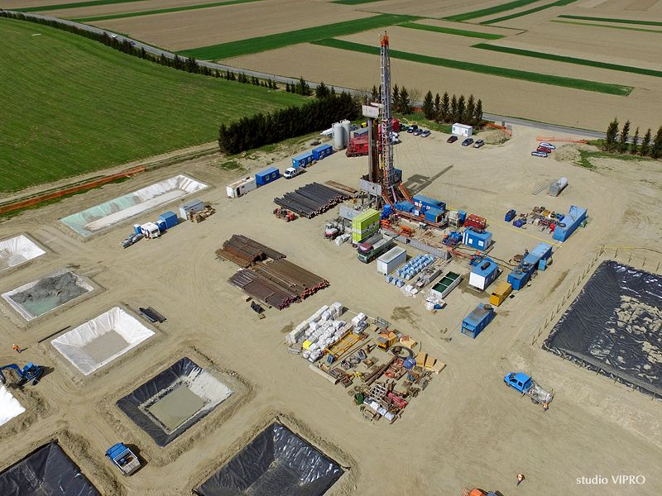
SECAP IN PRELOG
Main SECAP recommendations in order to reduce emissions by 40% by 2030:
Construction of the geothermal power plant in Draškovec (18,1 MW of electricity and 89 MW of thermal energy);
Construction of a district heating network to use the thermal potential of the power plant in Draškovec;
Electrification of transport through direct and indirect measures, i.e. reducing the number of cars with diesel fuel by 65% ​​and gasoline-powered cars by 30% by 2030;
Construction of 5 fast public charging stations for electric vehicles as well as subsidizing 100 private charging stations

Slide 7
REVISION OF SECAP
Revision of SECAP will include:
Determining the current state of affairs to see whether progress has been made;
Aligning the Action Plan with provisions of the European Green Deal and Renewable Energy Directive, as well as new technological solutions;
Incorporate new insights from the LEEWAY project, especially on how to remove obstacles and stimulate REC.

Slide 8
?
Time for questions

Slide 9
Thank you!
www.interregeurope.eu/LEEWAY

Slide 10
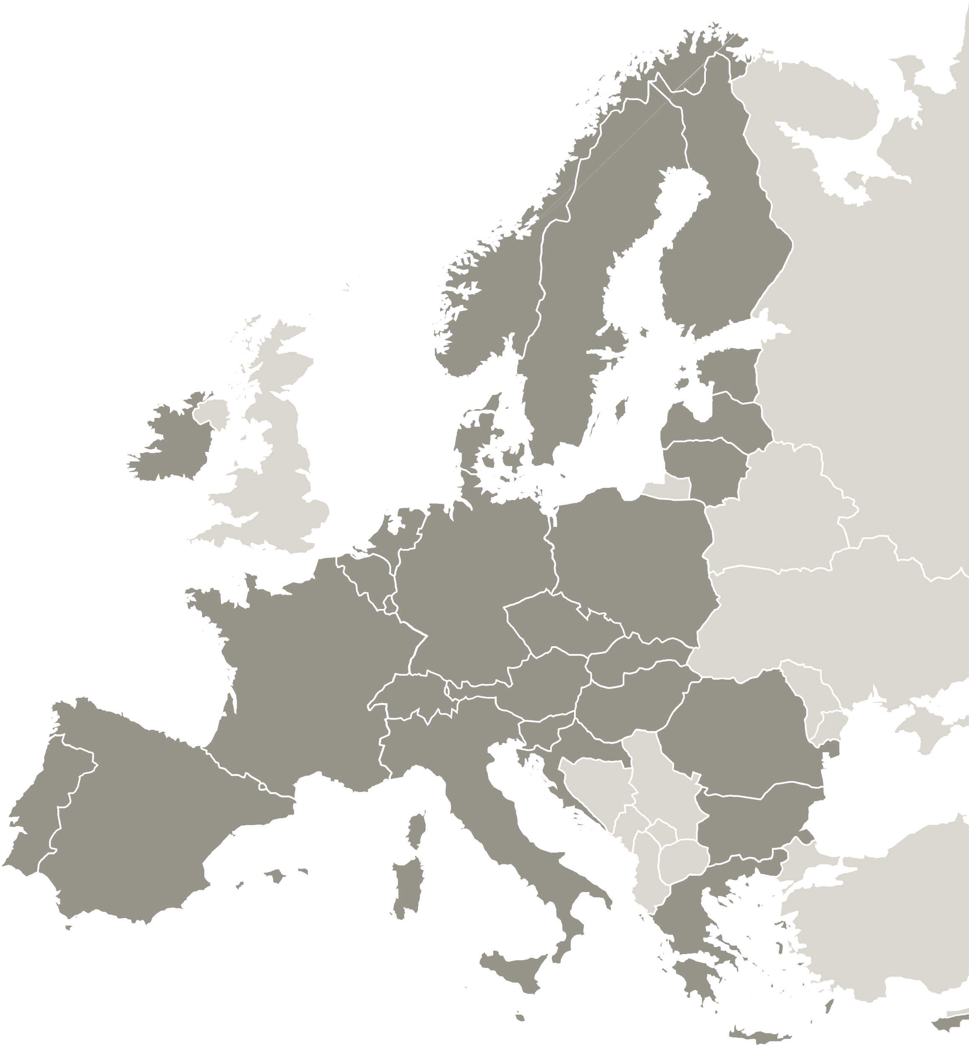
The project LEEWAY is implemented in the framework of the Interreg Europe programme and co-financed by the European Union.
www.interregeurope.eu

