Slide 1
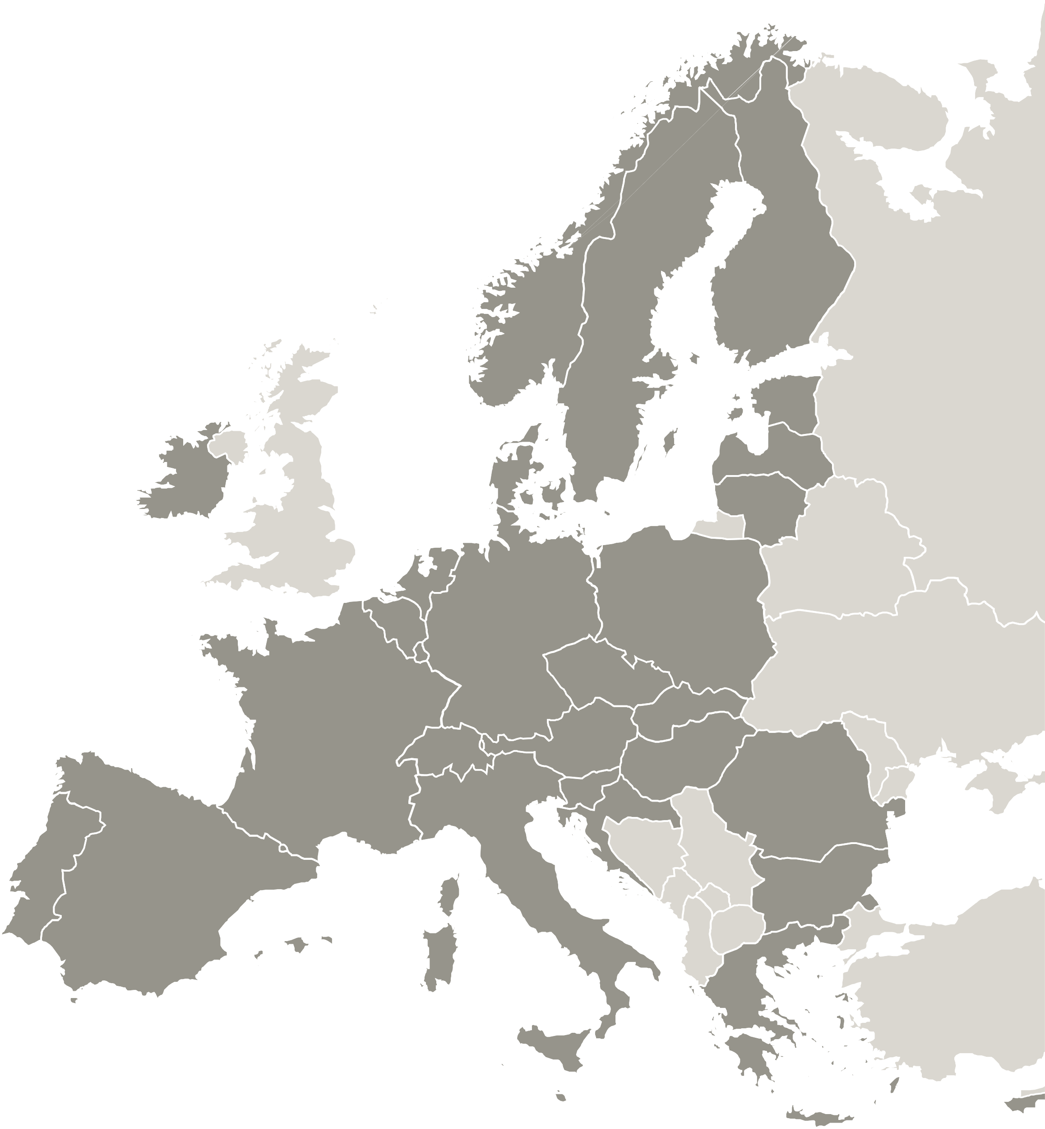
Project overview
Alexandra Cârcu
Lead Partner
alexandra.carcu@oirbi.ro

Slide 2
PROJECT’S OVERALL OBJECTIVE
To use interregional learning to improve public policy frameworks supporting microfinance, ensuring that we future-proof microfinance provision by learning from COVID and adapting to new policy and market requirements.
HOW ?
By increasing capacity of public authorities and socially orientated microfinance providers and changing microfinance loan and ancillary support schemes in line with new market needs.
By creating policy frameworks that encourage socio-economic recovery, making room for the social economy and ensuring that the microfinance multiplier-effect can amplify positive social, environmental and economic impact.

Slide 3
MICROFINANCE
Microfinance describes financial services targeting people with difficulties accessing credit for new businesses.
It can promote social inclusion, entrepreneurship, employment and sustainable development, but only if public policy is able to address some of the common development challenges.

Slide 4
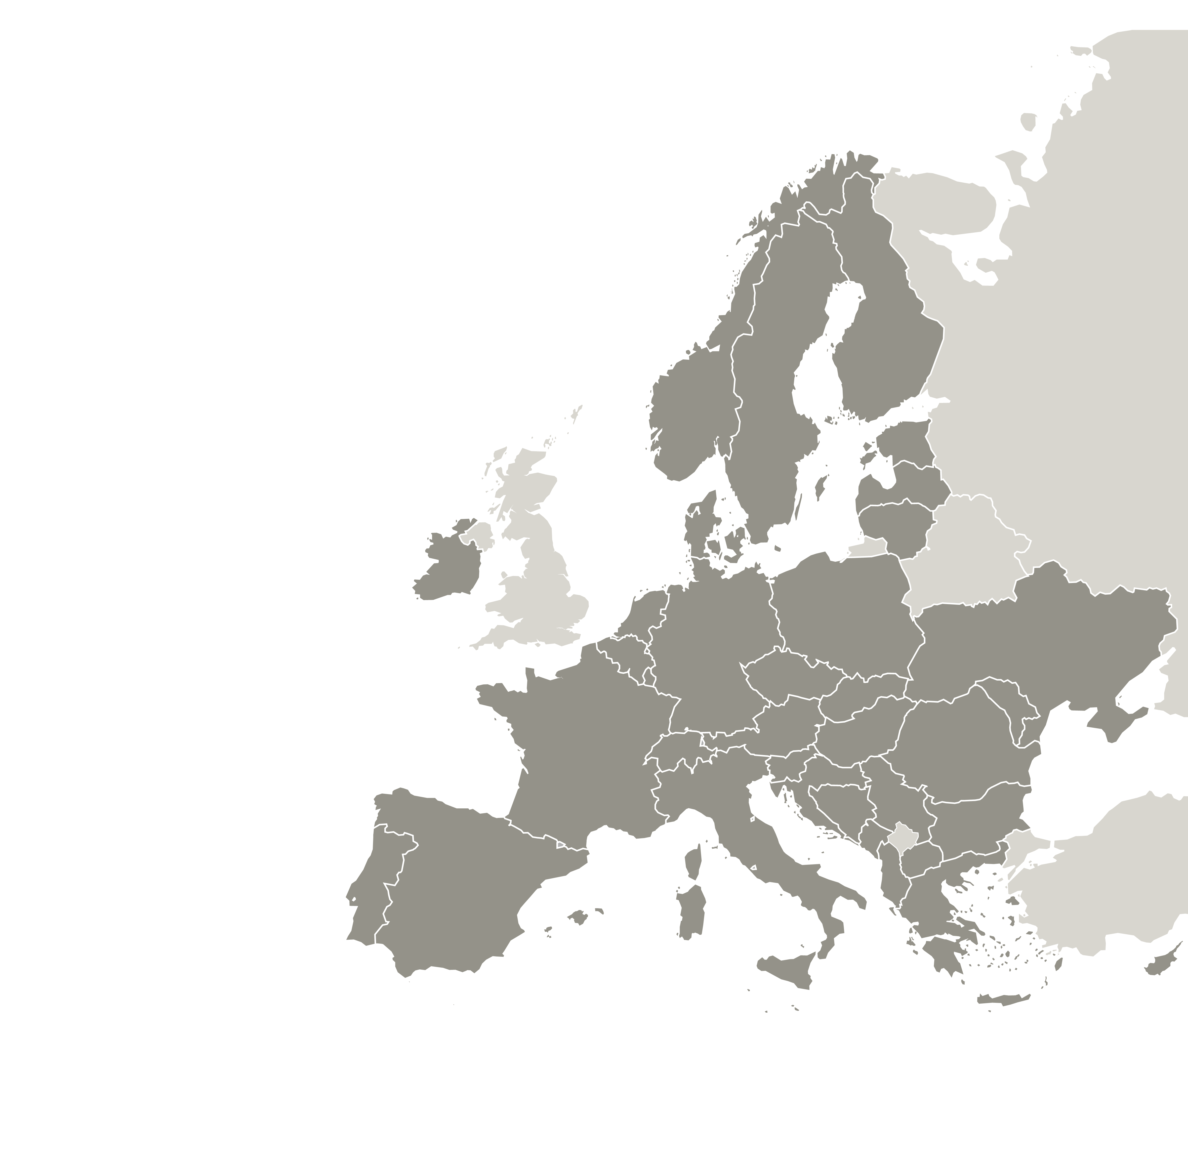
PROJECT PARTNERS
Regional Intermediate Body for European Programs Human Capital Bucharest Ilfov Region – Lead Partner (Romania)
Yunus Foundation – Advisory Partner (Italy)
Bologna Metropolitan City – Project Partner (Italy)
Development Centre of the Heart of Slovenia – Project Partner (Slovenia)
Region Orebro County – Project Partner (Sweden)
Département Seine Saint Denis – Project Partner (France)
01 Mar 2023 -
31 May 2027
6
Partners

Slide 5
CORE PHASE
FULL IMMERSION phase the project implements participative, interregional seminars with experts to help answering the initial set of questions posed by the Consortium about microfinance and its adaptation needs.
FUTURE PROOFING phase Interregional exchange workshops and visits focus on territorial challenges for policy improvements at Partner level, and involve the stakeholder groups identified to support this process, through active participation.
TERRITORIAL CHANGE/IMPACT phase the Consortium uses interregional exchange to match challenges to good practices (GP), using practical workshops, visits with GP owners / beneficiaries and bilateral sessions.
SEMESTERS
1-2
SEMESTERS
2-6
SEMESTERS
3-6
Partners aim at achieving policy changes in their territory.

Slide 6
POLICY INSTRUMENTS
5 Policy instruments addressed through MICROFUTURE:
Education and Employment Programme 2021-2027 (PEO 2021-2027) – Romania.
Metropolitan Strategic Plan 2.0 –PSM2.0 – Italy.
Local Development strategy of LAG the Heart of Slovenia – Slovenia.
Regional Development Strategy for Örebro County – Sweden.
Seine-Saint-Denis Inclusion Policy for the Most Vulnerable People: "Microfinance Programmes Strengthening Entrepreneurship“– France.

Slide 7
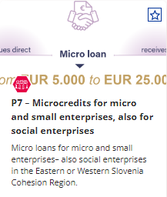
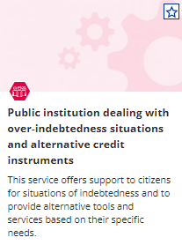
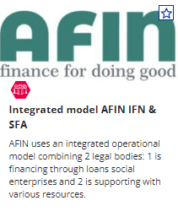
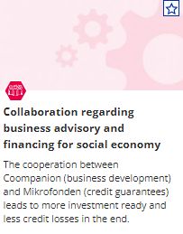
GOOD PRACTICES
discovered on the MICROFUTURE project

Slide 8
2024 HIGHLIGHTS
On May 16th 2024, Microfuture project partners had the honor of meeting Nobel Prize winner and Grameen Bank founder, Muhammad Yunus, during their meeting in Seine-Saint-Denis.
With his pioneering work in microfinance, Professor Yunus has provided loans to vulnerable communities, for over 50 years, inspiring the creation of the MICROFUTURE initiative.
His participation underscored the importance of innovative approaches in addressing current socio-economic issues. His extensive experience in microfinance, particularly through the Grameen Bank model, provided a significant learning opportunity for all attendees. He emphasized the role of microfinance in empowering marginalized communities, citing examples of successful micro-entrepreneurs who have benefited from these initiatives.

Slide 9
OUR ACHIEVEMENTS
8 Good Practices identified and published on the Interreg Europe website.
3 Interregional events organised in Italy, Romania and France.
Over 52 stakeholders involved by partners.
2 Survey launched and filled in in all partners’ regions.
1 project video disseminated.

Slide 10
01 Mar 2023 -
31 May 2027
6
Partners
The project MICROFUTURE is implemented in the framework of the Interreg Europe programme and co-financed by the European Union.
Follow us:
www.interregeurope.eu/microfuture

