Slide 1
SKALE2CT
Project
presentation
Last update on: 07 September 2024
Notes:
Use your project’s profile image (the one from the website)
Remember to use only images which meet the copyright criteria set by the regulation

Slide 2
SKALE2CT objective
How to improve scalability of SMEs?
SKALE2CT enhances resources and capacities of public and intermediary organisations to improve Business Acceleration providers and services, in particular when it comes to scale-up phase.
MEUR
1.6
Project budget
Mar 2023
May 2027
Notes:
Short summary of the issue addressed (in a form of a question) and what needs to be improved in the participating regions (text below)

Slide 3
In depth
Partners will support and prepare Business Acceleration providers and services, bringing special focus into Micro & SMEs’ main shortages:
Executive leadership (skills, mentoring)
Infrastructures (prototyping, accelerators, funds, incubators, co-living…) and
Talent management (talent attraction and retention tools)
The project aims to particularly address scale-up services for emerging sectors, such as health (biotech&biosciences) or digital (AI, big data…)
As a result…
Planned actions will contribute to greater scaling-up resources and services, leading to more efficient and proficient companies and, consequently, economic and employment growth

Slide 4
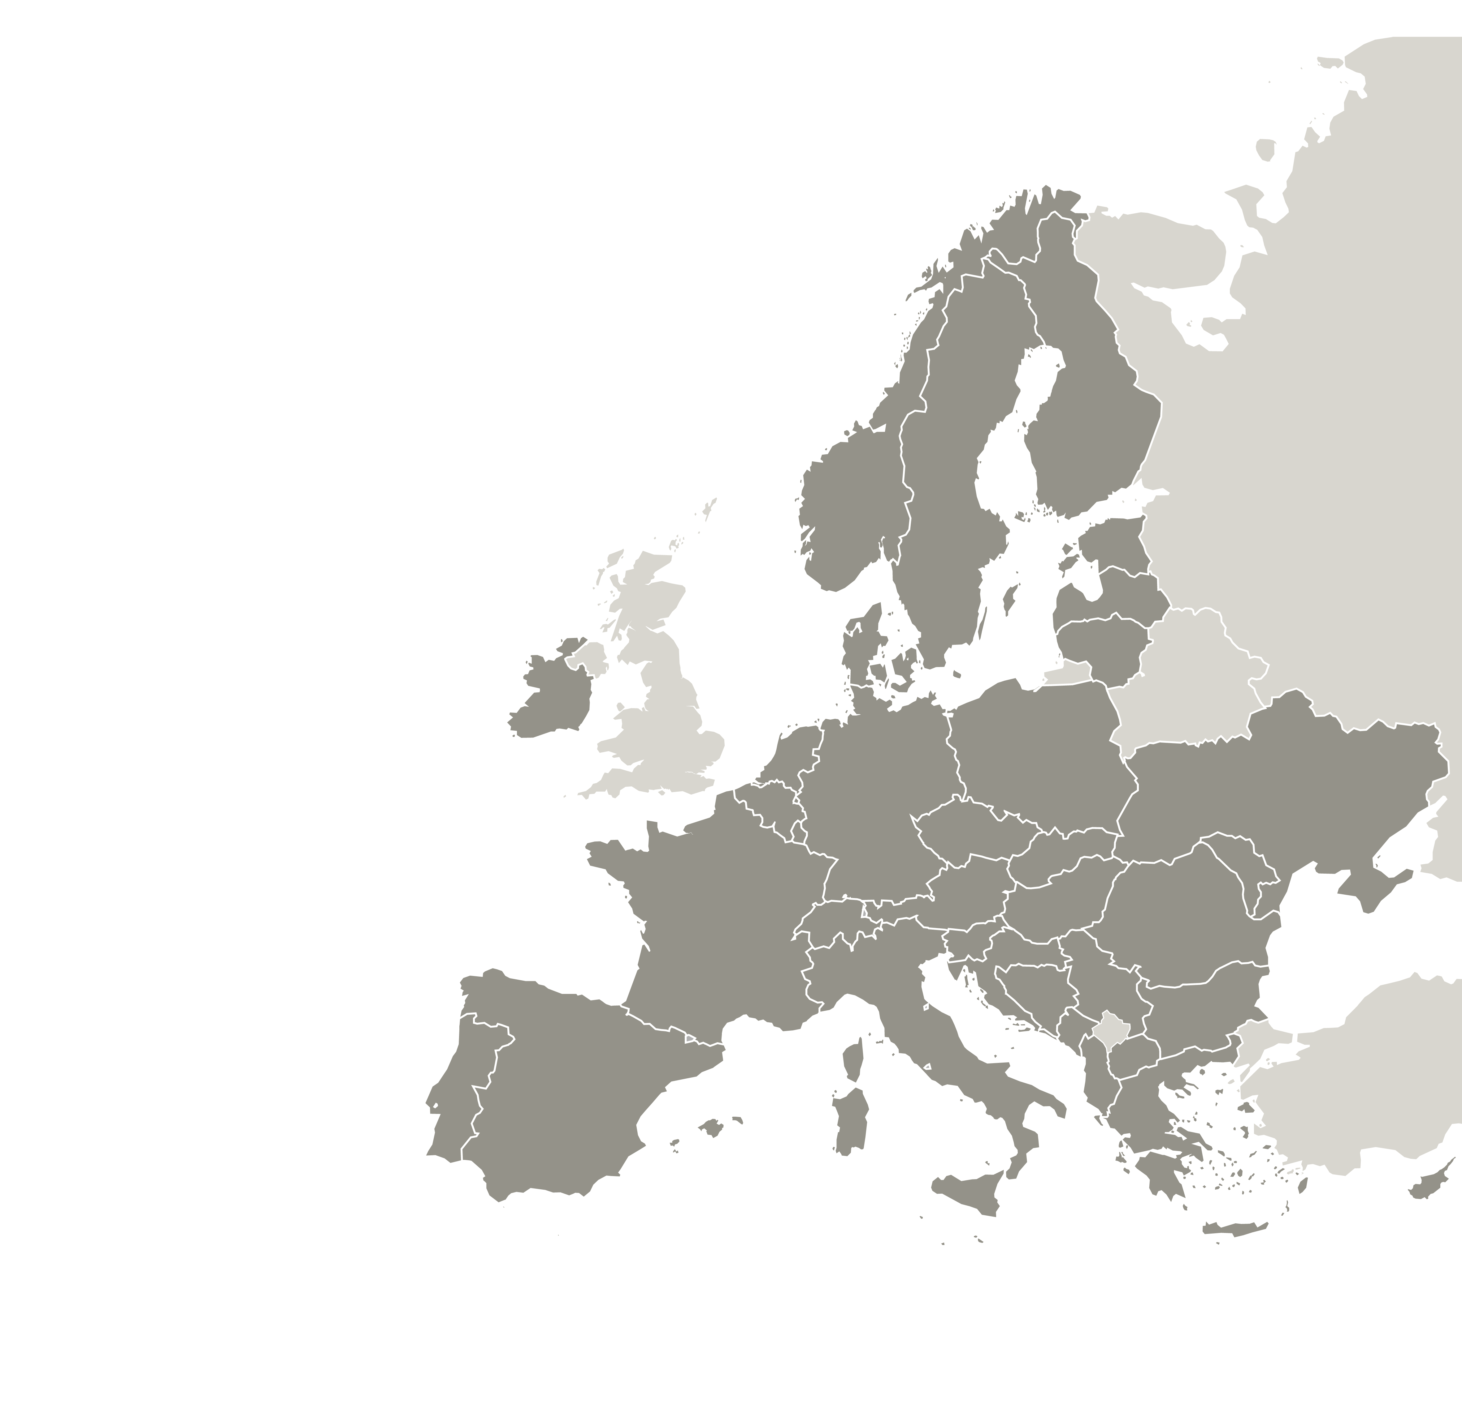
SKALE2CT partnership
8 project partners from 7 regions working together:
Fomento San Sebastian (Spain) – lead partner
Grenoble Alpes Métropole
Metropolitan City of Turin (Italy)
Portuguese National Agency for Innovation (Portugal)
Pannon Business Network (Hungary)
Latvian Chamber of Commerce (Latvia)
Latvian Ministry of Economics (Latvia)
Startup Europe Regions Network (Belgium)
LATVIA
BELGIUM
FRANCE
HUNGARY
SPAIN
ITALY
PORTUGAL
Lead partner
Project partners
Notes:
Associated policy authorities are not partners so they should not show as part of the ‘partnership’ – feel free to use another slide to show who the other key stakeholders are (APAs)

Slide 5
SKALE2CT addressing six policies
Six policy instruments:
France: Grenoble Local Economic Pact towards a more resilient economic alliance of the territory
Spain: San Sebastian “2030 Strategy”, Objective 5 on “Economic Balance”
Italy: Metropolitan Strategic Plan 21-23: Strategy 1.3 Stimulate innovation in the system of SMEs & micro-enterprises, Action1.3.5 Territorial clustering 4.0
Latvia: Law on Aid for the activities of Start-ups companies
Hungary: Ediop Plus – Economic Development and Innovation Operational Program Plus, CCI (2021-2027)
Portugal: National Smart Specialisation Strategy Portugal 2030
LATVIA
BELGIUM
FRANCE
HUNGARY
SPAIN
ITALY
PORTUGAL
Lead partner
Project partners
Notes:
Associated policy authorities are not partners so they should not show as part of the ‘partnership’ – feel free to use another slide to show who the other key stakeholders are (APAs)

Slide 6
PROJECT RATIONALE
Common challenge
European start-ups’ hurdles: Finding & retaining talent; Funding; Market Access; Executive Leadership
Issues addressed
Connect and improve Business Scalability Services for emerging sectors (Biotech, Digital…)
Improve skills and capacities of public or intermediary BAS organisations
Enhance their ability to better address expansion & competitiveness
Strengthen their capacity, infrastructure and talent to build up solid business ecosystems

Slide 7
SKALE2CT key outputs
13
Good practices
identified
4 in Good practice database
108%
of initially planned
Notes:
Reflect the share of planned activities delivered – move the arrow according to the actual percentage

Slide 8
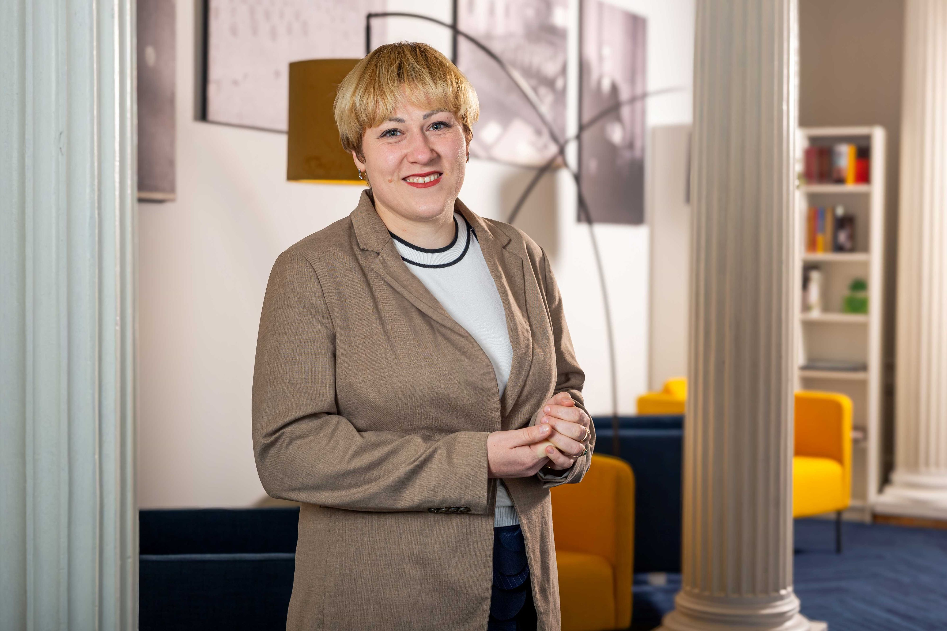
SKALE2CT benefits regions
“The butterfly effect is the idea that small things can have non-linear impacts on a complex system. This idea relates to the SKALE2CT project, where even sharing common practices can have an impact on the entire system”
Liga Siceva
Director of EU Project Department |Latvian Chamber of Commerce and Industry
Latvia
Notes:
Share an inspiring quote from a project partner or key stakeholder (APA) on the benefits of the project in their region

Slide 9
Learn more about SKALE2CT
Key links
Project website: https://www.interregeurope.eu/skale2ct
https://www.interregeurope.eu/skale2ct
Project videos
Introduction: https://www.youtube.com/watch?v=rg33pfwCHX0&t=6s
E&L in Grenoble: https://www.youtube.com/watch?v=Ij6a6jouYCQ
Notes:
Add links to your website and the two videos to be published on your website

Slide 10
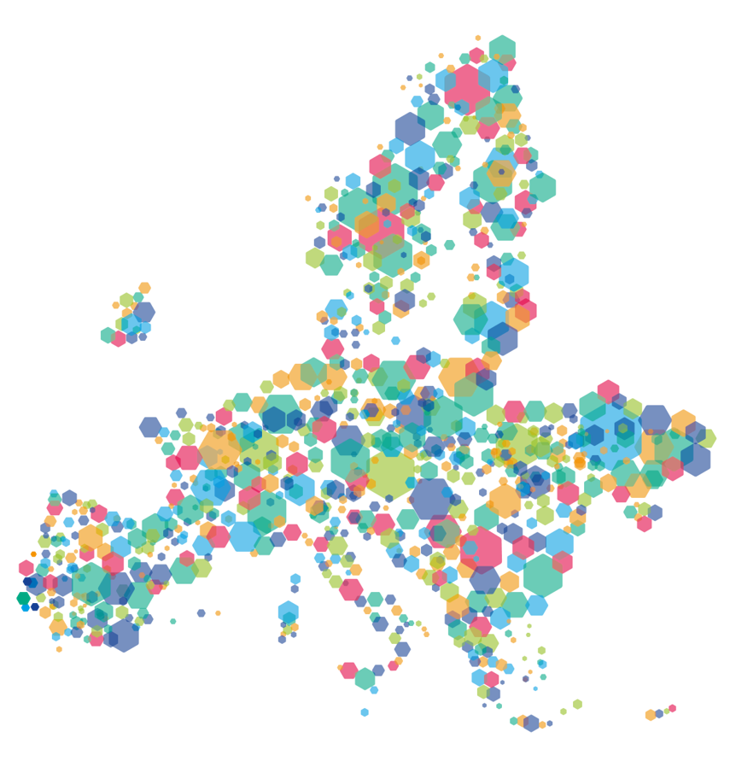
This project is implemented in the framework of the Interreg Europe programme and co-financed by the European Union.
www.interregeurope.eu
Notes:
Remember to include this slide!

