Slide 1
TEXAD project:
Advanced Circular Textile Waste Solutions for European Municipalities
Project presentation

Slide 2
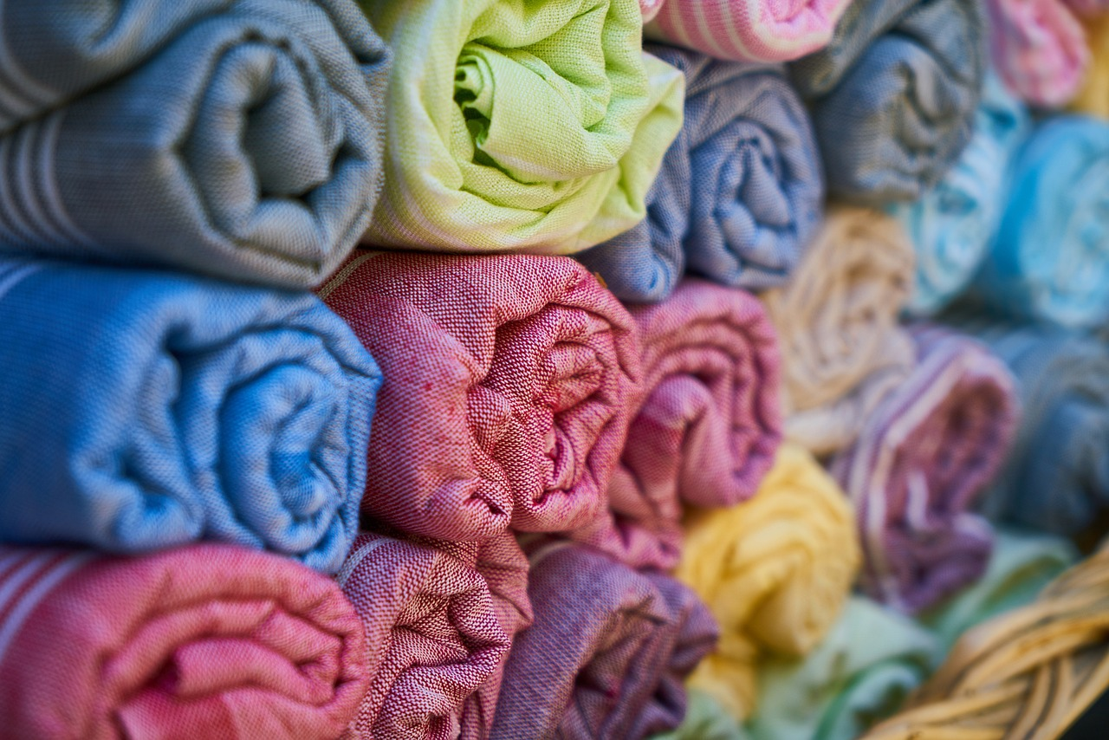
Background
Some 4 – 6% of the EU overall environmental footprint can be traced back to textiles.
It is estimated that 3.3 to 3.7 million tonnes are discarded in mixed household waste.
But in reality, it might be worse. As there is no Europe-wide obligation to report the amount of textile collected from consumers or companies, meaning that a large percentage of the textile waste possibly ends up in regular bins.

Slide 3
Background
We need to ensure that circularity becomes the driver of the textile and fashion sector.
It is essential that the different agents of the recycling value-chain cooperate – inspired and compelled by municipal policies.

Slide 4
Project relevance
New obligations for European municipalities related to the separate collection and management of textile waste from 1st January 2025:
Revision of the Waste Framework Directive. Requires EU countries to establish systems for the separate collection of textile waste
EU strategy for sustainable textiles, textiles placed on the EU market would need to last longer and be easier to repair and with an extended lifetime
EU Eco-design regulation. To a great extent, all textiles placed on the EU market must be made from recycled fibres.
New challenges
New solutions
A project to build capacities in the municipalities based on exchange of experiences and transferring of best practices

Slide 5
Objectives
Overall objective
The project aims to improve the policy instruments from European municipalities. By including and reinforcing circularity in the management of textile waste. And by adapting and aligning them to the requirements set by the new EU regulations.

Slide 6
Objectives
Specific objectives
Promote interregional exchange of experience: facilitate the sharing of knowledge and experiences among partners, including public policy makers, practitioners, and stakeholders from the textile industry, creating opportunities for mutual learning, joint policy development, and improvement.
Engage in interregional capacity building: enhance the capabilities of participating municipalities in integrating best practices for circularity in the prevention, collection, sorting and valorisation of textile waste.
Monitor and evaluate the impact of municipal policy improvements: assess the effectiveness of the implemented changes on the targeted policy instruments.

Slide 7
Key indicators
Organisations cooperating accross borders: 66
Policy instruments improved: 7
Interregional policy learning events organised: 11
Good practices identified: 12

Slide 8
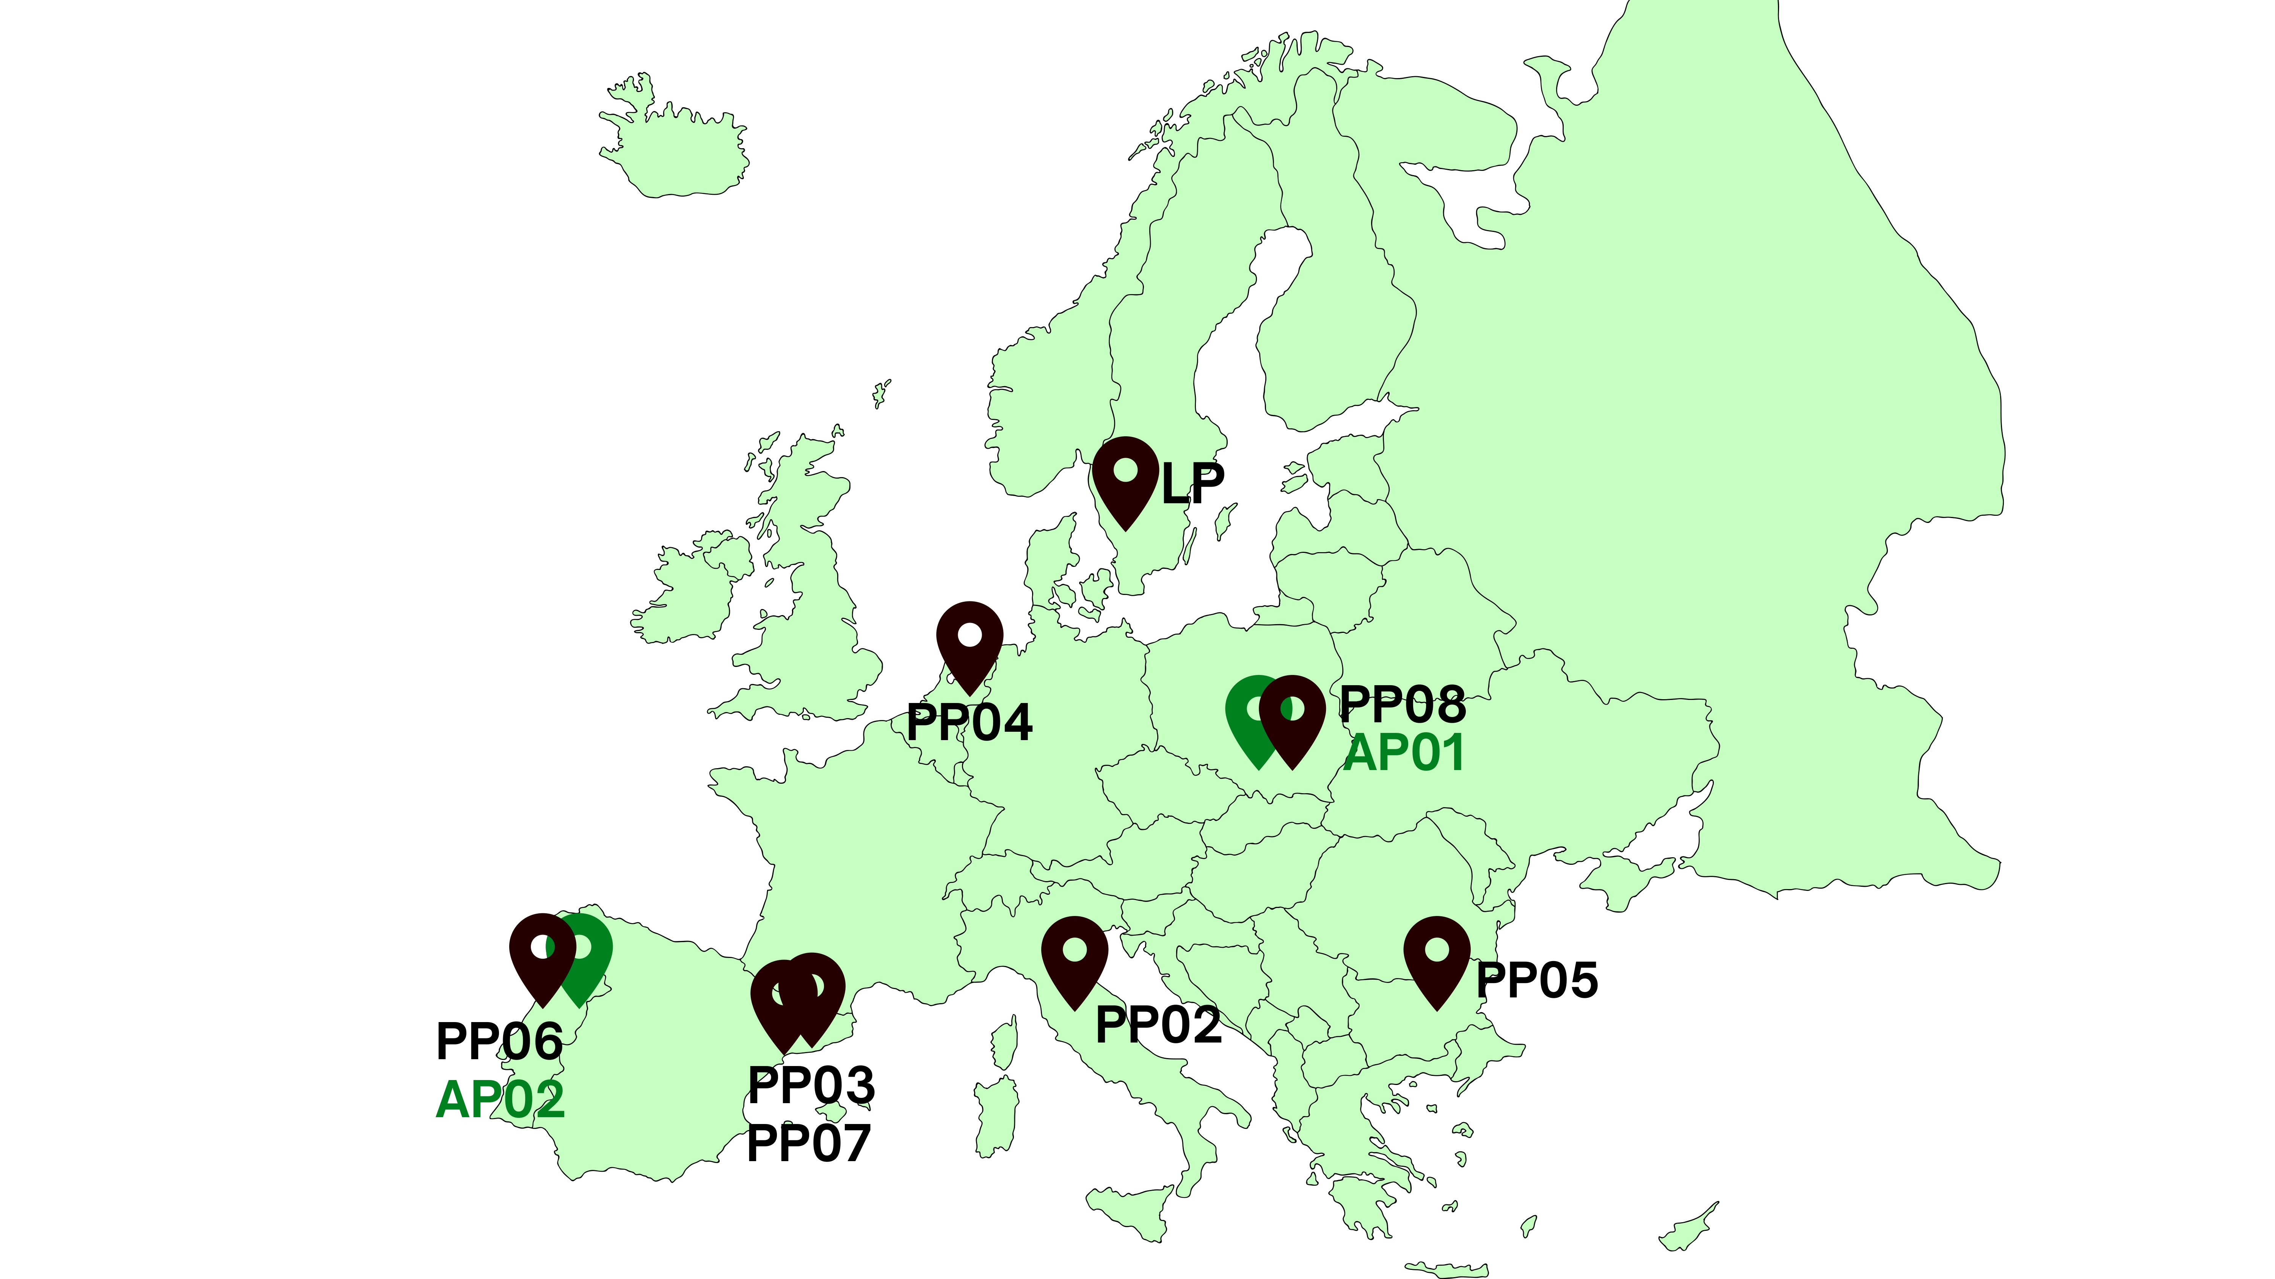
Partnership
LP01 City of Borås
PP02 Prato Municipality
PP03 Mataró Municipality
PP04 Enschede Municipality
PP05 Stara Zagora Municipality
PP06 Santo Tirso Municipality
PP07 MODACC - Catalan Fashion Cluster
PP08 Rzeszow Regional Development Agency
APA01 - Podkarpackie Region
AP02 - Norte Regional Coordination and Development Commission

Slide 9
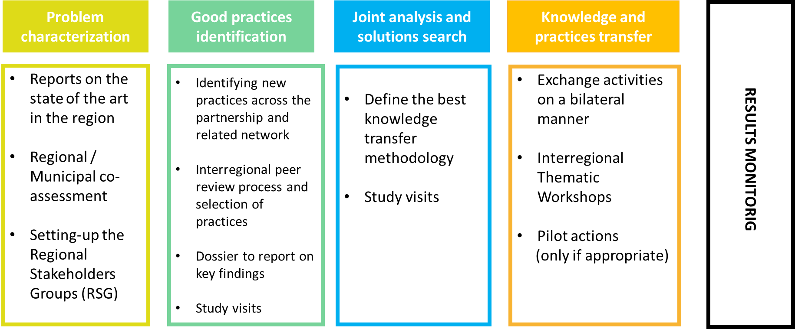
Approach overview

Slide 10
Budget
Calendar
TOTAL
1.8 M€
April 2024
Interreg funds:
1.4M€
March 2028

Slide 11
About TEXAD
An interregional cooperation project to
improve Circular economy policies
TEXAD aims at improving and driving the municipal policy instruments towards a circular model.
Doing this we contribute towards prevention, proper sorting, collection, and valorisation of textile waste. As waste needs to be transformed from being just waste into new products or secondary raw materials.

Slide 12
About TEXAD
An interregional cooperation project to
improve Circular economy policies
The partnership combines 6 European municipalities (BG, ES, IT, NL, PT, SE) with strong textile background and best practices to share and one Regional Development Agency (PL).
A fashion cluster plays the role of Advisory Partner, connecting the project with key stakeholders.
TEXAD targets the policy improvement of 6 municipal plans and 2 ERDF OPs.

Slide 13
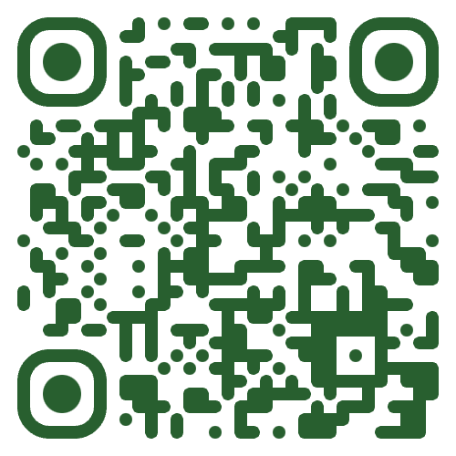
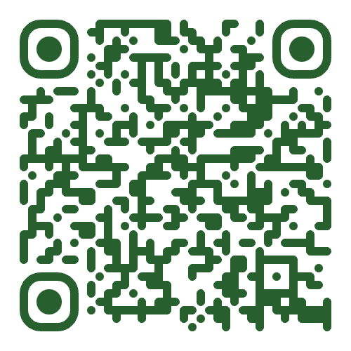
Read more www.interregeurope.eu/texad
TEXAD newsletter mailchi.mp/boras.se/the-texad-newsletter

