Slide 1
Meet CHEERS4EU Explanation of the project and its progress
Document date: August 15th, 2024

Slide 2
ABOUT CHEERS4EU
www.interregeurope.eu/CHEERS4EU

Slide 3
CHEERS4EU… … wants to accelerate the transition to a circular economy in Europe by focusing on Circular Hubs. By exchanging good practices, the structures of circularity in general and of Circular Hubs in particular in all EU regions can be strengthened.
A Circular Hub is a unique geographical location where talent, knowledge and experience, facilities and the necessary space are available to realize innovation and upscaling in the circular economy.
BUDGET
€ 1.740.422
www.interregeurope.eu/CHEERS4EU

Slide 4
PROJECT GOALS CHEERS4EU wants to identify what is key in forming and exploiting a Circular Hub in a specific regional context. This in order to influence local policy instruments to secure regional support.
CHEERS4EU enables the participants to refine the concept of 'Circular Hub as an engine for circular development' and to successfully integrate experiences and policies from other regions into their own regional policies.
In addition, other European regions and governments will also be able to use the knowledge and experience gained within this project to design a Circular Hub in their own region.
“Our approach strengthens coherence in a circular approach within the EU and contributes to accelerating the transition to a circular economy across Europe.”
www.interregeurope.eu/CHEERS4EU

Slide 5
Approach The participating Circular Hubs and potential future hubs within the CHEERS4EU-project, are working together to find new solutions to challenges and issues related to the three building blocks. They do this by exchanging good practices and experiences with each other, at an interregional
level. After all, transition problems that occur in
one region may already be solved in another.
The project consists of two main phases. A core phase (April 2024 – April 2027) and a follow-up phase (April 2027-April 2028).
The building blocks of a Circular Hub:
Multi-helix collaboration
Circular value chains and business models
Social impact
TOTAL
www.interregeurope.eu/CHEERS4EU

Slide 6
Core phase This phase focuses on the building blocks, one after the other, each time for one year. Each year, the same format is followed, consisting of several interregional and regional meetings. During these meetings, practical examples, issues and lessons are shared with each other, and at the regional meetings, input is also collected for the next interregional meeting. Each year will be concluded with an online workshop (the wrap-up).
This approach ensures a broad exchange of good practices, building blocks and conclusions. The online wrap-up results in a document summarizing the most important good practices and conclusions, which is shared with the stakeholder group.
Follow-up phase
The main objective of this phase is to monitor the initial effects of the policy improvements and to assess the results of the cooperation activities. Partners who have already achieved initial results in influencing their policy instruments, monitor the impact of the implemented improvements. Partners who have not yet achieved initial results can learn from the other partners to develop a strategy to further work towards this goal.
TOTAL
www.interregeurope.eu/CHEERS4EU

Slide 7
7 Project partners
Province of Limburg (NL)
Skive Municipality (DK)
Standortagentur Tirol (AT)
Pardubice Business Incubator (CZ)
University of Coimbra (PT)
SEKUENS, Science, Business Competitiveness and
Innovation Agency of Asturias (ES)
Helsinki Region Environmental Services Authority HSY (FI)
www.interregeurope.eu/CHEERS4EU

Slide 8
PROJECTS PROGRESS
Semester 1 April 2024 – October 2024
www.interregeurope.eu/CHEERS4EU

Slide 9
STATUS SEMESTER 1 Activities Lead Partner
1 APRIL 2024 – 30 SEPTEMBER 2024
PREPARATION BY THE PROVINCE OF LIMBURG (NL) | STATUS
Kick-off meeting Province of Limburg, incl. study visit and steering group meeting | Done
Workshop on good practices | Done
Two workshops on policy instruments | Done
Organize a process for the self-assessments | In progress
Provide a software tool for the newsletter | In progress
Organize Management Team Meeting | Done
Organize Communication & General meetings | Done
Identify three good practices | In progress

Slide 10
STATUS SEMESTER 1 Communication Lead Partner
1 APRIL 2024 – 30 SEPTEMBER 2024
PREPARATION BY THE PROVINCE OF LIMBURG (NL) | STATUS
The preparation of a common communication template | Done
Make Communication plan and workshop | Done
The design of 1 programme poster | Done
The creation of a newsletter-format | In progress
The creation of a mailing list where interested parties can sign up for the newsletter | Done
The creation of a common project website | Done
The creation of LinkedIn Communities | Done
Desiging the roll-up banner | Done

Slide 11
Dashboard Communication Figures ‘Must haves’ end of September 2024
PROJECT WEBSITE UPDATE
LINKEDIN POST
NEWSLETTERS PUBLISHED
Goal: 1
Goal: 2
Goal: 0
Realised: 2
Realised: >10
Realised: 0
PUBLICATIONS (SCIENCE/POPULAR)
E-BULLETIN
PROJECT VIDEO
Goal: 8
Goal: 0
Goal: 0
Realised: 0
Realised: 1

Slide 12
Dashboard Communiction (2) Figures ‘Nice to have’ end of September 2024
WEBSITE VISITORS
LINKEDIN FOLLOWERS
NEWSLETTER SUBSCRIBERS
Goal: 500
Goal: 50
Goal: 50
Realised: ?
Realised: 34
Realized: 10

Slide 13
STATUS SEMESTER 1 Project activities
1 APRIL 2024 – 30 SEPTEMBER 2024
 | Province of Limburg | Skive Municipality | Standort- agentur Tirol | Pardubice Business Incubator | University of Coimbra | SEKUENS, Science, Business Competitiveness and Innovation Agency of Asturias | Helsinki Region Environmental Services Authority HSY
 | NL | DK | AT | CZ | PT | ES | FI
Task Assignment Letters ready | Done | Done | Done | Done | Done | Done | Done
Partner Agreement signed | Done | Done | Done | Done | Done | Done | Done
Controller installed | Done | Done | Done | Done | Done | Done | Done
Organize stakeholder meeting | Done | Done | Done | Done | Done | Done | Done
Self - Assessment Multiple Helix discussed | Done | Done | Done | Done | Done | Done | Done
Self - Assessment Multiple Helix filled out | To do | To do | To do | To do | To do | To do | To do
Number of good practices identified | 0 | 0 | 0 | 0 | 0 | 0 | 0

Slide 14
STATUS SEMESTER 1 Communication all
1 APRIL 2024 – 30 SEPTEMBER 2024
 | Province of Limburg | Skive Municipality | Standort- agentur Tirol | Pardubice Business Incubator | University of Coimbra | SEKUENS, Science, Business Competitiveness and Innovation Agency of Asturias | Helsinki Region Environmental Services Authority HSY
 | NL | DK | AT | CZ | PT | ES | FI
Each partner creates a dedicated page to this project on their own website | Done | Done | Done | Done | In progress | Done | Done
The production of 1 roll-up per region (7+3), | Done | Done | Done | Done | Done | Done | Done
Each partner publishes a press release about the start of the project | Done | In progress | Done | Done | Done | Done | Done
Each partner will display one poster with information about the project on its premises | Done | Done | Done | Done | Done | Done | Done

Slide 15
2nd semester, what’s coming up:
Reporting, deadline financial report 14th of October
Reporting info (Ppt) will follow and next GM time for questions
Self-Assessment Multiple Helix aspect of the Hub
Process info & planning workshops & identifying 3 good practices
Final on-line policy learning workshop about this theme end of March
Preparation for visit Asturias
Prepare stakeholder sheets
Prepare next stakeholder meeting February/March
Communication
First newsletter, add organization info on website, flyer, Linkedin
www.interregeurope.eu/CHEERS4EU

Slide 16
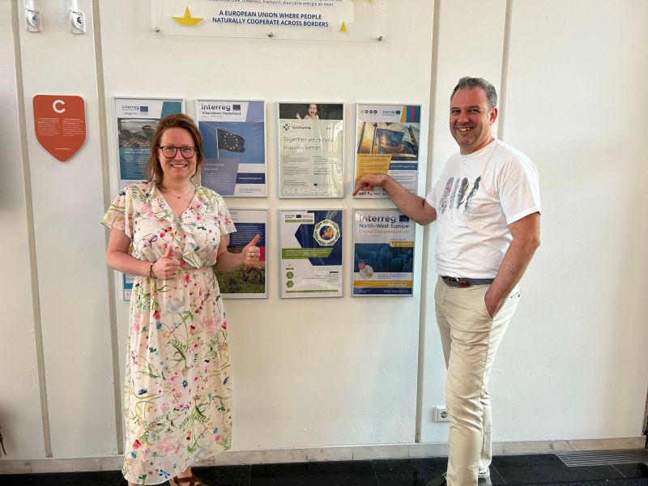
Feedback & questions

