Slide 1
TAAS - Tourism as a Service; a 360 degrees tourism experience
Project Overview
October 2024

Slide 2
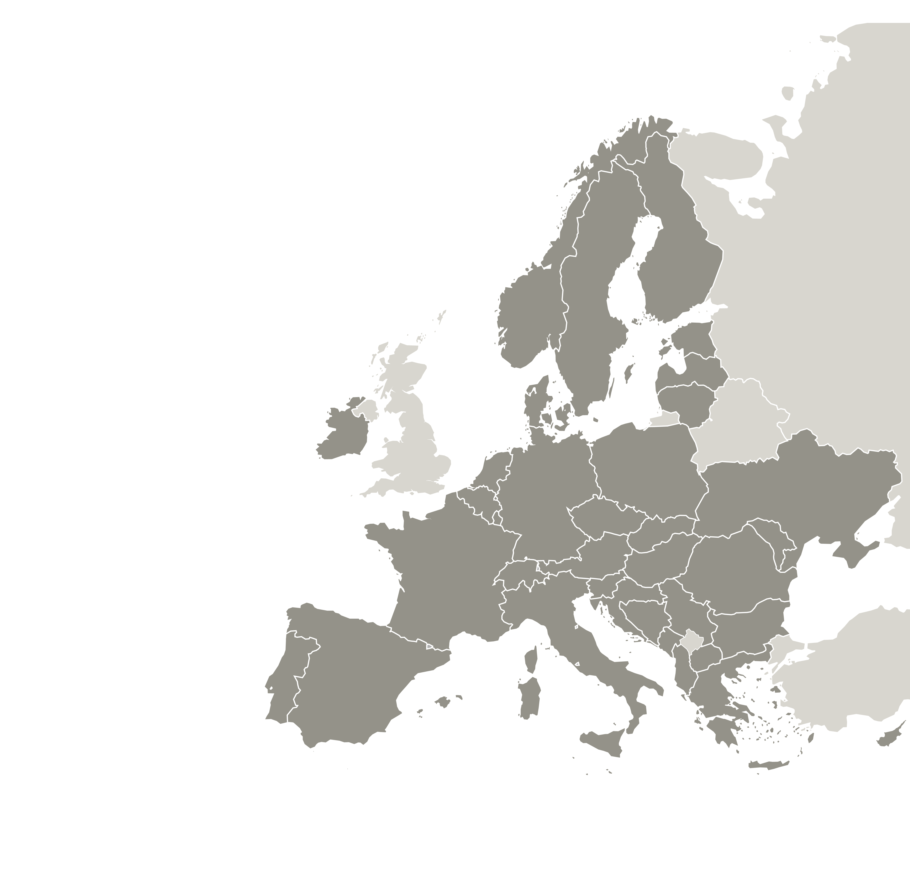
TAAS Overview
The project consortium comprises nine areas:
South Aegean Region, Greece
Tampere, Finland (represented by Visit Tampere Ltd)
Aspres Community of Municipalities, France (represented by the Inter-communal Tourist Office Aspres-Thuir)
Ljubljana, Slovenia (represented by Regional Development Agency of Ljubljana Urban Region)
City of Fano, Italy
Donegal, Ireland (represented by the partner Atlantic Technological University and Donegal County Council as Associated Policy Authority)
City of Stockholm, Sweden
South Limburg, Netherlands (represented by the partner Visit Zuid-Limburg and Municipality Beekdaelen as Associated Policy Authority)
Ungheni City Hall, Moldova
These partners, all with a special interest in tourism transformation, are coordinated by the Centre for Research and Technology Hellas / Hellenic Institute of Transport (Greece).
TAAS areas
10
partners

Slide 3
TAAS Overview
TAAS areas
10
partners
The project’s budget is 2,035,950€ and the implementation time of approx. 4 years.
Together, we aim to accelerate tourism digitalization and enhance related policy instruments that support smart and sustainable development.

Slide 4
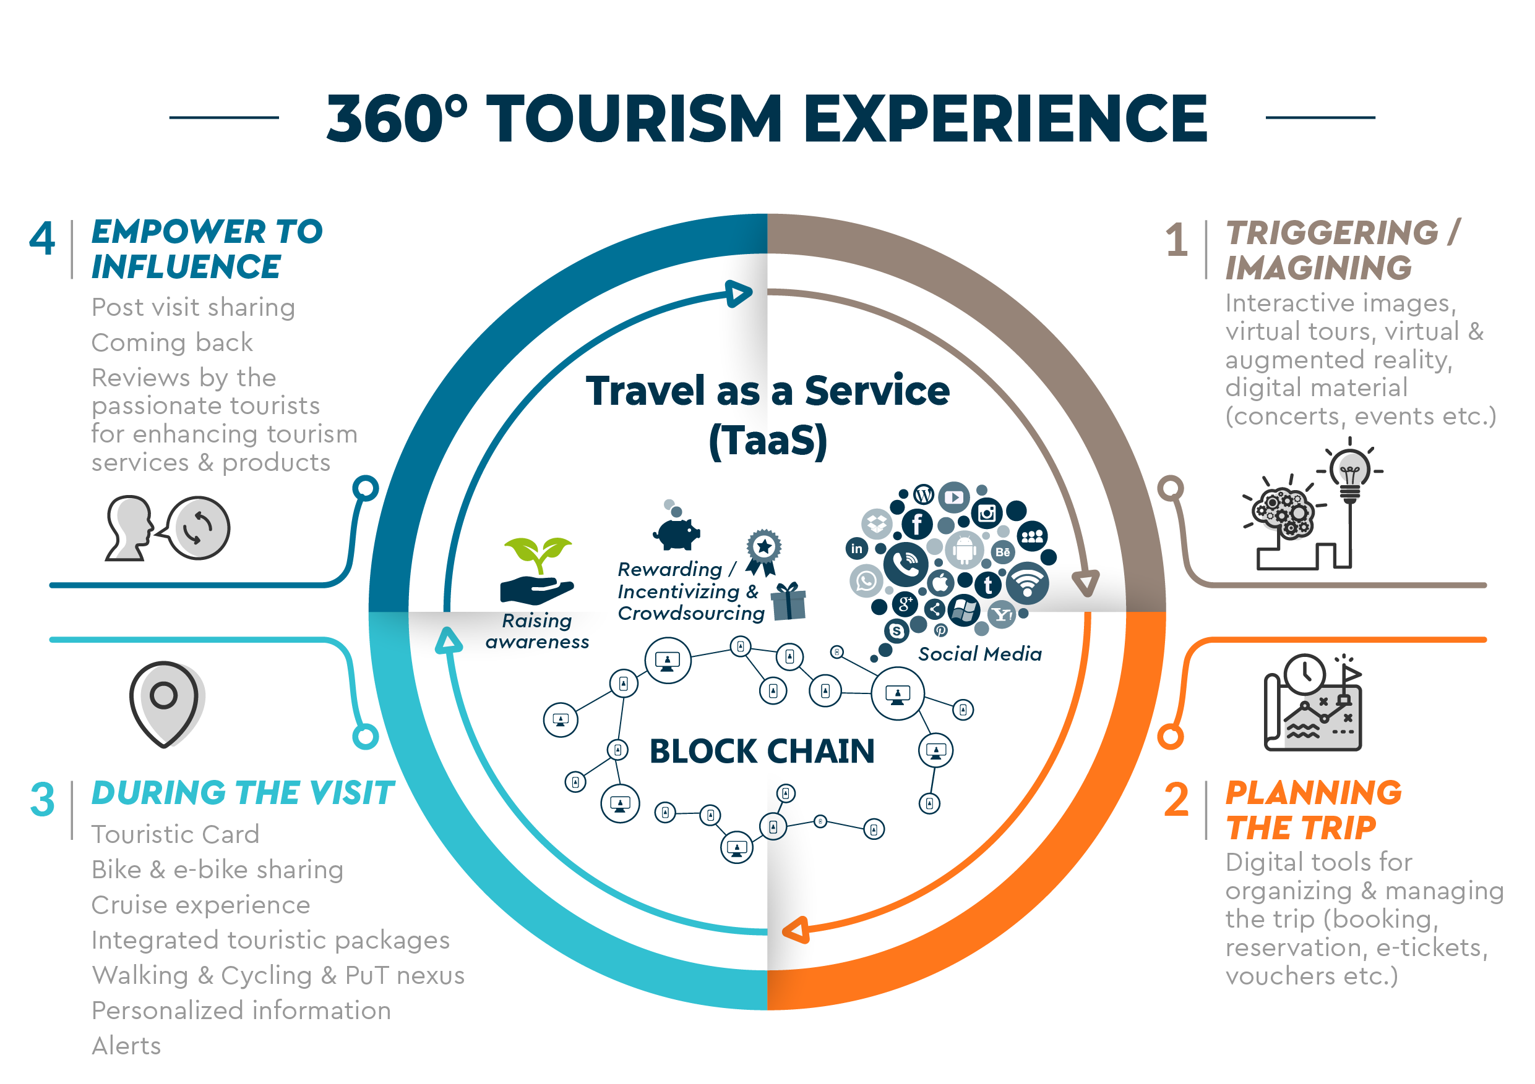
TAAS Approach
TAAS cycle
TAAS cycle approach considers the whole trip experience!
Key goal: to identify innovative digital tools and channels throughout the different stages of a trip that can support transition to a smarter tourism sector
TOTAL
++ MEUR

Slide 5
“TAAS is all about taking advantage of digital tools and innovative initiatives with a view to shift to smart and green tourism!”

Slide 6
TAAS Areas
&
TAAS Partners

Slide 7
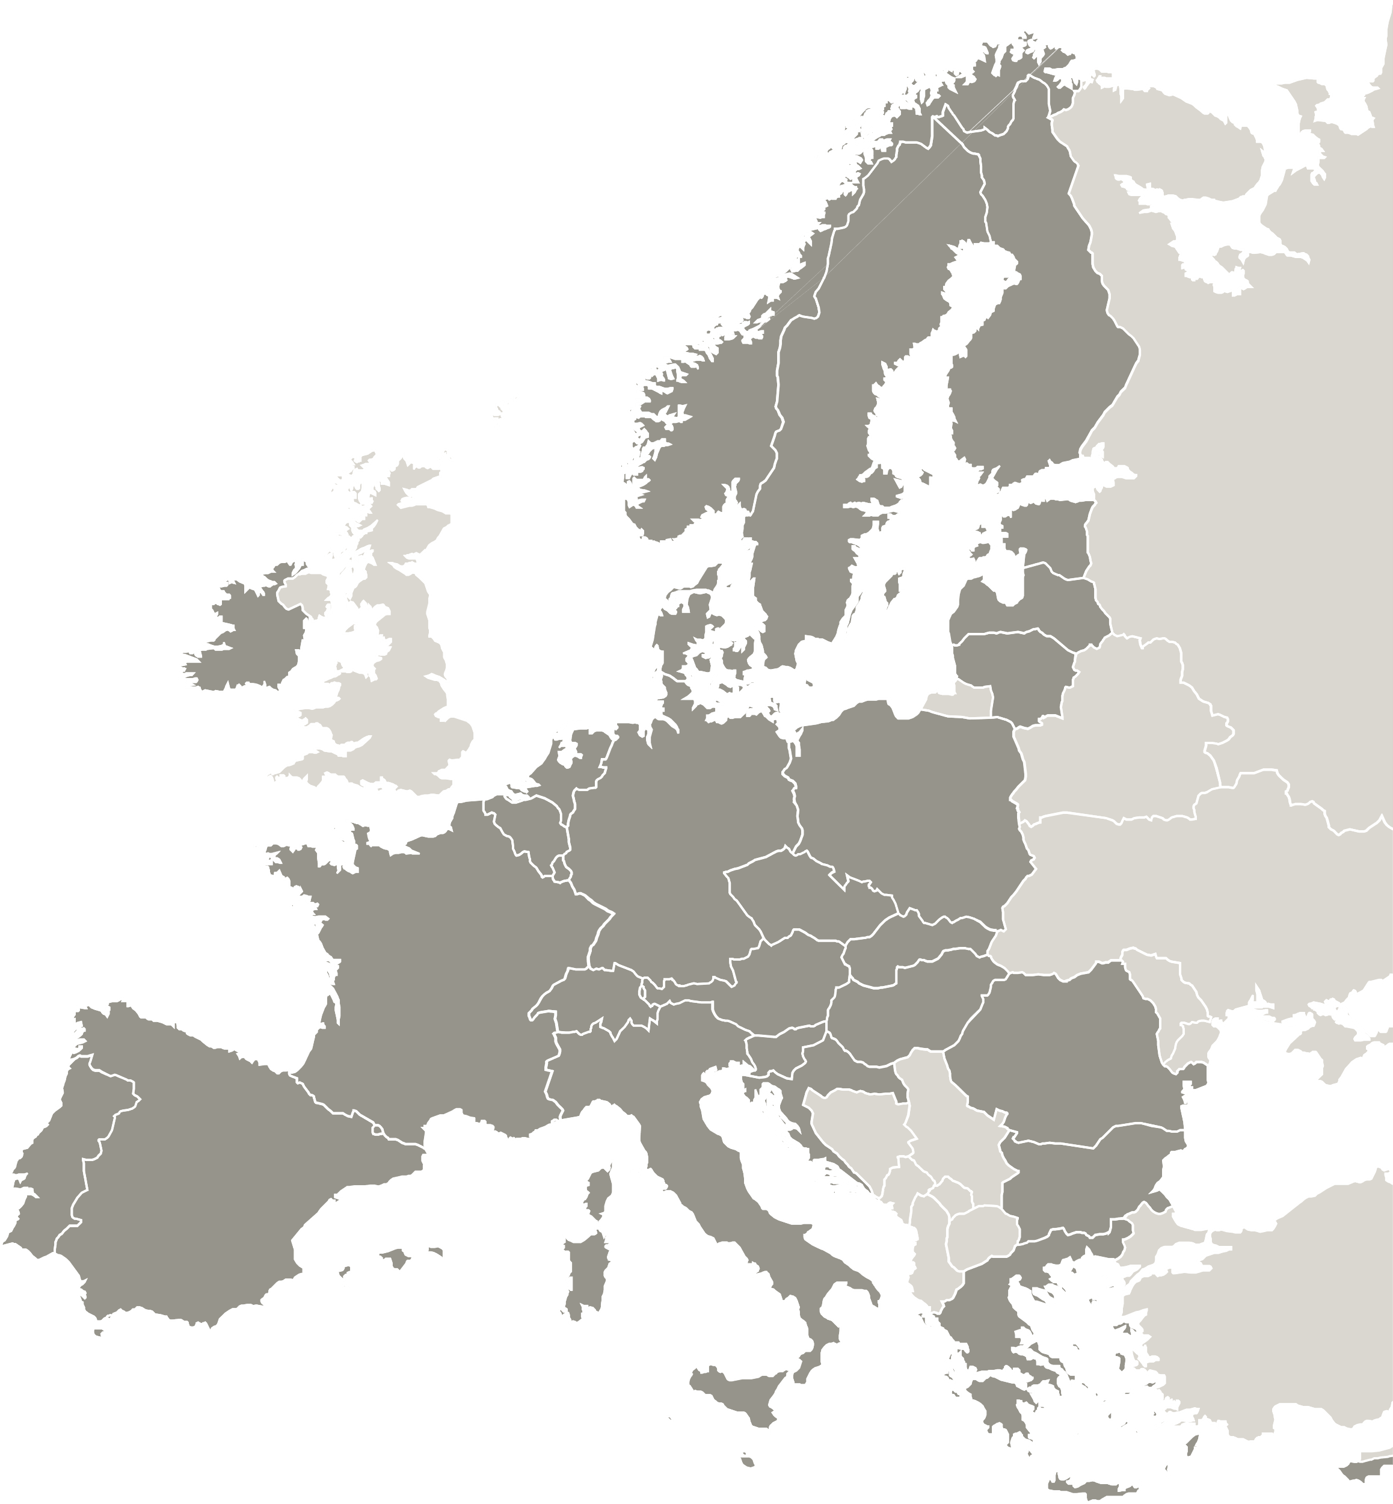
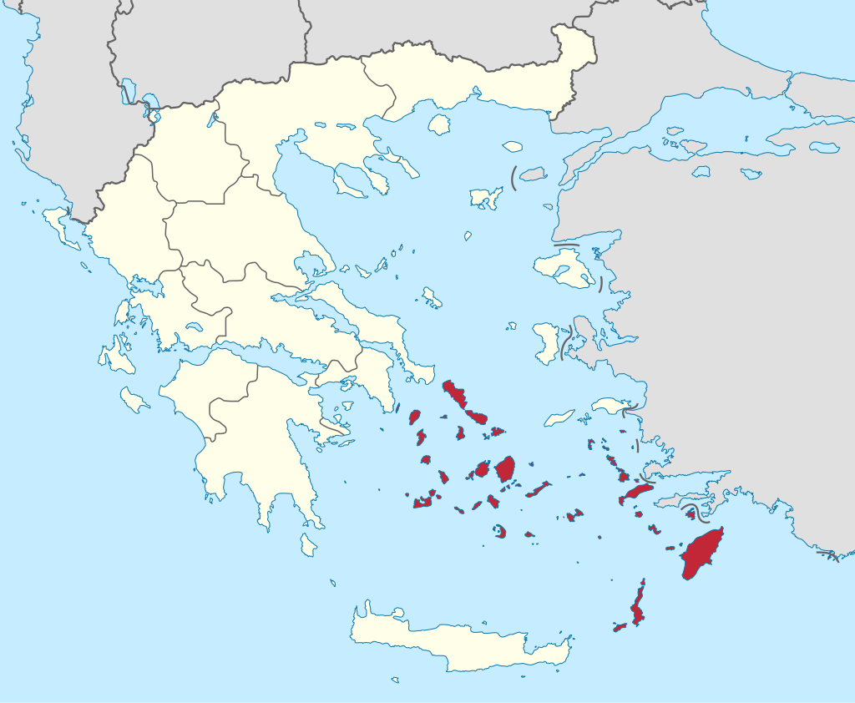
South Aegean Region, Greece
Catchment Area Description
Location: Southeast of Greece and the EU.
Island Clusters: Various islands (Cyclades and the Dodecanese island groups) with different sizes, characteristics, and development levels.
Economy: Tertiary sector dominates, High dependence on tourism
Key Tourism Destination: Recognized internationally for high-intensity tourism and unique cultural and natural identity.

Slide 9
South Aegean Region, Greece
Policy Instrument
Regional Programme 2021-2027 Notio Aigaio
Main Goals:
Strengthen and diversify the tourism product.
Ensure sustainable development and resource sustainability.
Strengthen spatial and social cohesion.
Strategic Objectives:
Diversify the production system.
Manage environment and resources effectively.
Improve regional connectivity and mobility.
Strengthen social cohesion and labor market.
Alleviate intra-regional inequalities.
Expected Policy Improvement
Embrace Competitiveness through Digitization:
Enhance competitiveness with state-of-the-art technologies for businesses.
Improve interaction with tourists and data collection.
Promote tourism using modern applications.
Increase staff digital skills and destination management.
New Projects:
Include tourism digitization enhancements in the ROP.
Exchange knowledge through TAAS activities for innovative projects.
Focus on integrated, inclusive socio-economic, and environmental development.

Slide 10
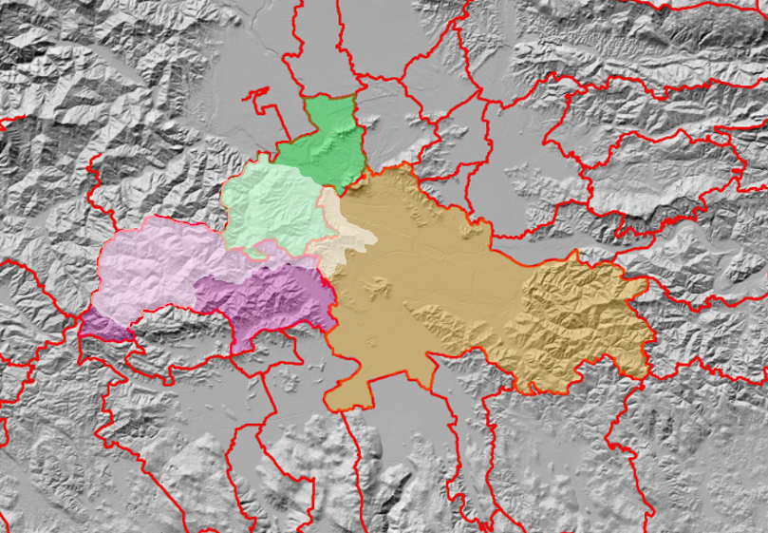
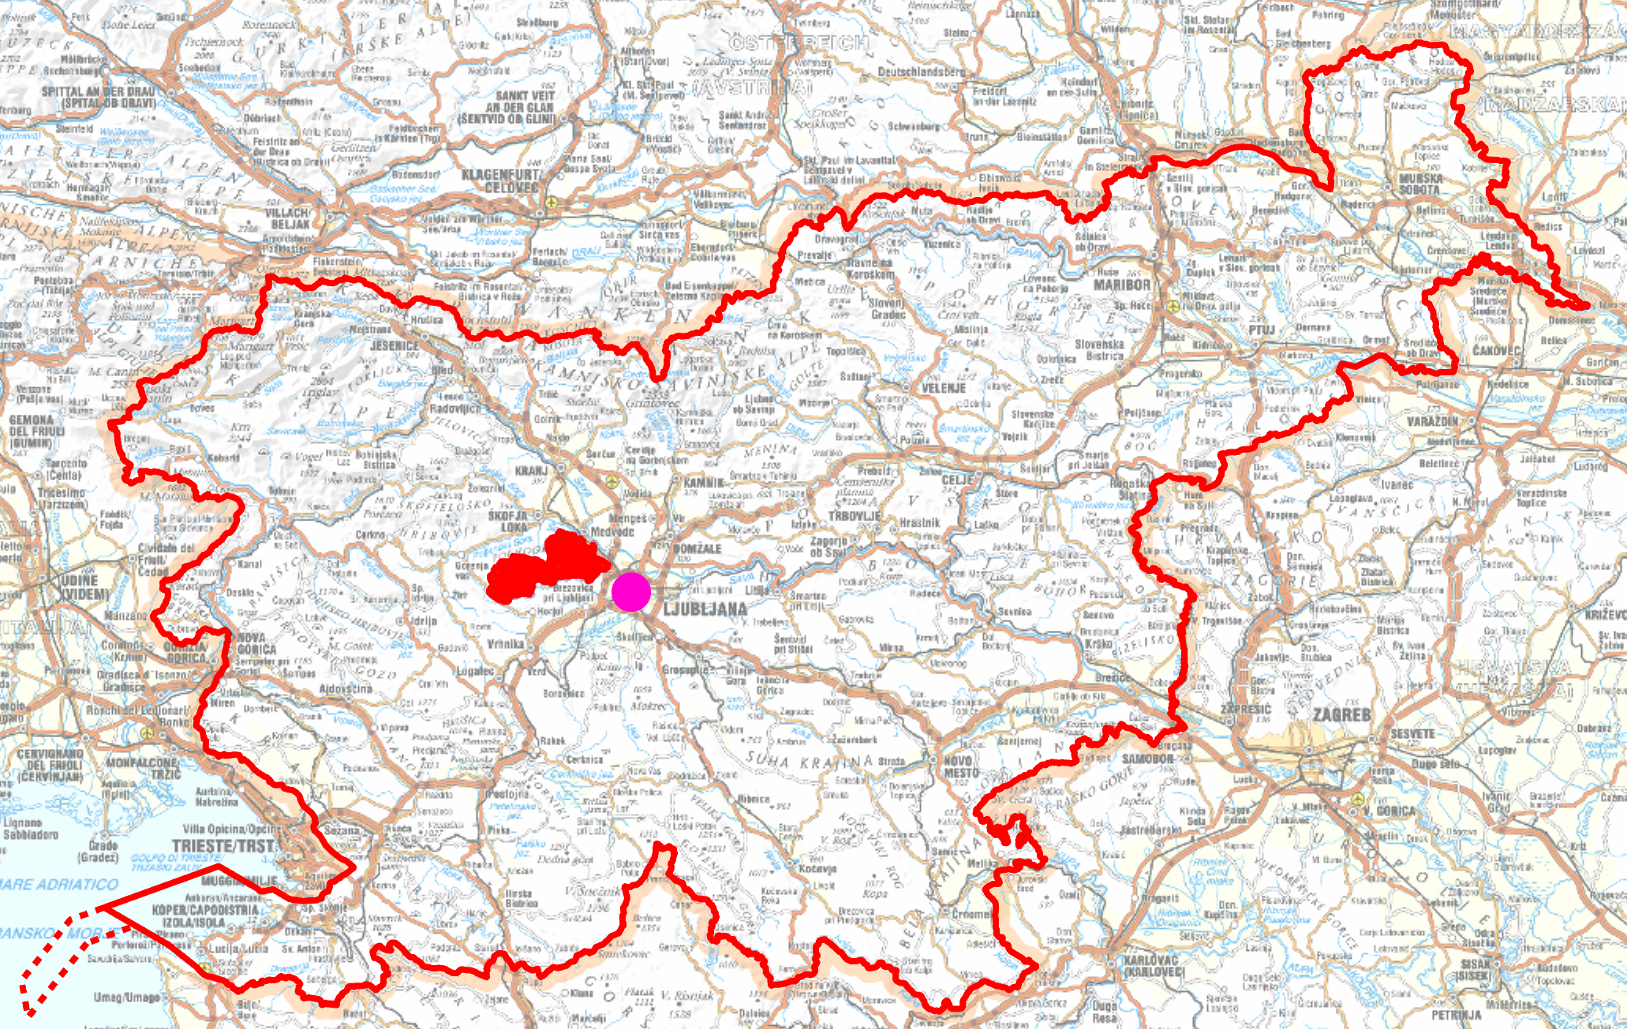
Ljubljana Urban Region, Slovenia
Catchment Area Description
Landscape park Polhograjski Dolomiti is in the western pre-Alpine region near Ljubljana, Slovenia.
It spans in three municipalities.
Characterized by preserved nature, a mix of forests and cultivated landscapes, with peripheral urbanization.
Established as a LP in 1974 with the aim of protecting it from uncontrolled construction and the consequent devaluation of the vast area.
Small population settlements, in recent years a population increase.
Economic activities: Mostly agriculture and forestry, tourism less developed
Excursion tourism and hiking are well-represented (Well-maintained and marked trails for hikers and cyclists).

Slide 12
Ljubljana Urban Region, Slovenia
Policy Instrument
Regional Development Program (RDP) of the Ljubljana Urban Region 2021 – 2027
Main Features:
Harmonizes development goals and determines instruments/resources for implementation.
Includes analysis, development opportunities, vision, goals, and priorities.
Implemented through regional development agreements (regional and sectoral projects).
Strategic Vision:
‘Innovative. Green. Connected’
Transform the region into an attractive living and visiting area.
Raise the level of tourist destination management, improve the quality of tourist services (staff, services, digital transformation), integrate the tourist industry and develop sustainable programmes in line with the guidelines of the green Slovenian tourism scheme.
Emphasizes innovative, knowledge-based development responding to current challenges like digital transformation and new technologies.
Expected Policy Improvement
Revision of the PI:
Based on TAAS experience exchange results.
Incorporate smart tools for data collection and visitor management in the Polhov Gradec Dolomites Landscape Park.
Commitment to sustainable management requiring coordinated efforts and resources.
Measures described and implemented as regional projects in the RDP, making them viable for EU cohesion funding.

Slide 13
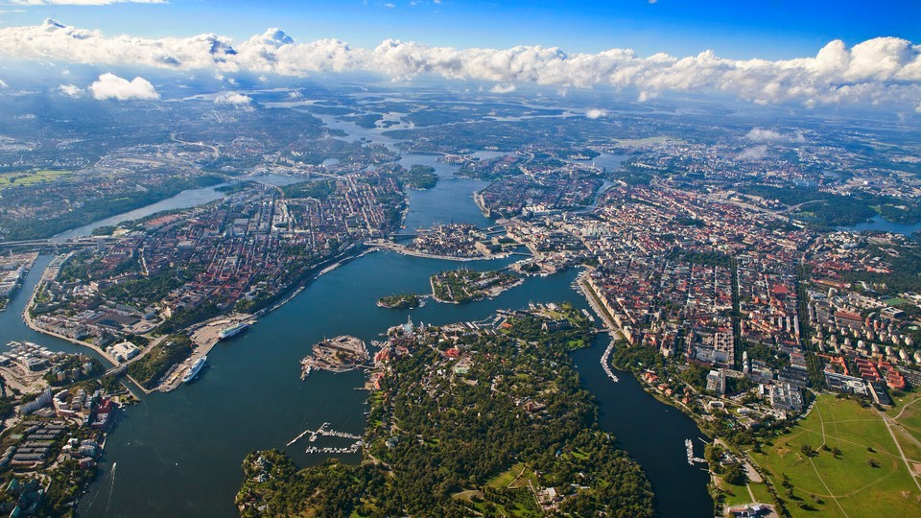
City of Stockholm, Sweden
Catchment Area Description
Geographic scope: the municipal area of the City of Stockholm.
The city is one of 26 municipalities in the Stockholm Region.
Mixed economy with a large service sector
Climate Mission City: the city aims to be climate positive by 2030. and completely fossil-fuel free by 2040. Consumption emissions should also be reduced by 50%.
Major destination for both national and international visitors.
Increasing numbers are coming for vacations with air and sea travel
Central pillar of tourism marketing is to attract visitors to “staycations”, i.e. high-value visitors staying for longer periods
Fairly advanced digitalization in terms of e.g. online services, ticketless and cash-free payment, etc.

Slide 14
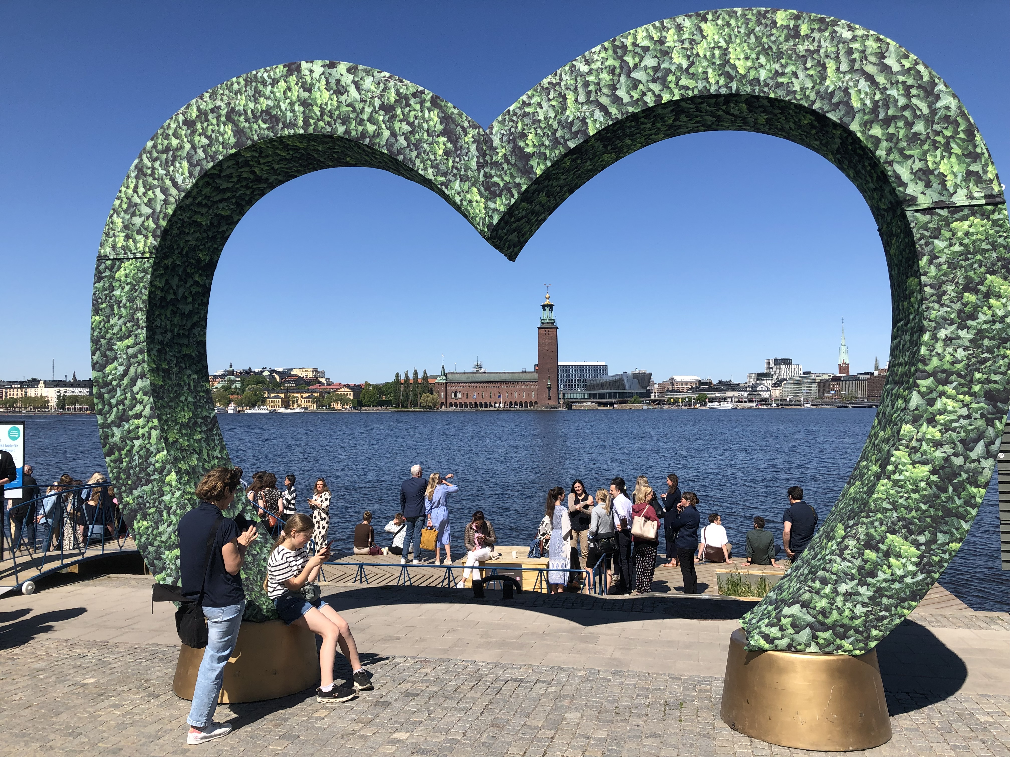
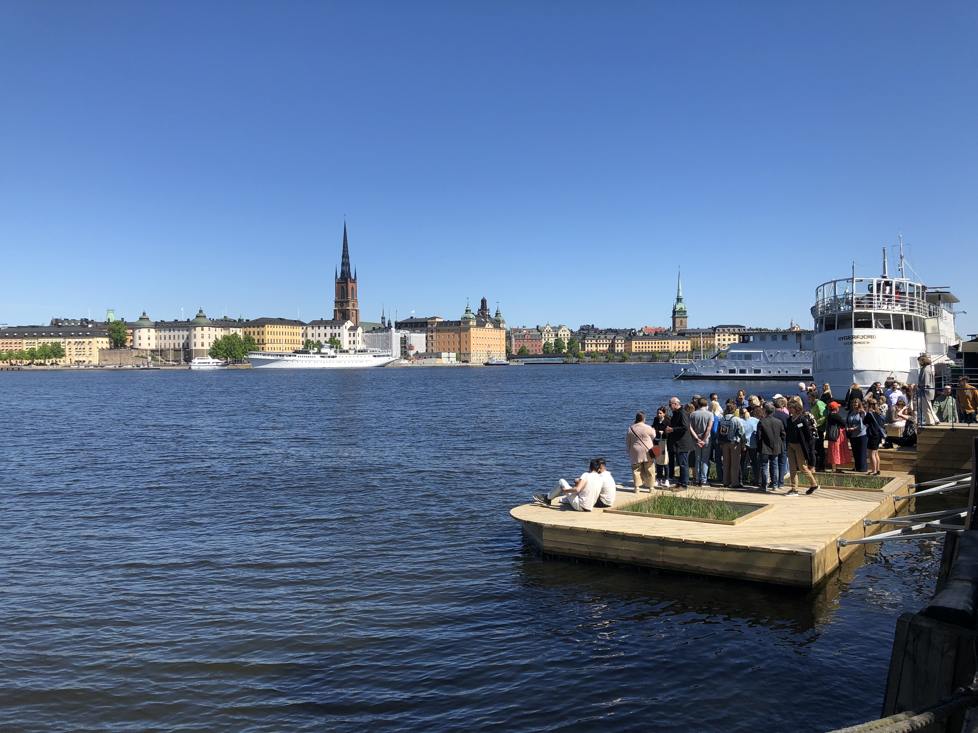
City of Stockholm, Sweden

Slide 15
City of Stockholm, Sweden
Policy Instrument
City of Stockholm Climate Action Plan (CAP, focus on tourist and visit sector)
Vision
To become a climate-positive city by 2030 and fossil-free by 2040.
Expected Policy Improvement
TAAS contribution
Develop more precise targets and actions that more directly address the specific needs and challenges of the tourism and visit sector.
Identify and integrate measures for the tourism sector into the revised CAP.
Identify plan implementation and in some cases initiate measures.
Integration of climate action goals and strategies into tourism digitalization initiatives to contribute to the tourism sector’s global climate change mitigation efforts.
Revision of the PI:

Slide 16
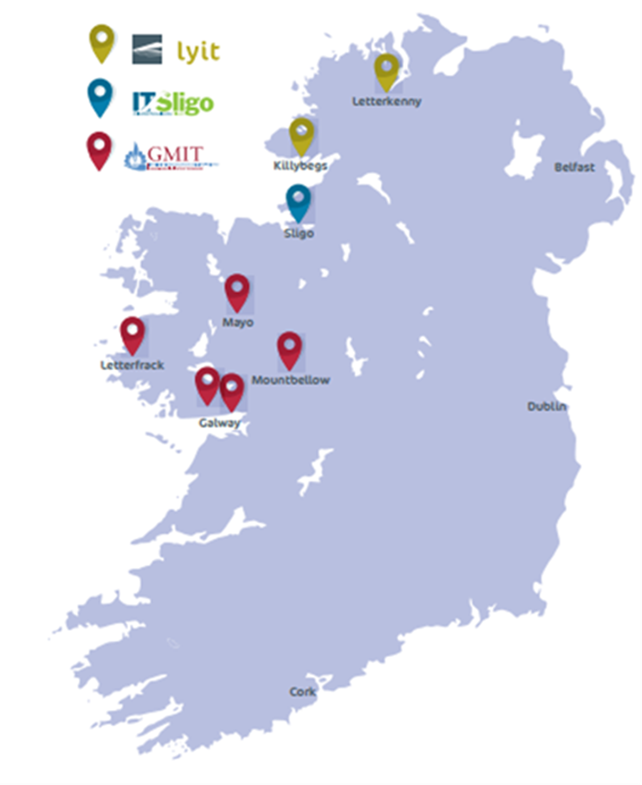
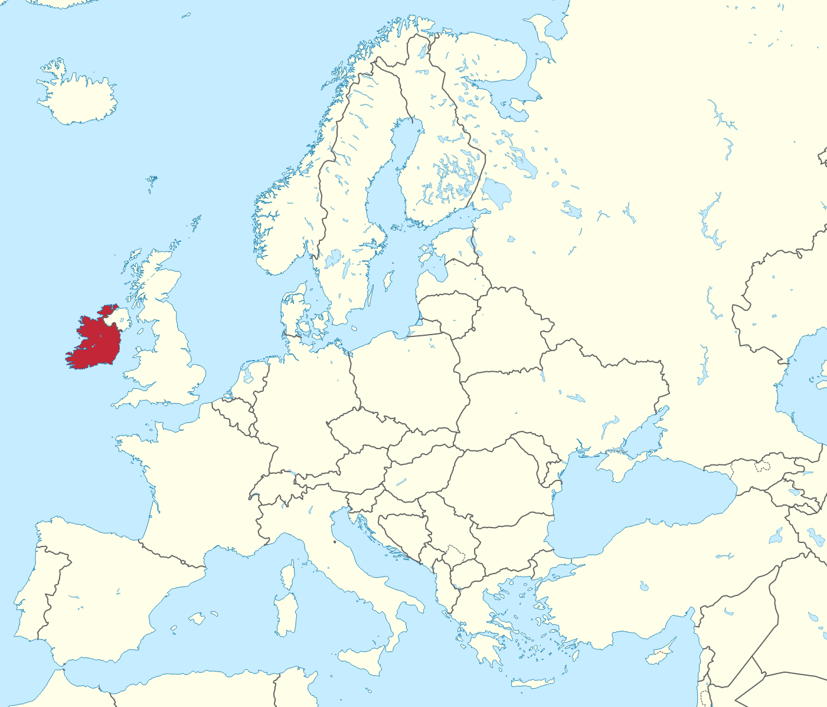
County Donegal, Ireland
Catchment Area Description
Geographic Scope: Donegal is situated in the Northwest of Ireland, bordering Northern Ireland with limited access to the rest of the Republic.
Economic Characteristics: Economy relies on agriculture, particularly sheep and cattle farming, and fishing.
Tourism has been growing, providing significant employment and economic growth of both urban and rural areas in County Donegal.
Tourism sector expanded over the past years, visitor from Europe, increase in number of tourists from Northern Ireland and Great Britain
Has one of the longest coastlines in Ireland with some 1,100km of coastline and over 100 beaches.
Hosts 37 Discovery Points and 3 Signature Discovery Points on the Wild Atlantic Way.
Donegal was given the accolade of ‘Best in Travel 2024’ by Lonely Planet.
Donegal’s coastal/island and inland natural features provide an extensive range of opportunities for outdoor activities offers ‘soft’ and ‘hard’ recreation opportunities, can be combined with visits to the towns and villages, where traditional lifestyle, culture and heritage can be explored.

Slide 17
County Donegal, Ireland
Policy Instrument
Donegal County Council Tourism Strategy 2024 – 2028
Focus
Achieving a balance between providing employment and business opportunities while ensuring a good quality of life for local people.
Creating an interest in, and support for, the cultural heritage of the people of Donegal, through performance, arts and crafts, providing both gainful employment while strengthening the traditional culture, language and heritage of the county.
Preserving natural heritage.
Expected Policy Improvement
TAAS contribution
Promotion of Low-Carbon Travel and Tourism Experiences through digital platforms and applications.
Smart destination management systems.
New projects financed by the instrument
Guiding principles to shape its ongoing implementation and approach to develop Donegal as a sustainable smart destination.
New projects by incorporating best practices from the rest TAAS areas.

Slide 18
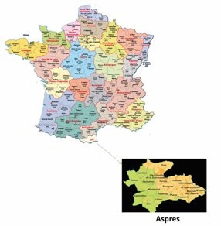
Aspres-Thuir, France
Catchment Area Description
Small natural region in the Pyrénées-Orientales in the South of France near the borders with Spain.
The Community of Communes of Aspres brings together 19 municipalities.
Administrative and economic capital is home to ⅓ of the population.
Economy mainly tertiary (commerce, transport, administration), crafts and agriculture.
Diversity of landscapes: Canigou foothills, plain, forests, vineyards, olive trees and fruit trees.
The Aspres not necessarily known “alone” but associated with the South of France destination.
Mainly one-day destination.
Tourism boom over the last 10 years.
Significant growth in tourist accommodation capacity and its quality and overnight stays over the past decade.
Main tourist offer: the natural, architectural and cultural heritage but also wine tourism and gastronomy, holidays in the countryside as associated by tourists.

Slide 19
Aspres-Thuir, France
Expected Policy Improvement
TAAS contribution
Integration of digital tools to enhance the effectiveness and efficiency of tourism development efforts in Aspres.
Improvement of marketing and promotion activities, streamline visitor experiences, and effectively engage with tourists.
Revision of the instrument itself
Include a digital tourism roadmap and action plan.
Creation of a "LE MAS DES ASPRES brand" to promote and differentiate the hosts and their offerings.
Support the creation of new services and offerings that align with the changing needs and preferences of tourists.
Use of digital marketing platforms, exploiting digital marketing campaigns, leveraging digital channels and platforms to reach and engage with target audiences effectively to data analytics and management systems that help optimize tourism operations and enhance visitor experiences.
Policy Instrument
Sustainable tourism development strategy in Aspres
Includes the vision and guidelines for the region's tourism development.
Includes an in-depth audit of the territory, existing service providers, and the proposed tourism offerings.
Includes a comprehensive understanding of the current tourism landscape in Aspres.

Slide 20
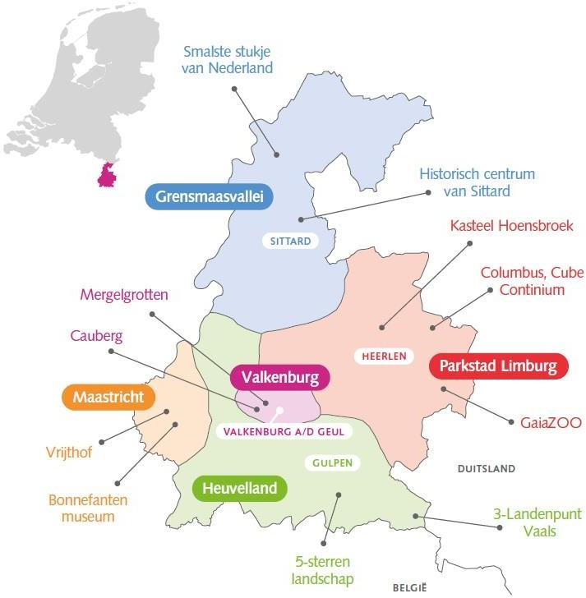
Region of South Limburg, Netherlands
Catchment Area Description
The most southern destination in the Netherlands.
Known for its distinct landscape of hills, which contrasts with the rest of the Netherlands,.
Influenced by German and French cultures due to its historical connections.
5 subregions (16 municipalities), each one with unique characteristics.
Distinct economic characteristics of each subregion, with tourism playing a significant role.
The oldest tourist destination in the Netherlands, with tourism development beginning in 1853.
Unique tourist-recreational destination due to its proximity to both urban and landscape top qualities.
The tourist season is mainly from April to September, nowadays extended to year-round due to the realization of the Region as a Christmas Destination (Christmas markets) and wine region.
Each subregion offering unique tourism experiences from natural landscapes and historical sites to modern attractions and vibrant city life, hiking and cycling, events.

Slide 22
Region of South Limburg, Netherlands
Expected Policy Improvement
TAAS contribution
Boost digital innovation in the five pillars of the PI.
Draw up an implementation programme of tourism digitalization activities/projects for each pillar.
Change in the management of the instrument
Projects related to data gathering and smart visualization tools, touristic flows management social media campaigns DNA digital storytelling Sustainable rejuvenation/innovation and Revitalizing Accommodation.
Policy Instrument
Strategic Tourism Vision Destination South Limburg 2030
5 Pillars
IMPROVING QUALITY - Qualitative growth over quantitative growth.
SPREADING - Spreading tourism in time and place by enticing guests to visit less known locations during all seasons.
EXPERIENCE THE TRUE DNA OF SOUTH LIMBURG - Connecting the true (cultural & geographical) DNA of South Limburg to tourism by changing the existing narrative that is built on ‘hills & attractions’ narrative.
SUSTAINABLE REJUVENATION - Continual rejuvenation, working on a better balance between demand and supply, providing accessibility and attracting guests.
STIMULATE CLIMATE CHANGE AND INNOVATION - Promoting and improving the innovation and the adaption to climate change of businesses.

Slide 23
Tampere, Finland
Catchment Area Description
Region in Northern Europe, Finland.
Tampere Region: 19 municipalities.
Tampere City the second largest city in Finland, functional entity in a compact size.
Home to multidisciplinary and new technological expertise in multiple fields.
Low unemployment rate, 40% of the population have a higher education degree.
Tampere City the leading destination.
Internationally Tampere and its region is not that well known, mostly domestic tourism.
High season: Summer months.
Attractions: Events (sports, concerts, theatre), Amusement park and various museums, Sauna culture (Sauna Capital of the World, over 50 public saunas), lake and nature travel and bicycle travel are on the rise.
Tampere aims to be Climate Neutral in 2030 – one of the EU’s 100 Mission Cities - tourism industry as a forerunner of this development.

Slide 24
Tampere, Finland

Slide 25
Tampere, Finland
Policy Instrument
Τampere Region Tourism Strategy 2020-2025: Sustainable Steps
Objectives
Competitive tourism ecosystem through digitality and data,
Bold marketing of the Tampere Region adding value to the marketing and sales of our partners,
Sustainable growth through a tourism-friendly operating environment and accessibility.
Strategic goals
Increasing the share of tourism income in regional economy.
Customer experience that exceeds expectations.
Smooth and attractive digital customer path.
Carbon-neutral tourism and events sector.
Increasing the attractiveness of the tourism and events sector.
Desirable and valued partner.
Expected Policy Improvement
TAAS contribution
Benefit from international benchmarking, peer learning, engagement and cooperation in smart and sustainable tourism development.
Revision of the instrument itself
Finding efficient actions and solutions to improve digital customer path, developing sustainable low carbon tourism services and knowledge management to monitor success and adjust the actions.
Defining a roadmap towards Tampere as a Smart Destination.
Improvement of both destination level management, development and cooperation and help and support tourism companies, addressing their needs and challenges.

Slide 26
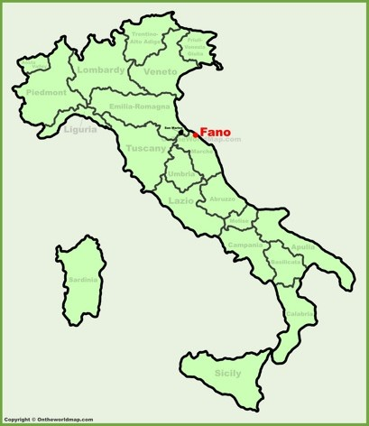
City of Fano, Italy
Catchment Area Description
3rd most populated town in Marche Region, Italy.
Seaside Roman town.
Identity Elements: fisheries and related cultural and traditional activities, beautiful inland with hills in front of the sea, extraordinary historical Roman heritage, seaside with sandy beaches and others with white stones.
Holds the Blue Flag for more than 20 years- criteria relating to sustainable management of the territory.
Holds Green Flag from 2016- for beaches suitable for children and adolescents.

Slide 27
City of Fano, Italy

Slide 28
City of Fano, Italy
Expected Policy Improvement
TAAS contribution
Exchange of experience and GPs.
New projects financed by the instrument
Introduction, adapted to the needs shared with local stakeholders, of one or more digitalization good practices currently active in the reference territories of the other partners.
Creation of a specific section to the new Strategic plan for Tourism of the Municipality of Fano related to the tourism management and promotion targeted to a wider area.
Policy Instrument
Strategic plan for Tourism of the Municipality of Fano
Goal
Making the City a smart, competitive, sustainable tourism destination based on a development market-oriented model that encompasses innovative tools for tourism sector.

Slide 29
Project Tasks
&
Actions Overview

Slide 30
Core phase: Exchange of Experience
Building on Success: Achievements and Remaining Steps
TAAS Experiential Learning
TAAS co-inspiration & improvement monitoring and strengthening
M36
M30
TAAS PI’s improvement plan & actions
CORE PHASE (04/2024-03/2027)
‘Inspiration to actions’ stakeholders’ meetings
M24
Study visits and key learnings
TAAS Good Practices identification
M18
International digital tools identification
4 Mentoring webinars on TAAS cycle
TAAS stakeholders’ meetings on GPs identification
TAAS local GPs
Co-finetuning TAAS approach
M12
Situational Analysis
Mentoring teams' formulation
Launching of the TAAS living labs
M6
Exchange of experience
TASK 1.1
TASK 1.2
TASK 1.3
TASK 1.4
TASK 1.5

Slide 31
TAAS smart communication strategy
Smart communication and dissemination actions
M48
M42
M36
Project Website
TAAS Poster
Social Media Channels
Newsletters Promotional Videos
Brochures/Leaflet
Events
Stakeholders engagement plan execution
M30
CORE PHASE (04/2024-03/2027) FOLLOW UP PHASE (04/2027-03/2028)
Stakeholder mapping and engagement
Communication plan
M24
M18
M12
M6
Communication
TASK 2.1
TASK 2.2

Slide 32
Follow up phase: Monitoring of results of main phase and exchange of experience
Continuation of monitoring of PIs improvement, assessment of their impact on the ground and strong results' communication
M48
FOLLOW UP PHASE (04/2027-03/2028)
M42
M36
TASK
Monitoring
Notes:
32

Slide 33
TAAS Stakeholders = TAAS wisdom
Purpose
Strong involvement of core stakeholders in TAAS project
Co-achievement of project goals
PIs improvement
Tourism digitization status upgrade
+ Common questionnaire survey for stakeholders across partners to collect valuable-comparable results
4 stakeholder meetings/per area
Co-Evaluate the Current Situation and Co-Identify Needs and Problems
Identify Local Good Practices
Co-Understand Adoption of Good Practices from Other Areas
Co-Improve Policy Instruments
Objectives per meeting

Slide 34
TAAS Performance Indicators Monitoring
Output Indicators:
Number of organizations cooperating across borders
Number of policy instruments addressed
Number of good practices identified
Number of interregional policy learning events organized
Result Indicators:
Number of organizations with increased capacity
Number of policy instruments improved
TOTAL
++ MEUR
www.interregeurope.eu/taas

Slide 35
Progress

Slide 36
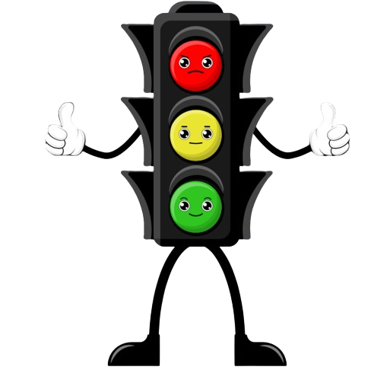
TAAS Monitoring Method
Traffic Light Method:
Green, Yellow, and Red indicators
Green: Green stands for “All is on track”.
Yellow: Yellow signals “Satisfactory” or “Caution”
Red: Red represents a “Problem.”
Key Indicators:
Number of Stakeholders Engaged
Number of Active Stakeholders in PI Improvement
Number of Local Meetings and Targets Achieved
Number of Local Good Practices Identified
Experience Exchange Level Satisfaction
Capacity Building on Sustainable Smart Tourism Planning
Improvement Level of PIs
TOTAL
www.interregeurope.eu/taas

Slide 37
*each partner Traffic Light Status
Indicators | Semester 1 | Semester 2 | Semester 3 | Semester 4 | Semester 5 | Semester 6 | Semester 7 and 8
Number of stakeholders engaged on the project | [insert value and highlight with red/orange green]
Number of Active stakeholders in PI Improvement
Number of Local meetings with stakeholders
Number of local Good Practices identified
Local Stakeholders satisfaction (exchange activities)
Capacity Building
Improvement level of the PIs
Notes:
Note: each Semester column could be added when needed

Slide 38
Partners
Associated Partners
www.interregeurope.eu/taas

Slide 39
The project TAAS is implemented in the framework of the Interreg Europe programme and co-financed by the European Union.
www.interregeurope.eu

