Slide 1
MaaSolutions
project
presentation
Last Update: January, 2025

Slide 2
Objective of the project
The project seeks to strengthen the capacity of public authorities to manage urban mobility through innovative strategies like Mobility as a Service (MaaS). By simplifying access to diverse transport options, MaaS encourages
sustainable travel, reducing car dependency and traffic impacts.
The initiative promotes efficient urban mobility planning through digital tools, regional collaboration, and shared best practices across Europe.
TOTAL
€ 1.691.772
April 2024
June 2028

Slide 3
PROJECT in a nutshell
Policy objective 2:
Greener Europe
Specific objective:
Zero-carbon urban mobility
51 month
Core phase
01.04.2024 – 31.03.2027
Follow-up phase
01.04.2027 – 31.03.2028
Closure phase
01.04.2028 – 30.06.2028
€ 1.691.772,00
ERDF
€ 1.353.417,60
Co-financing:
€ 338.354,40
MaaSolutions is co-financed by the Interreg Europe Programme
2nd call for project proposals

Slide 4
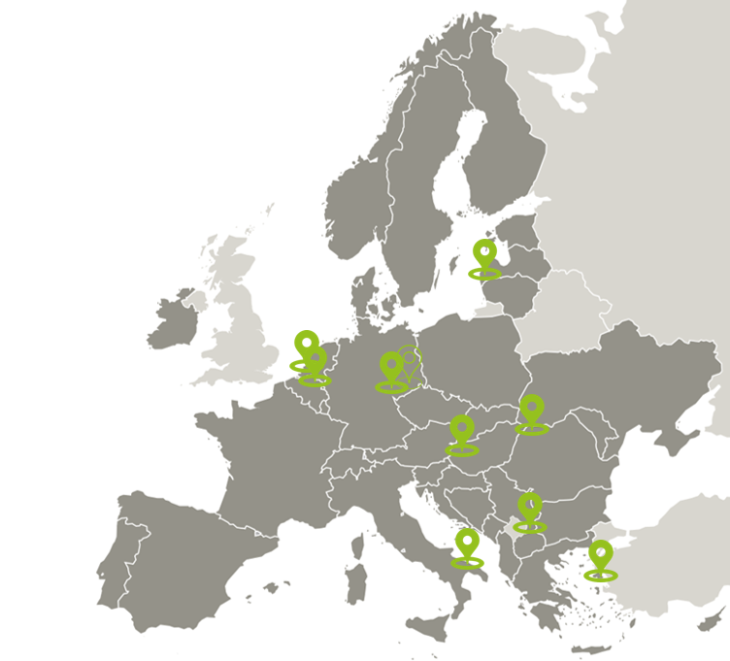
MaaSolutions Partnership
9 project partners and an associated policy authority working together.
Lead Partner:
Puglia Region (Italy)
PP2: Intercomunity Development Association Baiamare Metropolitan Area (Romania)
PP3: Stad Geel (Belgium)
PP4: Liepāja city municipal administration (Latvia)
PP5: Vas County Government Office (Hungary)
PP6: Aufbauwerk Region Leipzig GmbH (Germany)
PP7: University of the Aegean (Greece)
PP8: Gemeente Schouwen-Duiveland (Netherlands)
PP9: Grad Leskovac (Serbia)
Associated policy authority:
District of Northern Saxony (Germany)
8 COUNTRIES: ITALY, ROMANIA, BELGIUM, LATVIA, HUNGARY, GERMANY, GREECE, NETHERLANDS
PARTNERS

Slide 5
MaaSolutions addresses 7 Policy Instruments:
RP Puglia ERDF ESF+ 2021-2027 by Apulia Region
Sustainable Urban Mobility Plan 2030 by Intercomunity Development Association Baia Mare Metropolitan Area
Urban Mobility Plan by Stad Geel
Liepaja city and Dienvidkurzeme municipality development programme 2022-2027 by Liepāja city municipal administration
Territorial and Settlement Development Operational Programme Plus - TOP_Plusz- 1.2.1-21, Liveable settlements (Élhető települések) by Vas County Government Office (VVÖH)
Kreisentwicklungskonzept Nordsachsen 2030 by Aufbauwerk Region Leipzig GmbH
Strategic vision Schouwen-Duiveland “Tij van de Toekomst 2040” (Tide for the Future 2040) by Gemeente Schouwen-Duiveland
8 COUNTRIES: ITALY, ROMANIA, BELGIUM, LATVIA, HUNGARY, GERMANY, GREECE, NETHERLANDS
PARTNERS

Slide 6
MaaSolutions Key Outputs
0
1
Good Practices
identified out of 15
Interregional Policy
Learning Events
organised out of 9
0% of initially planned
10% of initially planned

Slide 7
Kick-Off Meeting MaaSolutions Project Launches – Digital Solutions for Sustainable Urban Mobility
The meeting fostered collaboration among partners, emphasizing the exchange of best practices and strategies to drive cultural and operational change in urban transportation.
Bari, 18th September 2024

Slide 8
First Newsletter
published
Overview:
The first MaaSolutions newsletter introduces the project which aims to enhance sustainable urban mobility through digital innovation and Mobility as a Service (MaaS) strategies. Partners from nine European countries collaborate to share knowledge, improve transport systems, and promote sustainable solutions.
Highlights include the kick-off meeting in Bari, inclusion of a new Discovery partner, and a webinar on urban logistics.
TOTAL
Stay Connected! Sign up to receive the latest updates. Don't miss out on exciting news and insights!
https://www.interregeurope.eu/maasolutions/library

Slide 9
First Regional Stakeholder Meetings ongoing:
Date: September 25, 2024 Location: Online, Hungary
The first online meeting gathered 11 stakeholders to collaborate on sustainable mobility who will contribute through seminars, study tours, and good practice exchanges.
Date: September 27, 2024 Location: Baia Mare, Romania
5 stakeholders discussed mobility solutions, public transport, and eco-friendly travel for the MaaSolutions project.
Date: October 25, 2024 Location: Geel, Belgium
6 stakeholders discussed mobility solutions, good practices like Hoppin points and bicycle highways, and future planning.
Date: October 30, 2024
Location: Online, Apulia
Municipal representatives and transport providers discussed their roles in the MaaSolutions project, focusing on regional policy improvements and mobility as -service solutions.

Slide 10
First Regional Stakeholder Meetings ongoing:
Date: December 11, 2024 Location: Liepāja, Latvia
Key stakeholders discussed MaaS integration, data management, legal frameworks, and pilot projects for smarter urban mobility.
Date: coming soon! Location: Schouwen-Duiveland, the Netherlands
Date: coming soon!
Location: Leipzig, Germany

Slide 11
Ongoing Data Collection and Territorial Analysis
📊
Quantitative & Qualitative Data
💬
Stakeholder Workshops
Semester 1 focuses on comprehensive data collection to assess regional mobility needs and opportunities. Using a common research model, partners gather quantitative data on user preferences and MaaS market potential, along with qualitative insights from the stakeholders through surveys, workshops, and focus groups. This effort will identify good practices and inform tailored solutions for sustainable urban mobility across partner regions.
🌍
Interregional Collaboration
📈
Good Practices

Slide 12
Waiting for the Second Interregional Learning Event in Hungary
Event Highlights:
Study Visit and thematic workshop
Participants: Stakeholders and policymakers from 9 European partner regions.
Goals:
Share best practices such as the Hungarian “Rail & Bike” model and the implementation of the integrated ticket system called “Tekergo”.
Conduct a thematic workshop on various business models applicable to the regions.
Strengthen partnerships to promote sustainable urban mobility.
Hungary, March 25–26, 2025

Slide 13
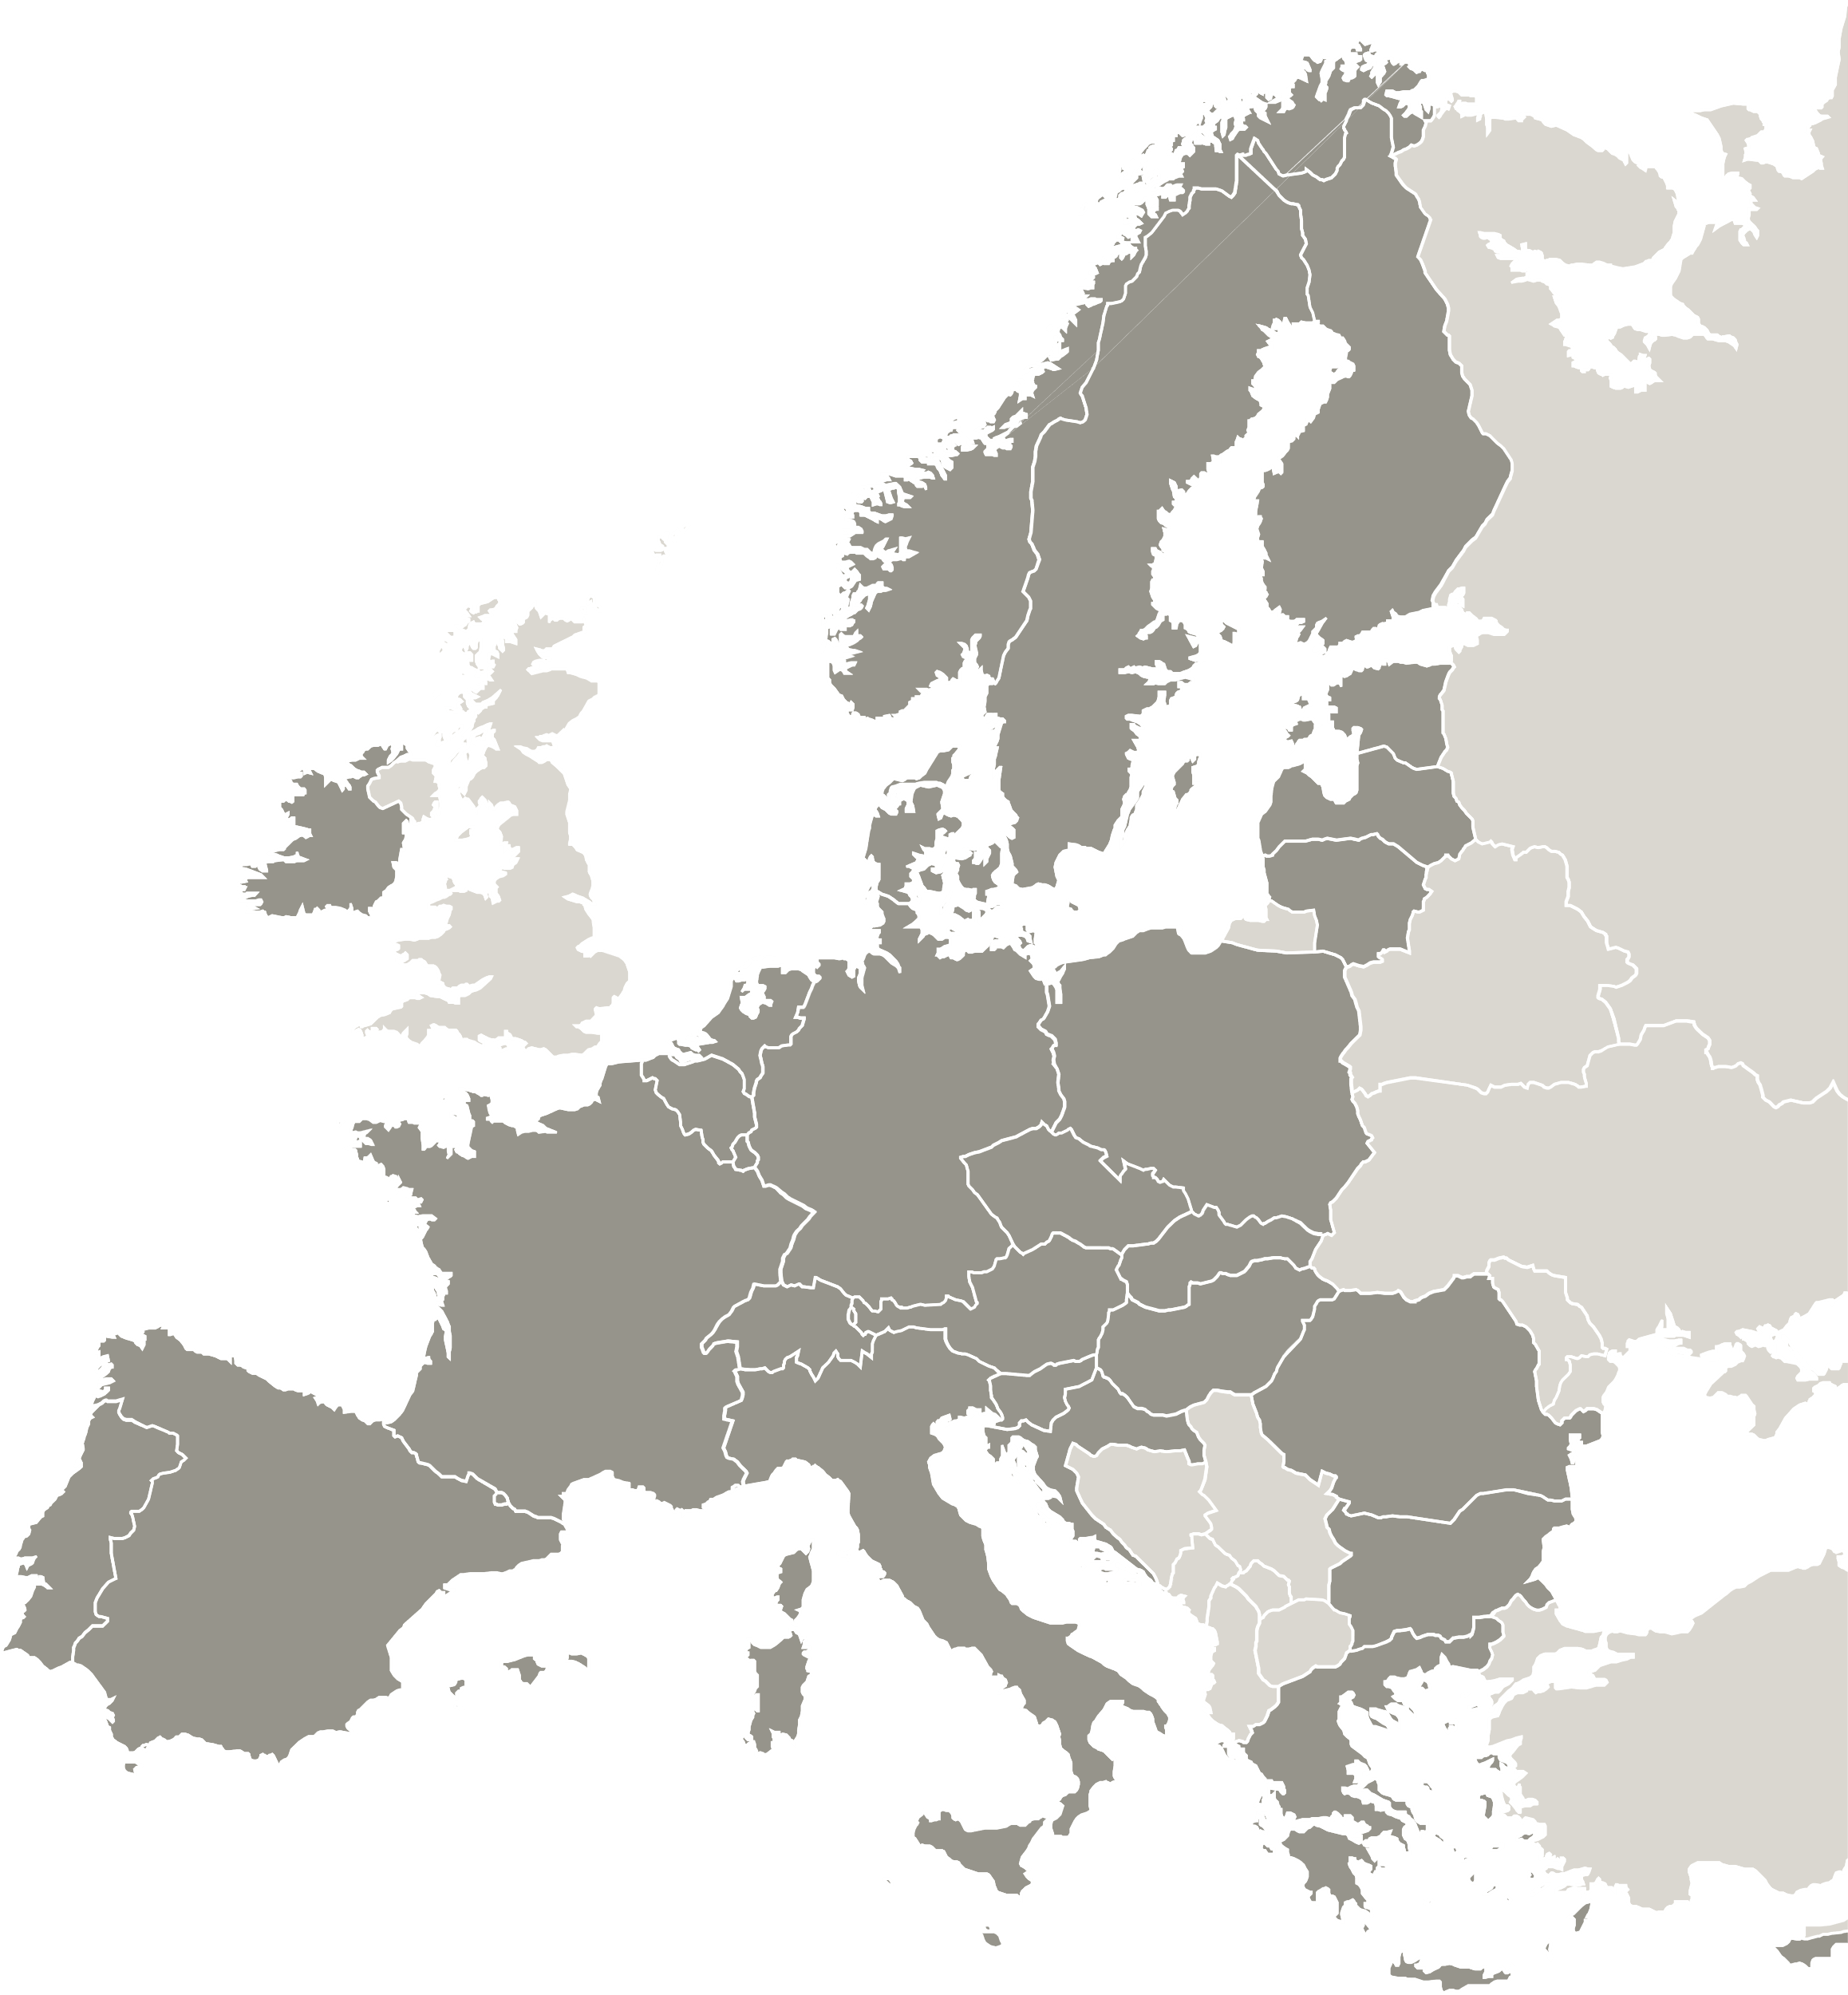
The project MaaSolutions is implemented in the framework of the Interreg Europe programme and co-financed by the European Union.
www.interregeurope.eu/maasolutions

